Slide 1
Principles of Higher Education
(and some thoughts on teaching large classes)
Brett Gilley
bgilley@eoas.ubc.ca

Slide 2

A Secret

Slide 3
Goals
Discuss how to teach a topic “Foundations of pedagogy,” in an active way, to a large class
List and describe 4 models of learning
Analyze and create learning activities according to the model of constructivism
Reframe what you mean by “large class”

Slide 4
How big is a large class?
How many students is a “large class”

Slide 5
How big is a large class?
Why? What are your reasons?

Slide 6
Large classes
How many of you have taught a large class?

Slide 7
Large classes
Think/Pair/Share
What concerns you about teaching large classes? What are the difficulties?

Slide 8
What is hard about large classes?
Your list:
Hard to do activities
So many students
Can’t speak to all
Names
Marking
Student assessment
Giving feedback to many
Teaching schedule to meet all needs
Get attention
Teaching different levels, some need more help
Differentiating the final assessment
Eye contact

Slide 9
What is hard about large classes?
Student attention
Diversity –
Communicating effectively
Individual feedback
Easily distracted
Assessment
Homework/marking
Activities
Difficult rooms
Names
Technical problems

Slide 10
Some Foundational Theories
Why do this?
“All models are wrong, some models are useful”
Attributed to George Box

Slide 11
How do we think of learning?
Talk to your neighbour
How do you learn?
What do you think helps you?
What do you think does not help you?
What is happening in your head when you learn?

Slide 12
Attempt 1 Lecture!

Slide 13
Some older ideas

Slide 14
Some older ideas
1) Pragmatism (John Dewey 1859-1952)
Summary
Schooling was not good enough
“too teacher centered”
Should be more learner centered – guided experiences not authoritarian instruction
Learning is life, not just preparation for life

Slide 15
Some older ideas
2) Behaviorism (Edward Thorndike, John B. Watson, B.F. Skinner)
Learners are “passive”
Learning is a change in behavior
Behavior is influenced by positive or negative feedback
Genetics is important (Note: This is not true for humans)

Slide 16
Some older ideas
3) Cognitivism
What happens in the mind is important
Humans are like computers – new input causes processing which changes the mind

Slide 17
Attempt 2: Big Jigsaw

Slide 18
A more modern theory of learning
4) Constructivism (Lev Vygotsky, Jean Piaget)
The learner is active in construction of knowledge
Past experiences and culture are very important
Each person will see things differently

Slide 19
Three themes of constructivism
Get into groups of 3!

Slide 20
Expert groups
1) Discuss the idea (make sure everyone understands)
2) Why is this important to learning?
3) What can you do in your class that uses this idea?
4) How would this relate to teaching a larger class?

Slide 21
Mixed groups
1) Discuss the idea (make sure everyone understands)
2) Why is this important to learning?
3) What can you do in your class that uses this idea?
4) How would this relate to teaching a larger class?
Finally, how do all these ideas fit together?

Slide 22
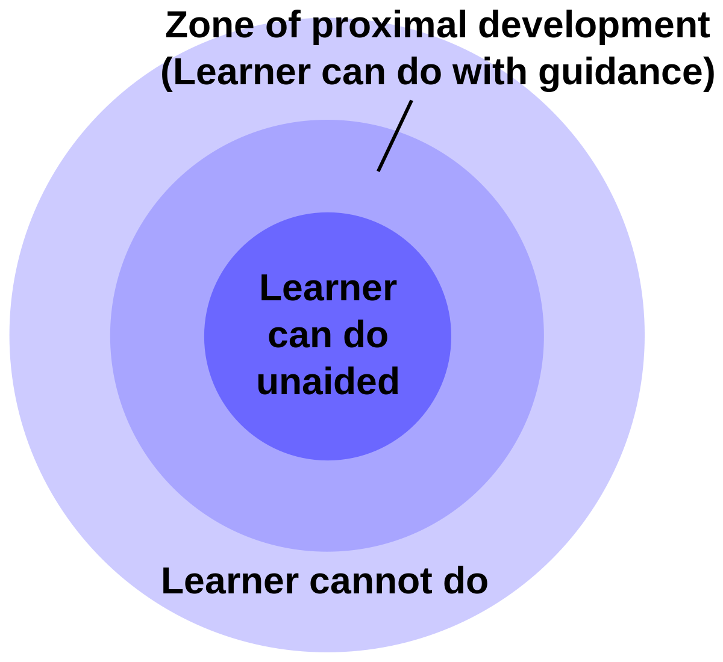

Slide 23
High
Cannot do!
Fear, anxiety
Level of Challenge
Zone of Proximal Development – can do with help or peers
Can do on their own!
Boredom
Low
Low
High
Level of Skill

Slide 24
Hey! This works in a large class
How did it work for you?
Analyze it using constructivism. What did I do that relates too:
Social interaction
The More Knowledgeable Other
Zone of Proximal Development

Slide 25
Important implication
Scaffolding!
What does this word mean?

Slide 26
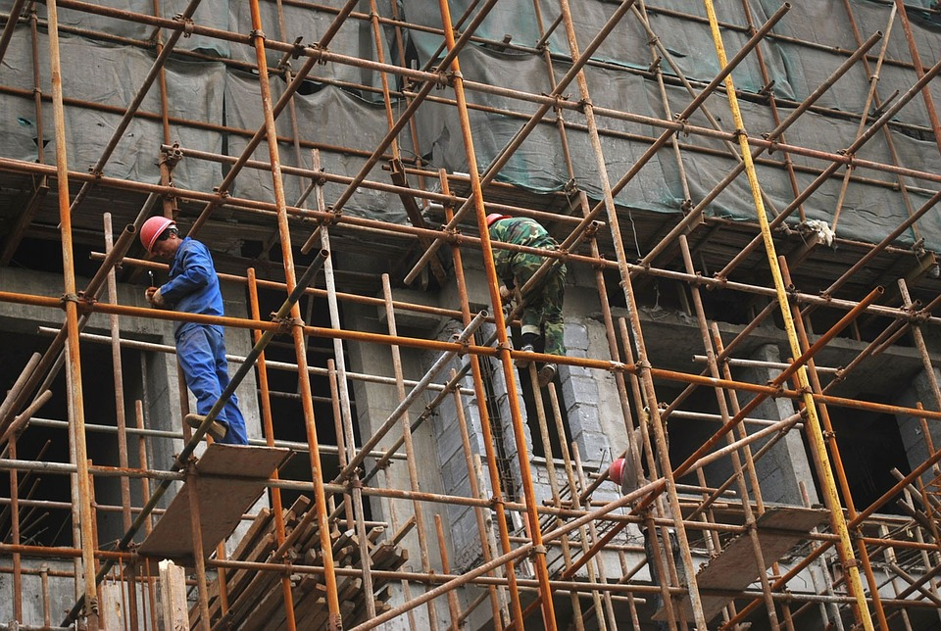

Slide 27
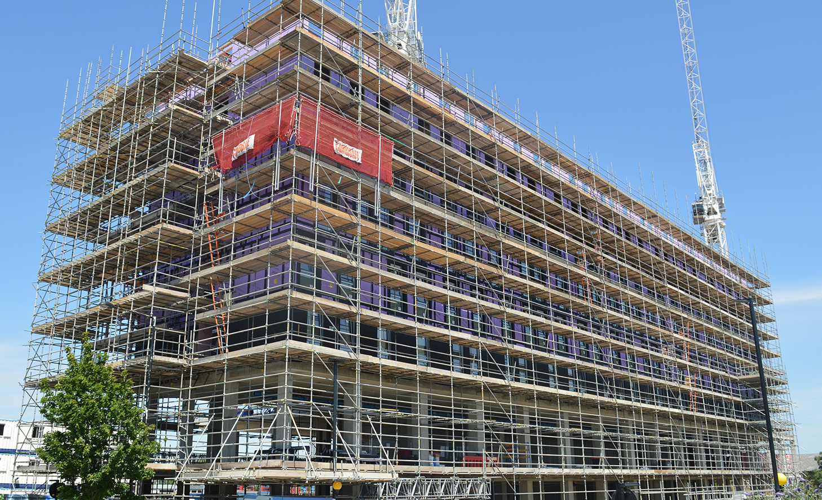

Slide 28
Important implication
Scaffolding
In teaching, scaffolding is building a lesson (or activity) with structures to help the students
To keep them from failing (or falling)
Examples:
On a worksheet giving hints
Making the task easier by removing unimportant details
Helping them with a well timed lecture if they are confused

Slide 29
Large classes…

Slide 30
How big is a large class?

Slide 31
The 2 sigma problem
One on one tutors are best
> 1 student results are similar:
Average of one standard deviation below one on one
Bloom, Benjamin S. 1984 The 2 Sigma Problem: The Search for Methods of Group instruction as effective as One-to-One Tutoring. Educational Researcher Vol. 13, No. 6, pp. 4-16

Slide 32
Benefits of Large Classes?
?

Slide 33
Benefits of Large Classes?
$$$
Lots of TAs
Efficient/save time
Sense of achievement
Diversity
Statistics!
Famous
Students learn with each other

Slide 34
Benefits of Large Classes?
Diverse perspectives
Efficient way to learn basics
Efficient for important scholars
Potential to build confidence
Community
Sense of safety (anonymous)
More chance of answer
You have an army…

Slide 35
Tips for large classes
Some final tips:
Set up class culture on day 1
Efficiency is important
Adapt. If it works for 30, it should work for 500
Use the whole space

Slide 36
Tips
Some final tips:
Still make eye contact
Talk to them!
Use technology if it helps
Print their pictures, try to remember names, and use them (even if only a few)

Slide 37
What have I done today?

Slide 38
Homework
Read:
https://en.wikipedia.org/wiki/Constructivism_(philosophy_of_education)
Visit
Queen Elizabeth Park and the Bloedel Conservatory
https://vancouver.ca/parks-recreation-culture/queen-elizabeth-park.aspx

