Slide 1
Difficult Classroom Situations

Slide 2
Bridge
What is the worst thing you have seen happen in a classroom?

Slide 3
Objectives
Discuss difficult classroom situations
Create a list of things that can go wrong when teaching
We are going work on solutions

Slide 4
Participation
Create a list of things that can go wrong when teaching

Slide 5
Carousel
Pass the paper around the room and solve the problems. ☺

Slide 6
What is your biggest fear in teaching?

Slide 7
Post test
Discuss difficult classroom situations
Create a list of things that can go wrong when teaching
We are going work on solutions

Slide 8
Summary
Write a letter to yourself in the past
on the first day you taught.
Tell yourself why it will be okay.
Now… consider who you know that could use this

Slide 9
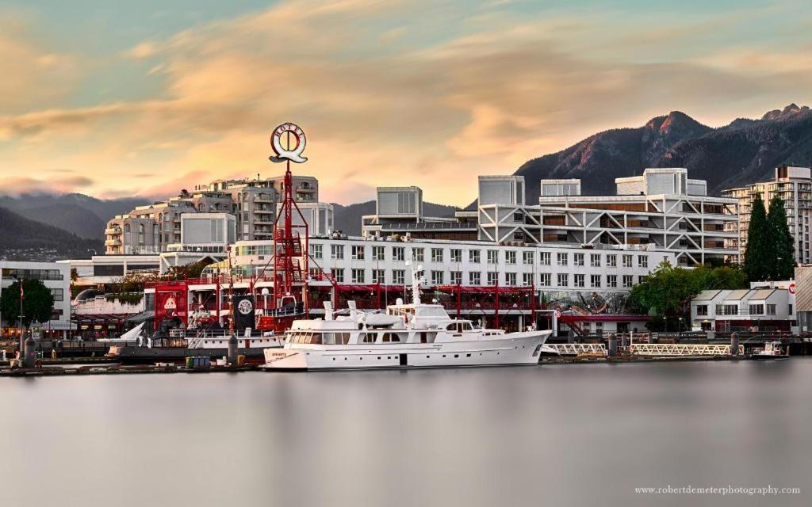
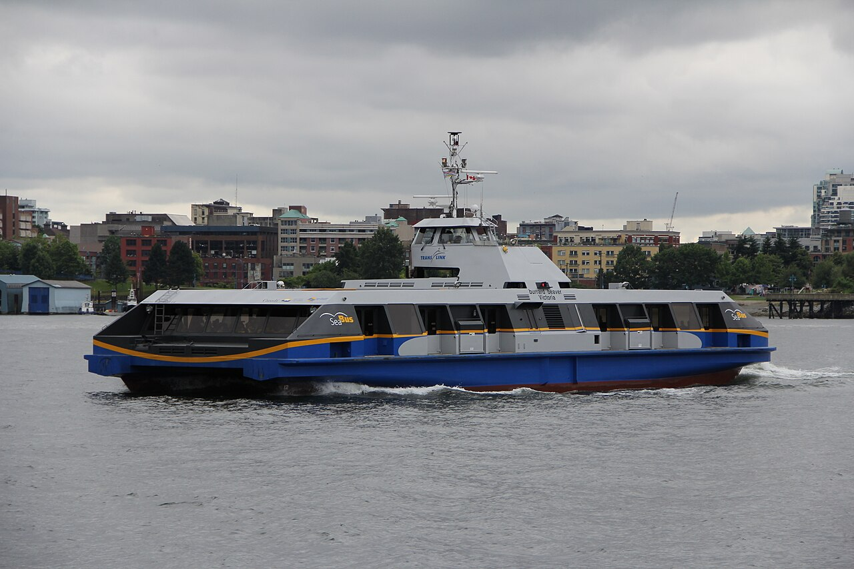
Tourist homework
The Seabus and Lonsdale Quay

