Slide 1
Classroom Assessment Techniques: What are students learning?
Brett Gilley

Slide 2
Misconceptions (/Preconceptions)
Misconception – idea that is incorrect because of faulty understanding or reasoning (dictionary.com)
What is the most amazing misconception you have heard of from your discipline?

Slide 3
Objectives
By the end of this workshop participants will be able to:
Define Classroom Assessment Techniques
Discuss the use of CATs
Evaluate several different CATs and how they will work in your classroom

Slide 4
Who has heard of CATs before?

Slide 5
Classroom Assessment Techniques
Just from the name…
What are CATs?

Slide 6
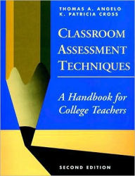
Features of CATS
Formative vs Summative
Fast , Simple
Easy to understand, easy to assess
+/- Anonymous
Lots out there.
Below is a book
I’ll give you a file too.
Classroom Assessment Techniques; A Handbook for College Teachers by Thomas A. Angelo, K. Patricia Cross

Slide 7
Why are CATs useful?
Your list

Slide 8
Activity
For each of your CATs
What do you think?
Would/could you use this? Why or Why not?
What alternatives or modifications would you suggest?
Can you suggest a theme for your 4 groups of CATs (what skills or ideas are they asking students to work on)?

Slide 9
How would you use these?
Using CATs in your teaching

Slide 10
A Quick CAT
One minute paper
How will you use these in your teaching?

Slide 11
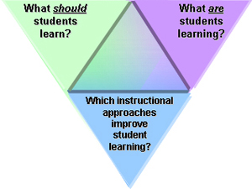
Summary
Assessment a is
key step towards
Expertise

