Slide 1
Working with Faculty to Improve Their Teaching: Science Teaching & Learning Fellows
和教授们一起提高教学:科学教育研究员
Warren Code
Associate Director, Skylight
Director (2014-2017), Carl Wieman Science Education Initiative
Thanks to: Ashley Welsh, Faculty Liaison, CTLT & Skylight
Brett Gilley, Professor of Teaching, EOAS

Slide 2

The Plan 今天的计划
  Introduction to the Carl Wieman Science Education Initiative (CWSEI)
  Carl Wieman 科学教育创新简介
  Reformed example lesson
  改革后的示例课程
  Science Teaching & Learning Fellows
  科学教育研究员
  Challenges, Benefits, & Lessons Learned
  挑战，收获与经验教训
  Question & answer period
  问答环节

Slide 3
But first…

Slide 4
Icebreaker
Questions…

Slide 5
Introduction to:
The Carl Wieman Science Education Initiative at The University Of British Columbia Carl Wieman 科学教育创新简介
Notes:
Edited based on a presentation from the Canadian Society for the Study of Higher Education

Slide 6
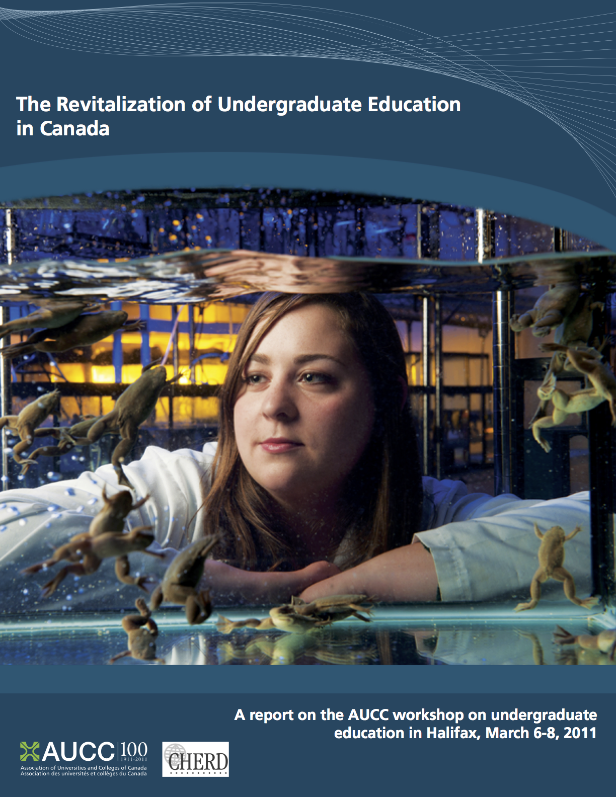
Reforming Undergraduate Science Education 改革本科生科学教育
  “Formal, systematic process of inquiry that provides evidence of what works and why, and that evidence must be disseminated, critically reviewed and built upon.”
(AUCC, p. 5)

Slide 7
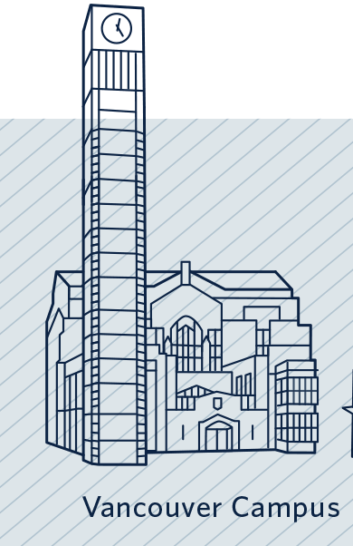
Faculty of Science @ UBC-V
UBC理学院
  ~ 10,000 undergraduates 本科生
  ~ 2,200 international undergraduates 国际学生
  ~ 450 faculty 教师
  ~ 650 staff 员工

Slide 8
Carl Wieman Science Education Initiative
Carl Wieman 科学教育创新简介
  Multi-year initiative (2007-2017) to support extensive and lasting change
  多年的创新来支持大量和持久的改变
  Faculty & department commitment to teaching and learning
      Competitive grant program
  院系对教学的投入：经费的竞争
  Embedded Science Teaching & Learning Fellow
  嵌入式的科学教学研究员

Slide 9
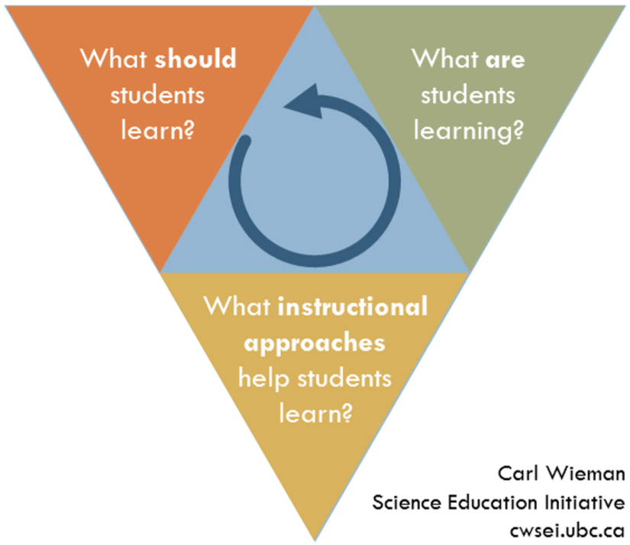
Carl Wieman Science Education Initiative
Image credit: Peter Newbury

Slide 10
  Science Teaching and Learning Fellows
  科学教学研究员
Disciplinary Knowledge 学科知识
Research 研究
Teaching & Learning 教与学

Slide 11
  Science Teaching And Learning Fellows
  科学教学研究员
STLF
Department
Course/Person Transformation 改变课堂
Teaching & Learning Projects 教与学项目
CWSEI
Community of Practice
社区实践
Professional Development 职业发展

Slide 12
Extent of Change
Over 200 courses influenced by CWSEI
Including almost all of the large introductory science and mathematics courses (1st & 2nd years);
In total, about 2/3 of course registrations
Involvement of nearly 200 faculty, ranging from 10% to over 90% involvement per department
Notes:
Approximately 150,000 credit hours per year transformed.
Also, very few upper-year courses transformed, which arguably are less in need.
One department: mini-initiative, less money overall, decent progress in more recent years.
One department: lots of money, minimal change.

Slide 13
Impact on Teaching by Department
UBC by 2014/2015 对教学的影响

Slide 14
Questions? Comments?
Notes:
Brett – do you want to add your slides to this?

Slide 15
  Reformed Example Lesson 改革后的示例课程
Notes:
Brett – do you want to add your slides to this?

Slide 16
Course
Transformation
Clear learning goals
Make the most of time in class:
  Preparatory assignments (pre-reading)
  In class:
    Peer discussions (often using clickers)
    Group work (often using worksheets)
    Feedback and “reactive lecturing” by instructor
Assessment that exposes student thinking
Measure learning and associated issues
Notes:
Pre-reading: recent paper about effective way to get students reading, also gives information about where they are confused.
Key instructor involvement:
Design of activities and assessments: what does an expert need to do? What are students capable of at this level? How would you know they have achieved that.
Feedback during activities:
Better-prepared students can ask deeper questions during class time
Instructor reacts to student pre-class questions and in-class results

Slide 17
Example from a Math course
When I first started teaching: review topic list, check the book, choose examples, present.
After learning more about learning as an STLF, I started by thinking about aspects of the course that are very challenging (and what would a mathematician do).
Example challenge: students struggle with the technical definition of “continuous” for functions and graphs.
Notes:
Note: this is sort of a deficit model for thinking of instruction, but it can be easier for people to get started this way.

Slide 18
Example from a Math course: some Learning Goals
Interpret piecewise continuous graphs in terms of continuity at a point, left- and right- hand limits.
Convert to/from a piecewise-defined function expression and its graph.
Sketch graphs of simple functions based on provided data about rates, certain values, and other information.
Convert a “word problem” to a mathematical representation.
Interpret a constant rate as having a straight-line graph (and vice versa).
Attend to important features of a graph when sketching (key points or parts of a shape) instead of precise scale drawings.
Notes:
Unpacking what students are struggling with can take time.
Pieces of knowledge, component skills, and the framework that integrates them.

Slide 19
Example from a math course: class time
I want students to sketch and interpret a graph with discontinuities to help build in this direction.
Paint Store activity

Slide 20
Paint Store 油漆店
(on a handout/worksheet)
There is a special paint store with only one size of bucket that will sell exact amounts of paint, meaning they will partially fill a bucket to your exact specifications. Each bucket can hold a maximum of 5L and costs $6.00, while the paint costs $10.00 per litre.
Draw a graph that represents cost of 0L to 12L.

Slide 21
Paint Store
There is a special paint store with only one size of bucket that will sell exact amounts of paint, meaning they will partially fill a bucket to your exact specifications. Each bucket can hold a maximum of 5L and costs $6.00, while the paint costs $10.00 per litre. (Assume we are only buying one colour of paint, and that there is a large fine for not using all of our paint, so that we always want to buy the exact amount of paint and no extra.)
Draw a graph that represents cost of 0L to 12L.
Notes:
Worksheet and clicker problems can be underspecified (on purpose or by accident) and this opens up additional conversations, particularly with students who are further head on the material.

Slide 22
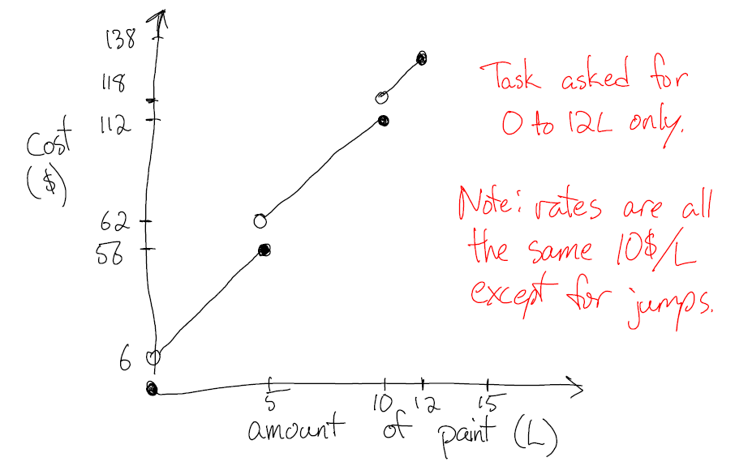
Paint Store: solution
Notes:
Provided solution – note the rough sketch – that’s what people draw when they are talking about ideas.

Slide 23
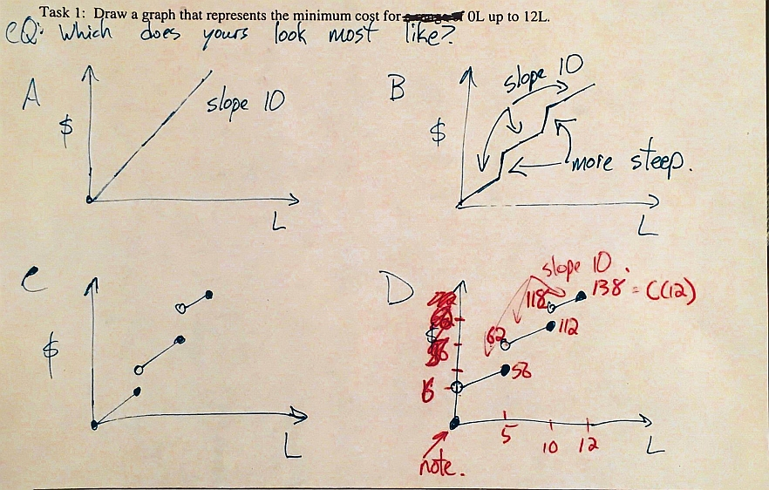
Paint Store: Clicker Question
Notes:
These were based on student solutions, from walking around.
Second time: I had a prepared slide.
Key issue: I didn’t know the ways they would make mistakes, but I provided enough space and a task that would reveal them.
Can prod things along, can check in.
Peer Instruction

Slide 24
Paint Store: alternate set of clicker questions
How much will it cost to buy 1L of paint?
How much will it cost to buy 4.9L of paint?
How much will it cost to buy 5.1L of paint?
How much will it cost to buy 5L of paint?
Sequence of questions to explore the issue with discontinuity.
Notes:
Alternate way at getting at student solutions, they have to use their graph.
Can prod them along

Slide 25
Paint store: more tasks
Use limit notation to describe the behaviour of the paint cost function you drew at 5L, 2L and 0L.
Suppose the store also offers full, sealed buckets of exactly 5L of paint for a special price of $40 ...
Notes:
It depends on the goal I have. Also, I can lean on the Paint Store in a later class that is exploring other behaviour.

Slide 26
Questions? Comments?
Notes:
Brett – do you want to add your slides to this?

Slide 27
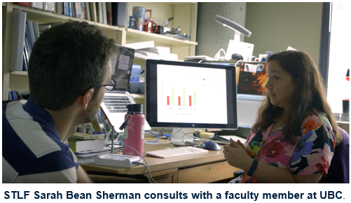
  STLF Role 科学教学研究员的角色
Notes:
Brett – do you want to add your slides to this?

Slide 28
Responsibilities 职责
Develop expertise in educational research practices and methods
培养教育研究实践和方法的专长
Work with faculty and develop community of practice
与教师合作，发展实践社区
Lead teaching and learning projects
牵头教学项目
Create publications and do research
创建出版物并做研究
Teach 教学
Notes:
“Engineers” for Education
1-on-1 faculty development;1-3 iterations of a course
Translator between education research, traditional educational developers, department culture
Conduct research & evaluation related to projects
Teaching own course once per year or less

Slide 29
Brett Gilley: 7 years 他的7年
Worked on 46 courses 46门课程
Worked with 42 out 54 faculty in EOAS
与 EOAS 54名中的42名教师合作
Untold number of grad students 无数的研究生

Slide 30
A week in the life…他的一周什么样的
 | Monday | Tuesday | Wednesday | Thursday | Friday
8:00
9:00 | 100 Level Class | Work at Home | 100 Level Class |  | 100 Level Class
10:00 | Meet with Faculty 1 | Email |  | Observe Class
11:00 |  | Research | STLF meeting | Meet with Faculty 5 | Meet with Faculty 6
12:00 | Observe Class | Writing | Meet with CTLT | Student interview | Teach Grad Student
13:00 | Meet with Faculty 2 | Online meetings |  |  | Class
14:00 |  | Prep classes, |  | Reading Group
15:00 | 100 Level Class | workshops, or, | 100 Level Class |  | 100 Level Class
16:00 | Meet with Faculty 3 | conferences |  | Teaching Workshop
17:00 | Group meeting | etc. | Meet with Faculty 4 |  | Go to Pub with STLFs

Slide 31
Early days 早期
Took us about 2 years to figure out the job
花了我们大概2年的时间才有了方向
Professors (even allies) were somewhat resistant
教授们（甚至盟友们）也会抵触
Students were also resistant
学生也有抵触

Slide 32
Early days
Tried the big 100 level courses first
首先尝试了一年级的大课
  Can be a mistake (too many stake holders)
  可能是一个错误（利益相关者太多）
  Very complicated 非常复杂
But “Apparently Successful”
“取得显著成功”

Slide 33
Middle of the project
项目中间阶段
By then only 1 year to figure out job!
到那时只有一年时间来把工作弄清楚
In EOAS 4 STLFs 在EOAS 有四名STLFs
Together “officially” worked on 17 courses at once (+ consulting) 一起“正式”完成了17门课程（加上咨询）
Faculty wanted to work with STLFs 教师们想和我们一起工作
Students would write “course needs to be Wiemanized” on surveys 学生在调查中写出“课程需要被改革”

Slide 34
Later on 后来…
Year 4 of 5 they changed formats
在五年中的第四年他们改变了模式
They changed the model, cut some courses from the end
他们改变了模式，去掉了一些课程
Moved towards “consulting”
转向“咨询”

Slide 35
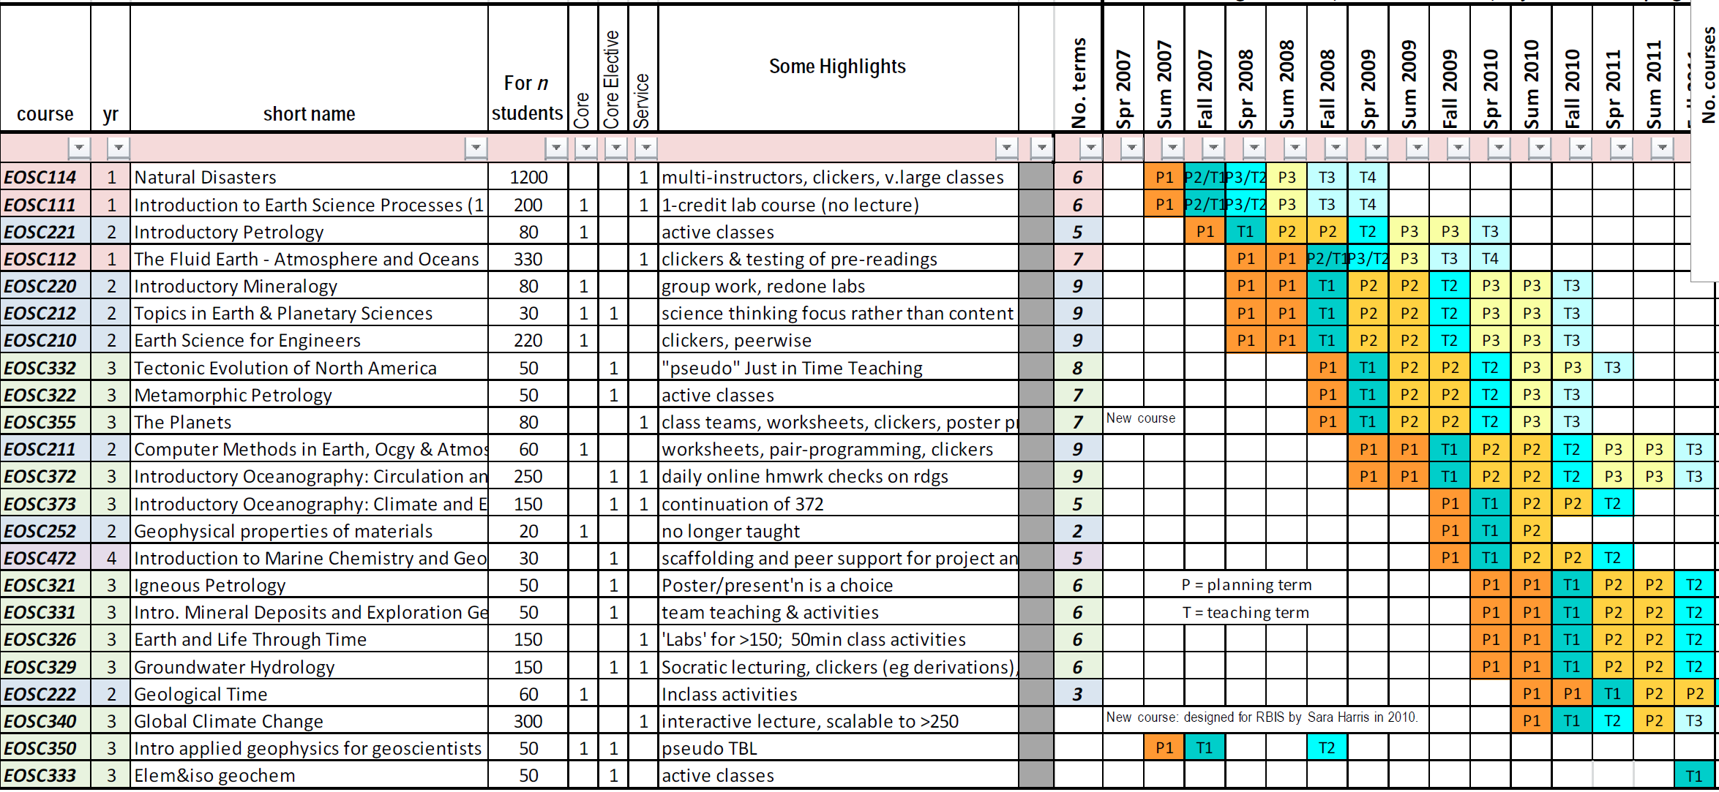
Official course transformations in EOAS 在EOAS官方课程的转换

Slide 36

Currently 目前…
The CWSEI is over, but Skylight is our permanent home of teaching transformation (skylight.science.ubc.ca)
There are new positions: Science Education Specialists - SES

Slide 37
Our secret 我们的秘诀
The community
社区

Slide 38
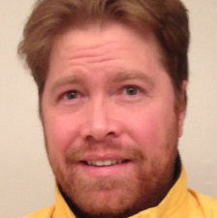
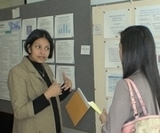
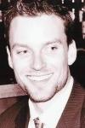
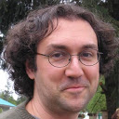
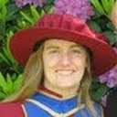
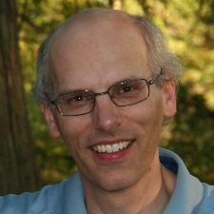
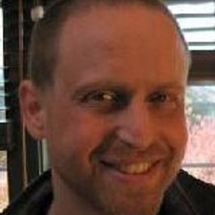

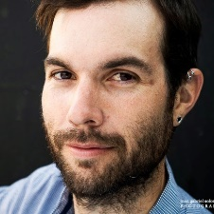

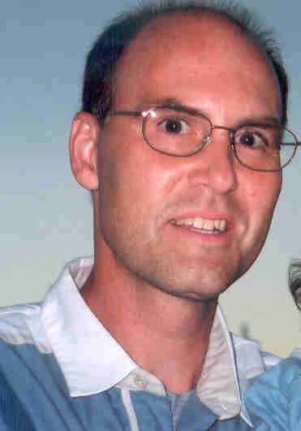
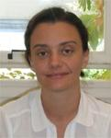
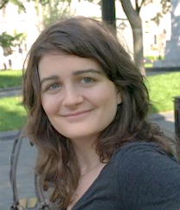




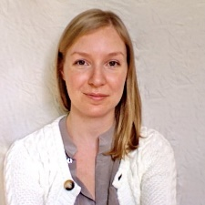

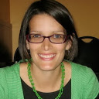



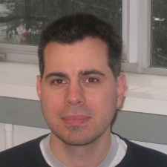
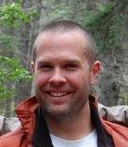
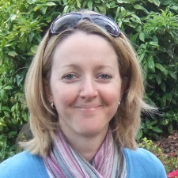
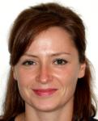



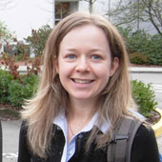


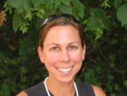
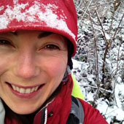
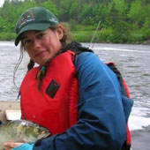
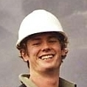
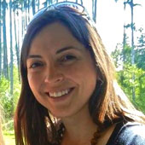


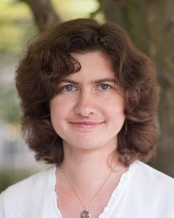

Slide 39
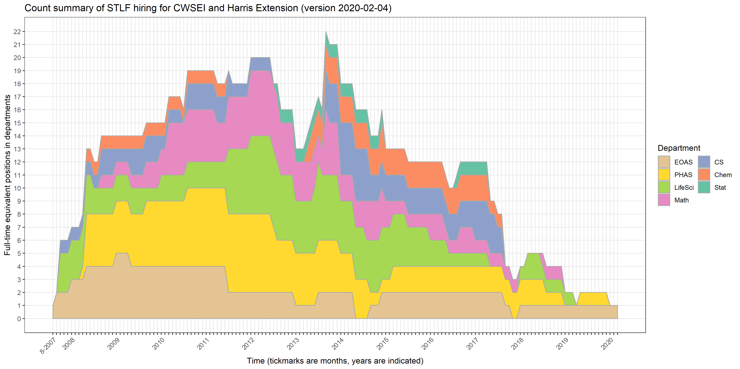
STLF counts, by department
Code, W. J., Welsh, A. J., & Maxwell, E. J. (2023). A longitudinal perspective of the experiences and career trajectories of discipline-based education specialists in teaching and learning in higher education. International Journal for Academic Development, 29(4), 563–576. https://doi.org/10.1080/1360144X.2023.2210535
Notes:
About 50 total
Peaks of 20, 22.
Average 2-3 years
1-4 in department at any given time
Note:
PHAS = Physics & Astronomy
EOAS = Earth, Ocean, and Atmospheric Sciences

Slide 40
Question 问题
In your groups, discuss 小组讨论:
  If you were an STLF (Science Teaching and Learning Fellow), what type of support might you need to be successful?
  如果您是STLF，您需要什么类型的支
  持才能成功？
  What would be the benefits of doing this in your university?

Slide 41
Review: Challenges, Benefits, and Lessons Learned
回顾：挑战，收获和经验教训
Notes:
Brett – do you want to add your slides to this?

Slide 42
Challenges 挑战
Incentive system in higher education
高等教育中的激励制度
      Lower priority of teaching
      教学不在优先位置上
Departmental culture and organization
部门文化和组织
Heightened focus on content instead of learning
对内容而不是对学习的重视
Siloed departments and Faculty 院系之间的断层
      Multi-section, multi-instructor courses
      多部分，多教师课程
      Lack of communication 缺乏沟通

Slide 43
Benefits 收获
Improved student learning and experience
提高学生的学习和体验
Adoption, development, and dissemination of evidence-based practices/research in STEM
采用，开发和传播有证据做支持的STEM
领域的实践和研究
Growing teaching & learning culture and community of practice within a research-intensive university
在一所研究型大学里，不断增长的教学和学习文化以及实践的氛围
Local, national, and international collaborations and research
地方，国家和国际合作与研究

Slide 44
Lessons Learned 经验教训
Large-scale change is possible
大规模的改变是可能的
Reach out to and work with all profs (not just the top 10%) 主动联系并与所有的教授合作（不只是前10％的教授)
Support from Heads and Deans is critical
校长和院长的支持至关重要
  Embeddedness of STLF central to success
  嵌入式的科学教育研究员是成功的关键
Momentum leads to shift in departmental culture
改革的势头引领了院系文化的转变
Student desire for more transformed courses
学生希望更多的转化课程
Recognition that teaching is an acquired expertise
认识到教学是一种需要后天学习和培养的专业知识

Slide 45

Reforming Undergraduate Science Education
改革本科科学教育
http://www.hup.harvard.edu/catalog.php?isbn=9780674972070

Slide 46

Reforming Undergraduate Science Education
改革本科科学教育
https://pressbooks.bccampus.ca/seihandbook/

Slide 47
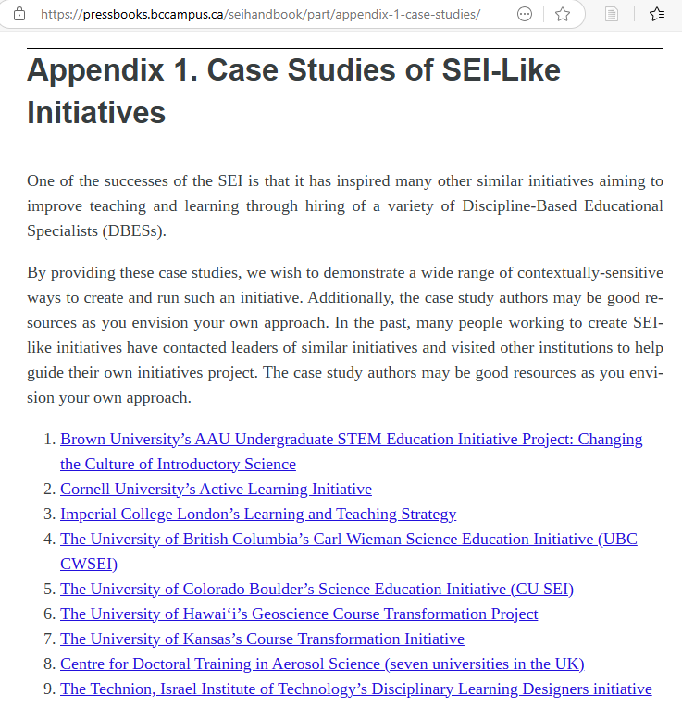
Other examples with this model

Slide 48
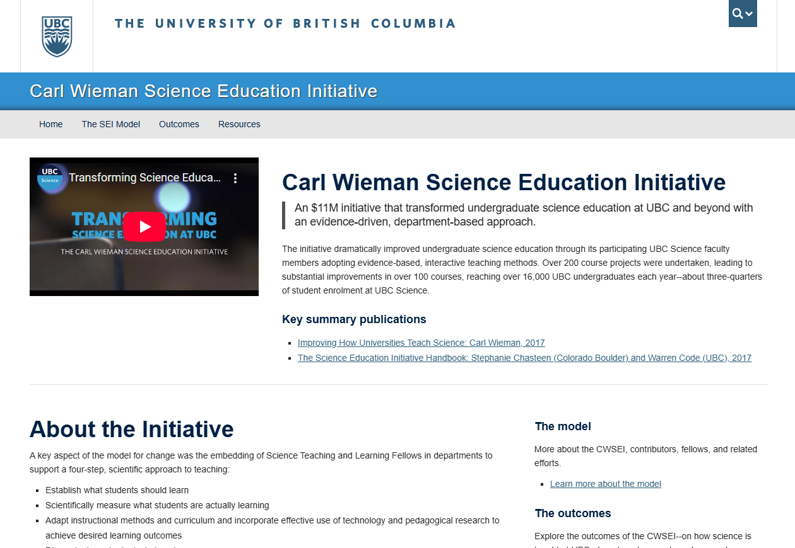
cwsei.ubc.ca

Slide 49
Question & Answer Period
Notes:
Brett – do you want to add your slides to this?

Slide 51
cwsei.ubc.ca
Warren Code – warcode@science.ubc.ca

