Slide 1
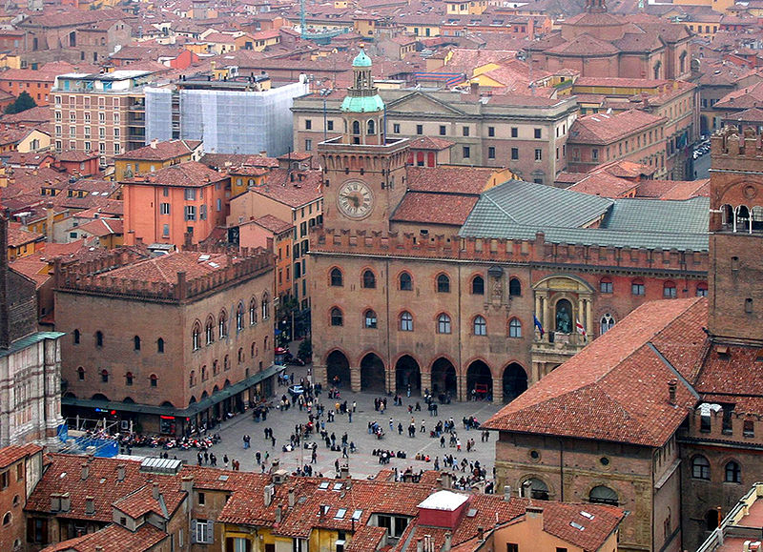
Engaging Students via Bologna
Engaging Students via Bologna
Matt Yedlin , Dept. of Electrical and Computer Engineering, UBC

Slide 2
Outline of Presentation
( Questions may be asked at any time)
Motivation
Design
Next Steps

Slide 3
Motivation
Setting the Context: ( I wanna be sedated)
Who is getting sedated? Teachers or students?
(http://www.youtube.com/watch?v=lQeo3OfuEDM)
My observation – what is a phone?– content
in the classroom? Observations in EECE 261 Class
Nothing new has been invented!
Katie Gimbar’s flipped classroom video
(http://www.youtube.com/watch?v=9aGuLuipTwg)

Slide 4
Design
General comments :
Many discussions on how to do this – Paul Carter, Jim Sibley, Lucas Wright,
Michelle Lamberson, Simon Bates ;
Design emerges – 2 modifications – Accountability and Feedback
i) Added Accountability – online quizzes based on content ( Webwork)
ii) Feedback – embedded in quiz – essay type question
Processing Feedback – use text processing, semantic analysis, Wordle display;
d) Use Feedback for classroom activities – JITT, hot seat, clickers;

Slide 5
Design of a system of this type does not happen in a vacuum! Initial discussions began
in the summer with Jim and took off from there!
Added Value:
Accountability
JITT engine including text summaries
Content Delivery on Mobile Phones – not trivial!
The classroom is more fun! More learning –like
Bologna 1088.

Slide 6
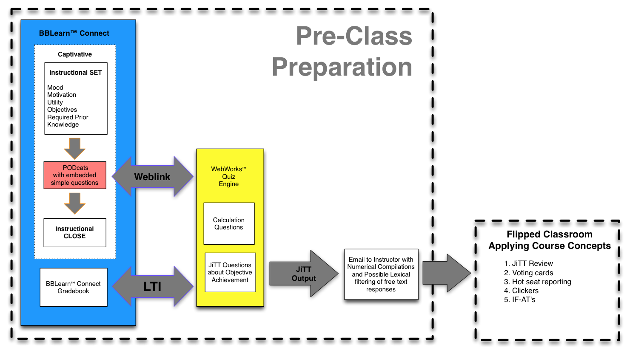
Courtesy of Jim Sibley – Co-designer in this project ( and following screenshots)

Slide 7
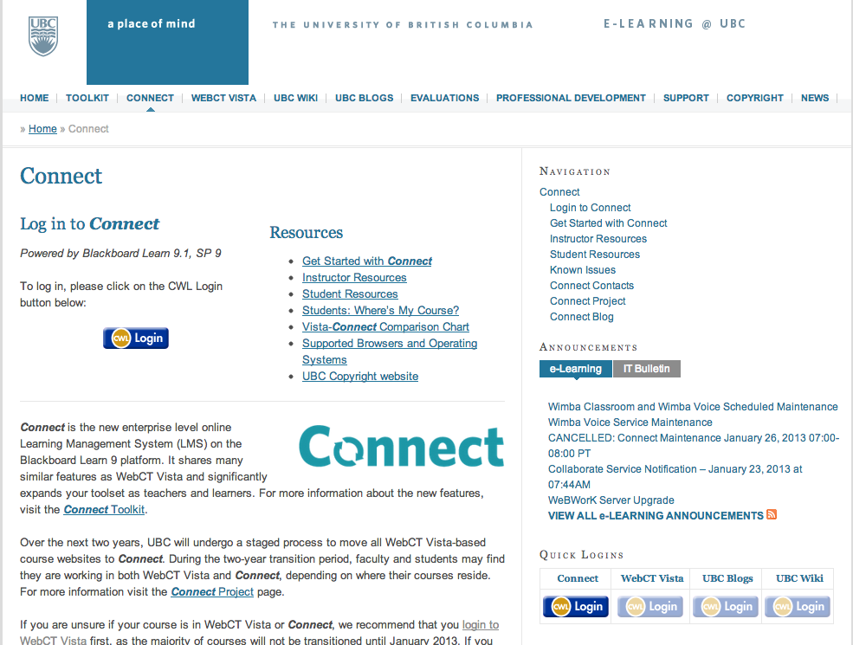

Slide 8
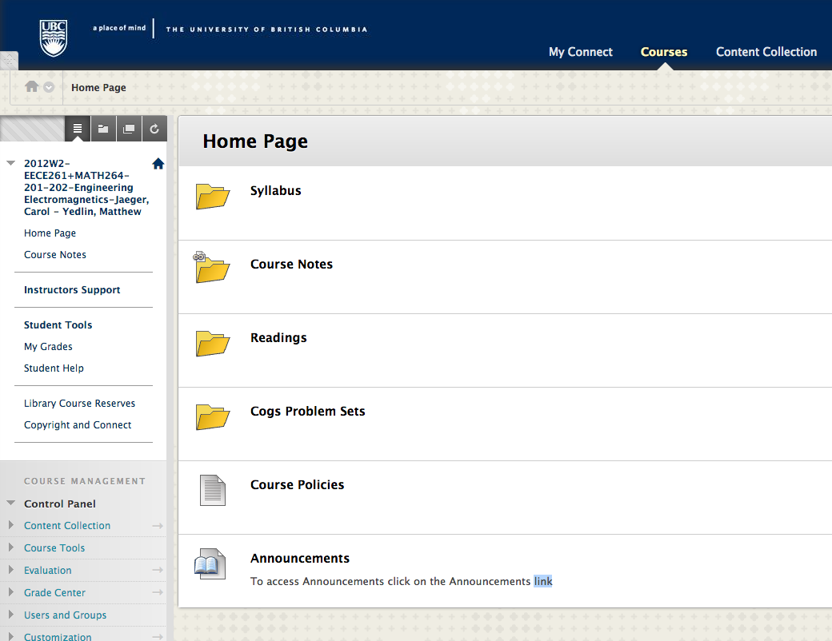

Slide 9
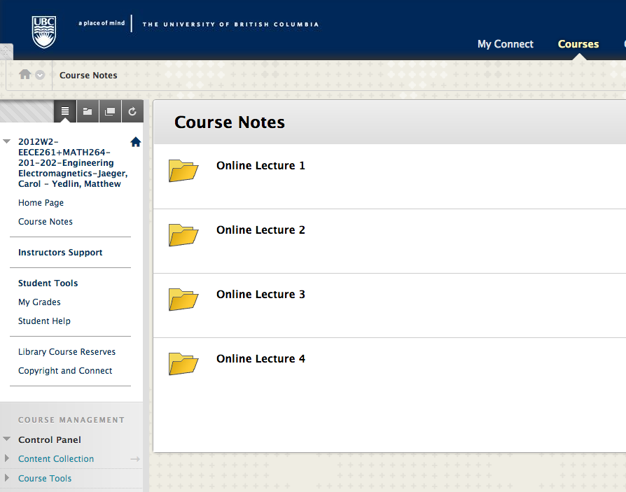

Slide 10
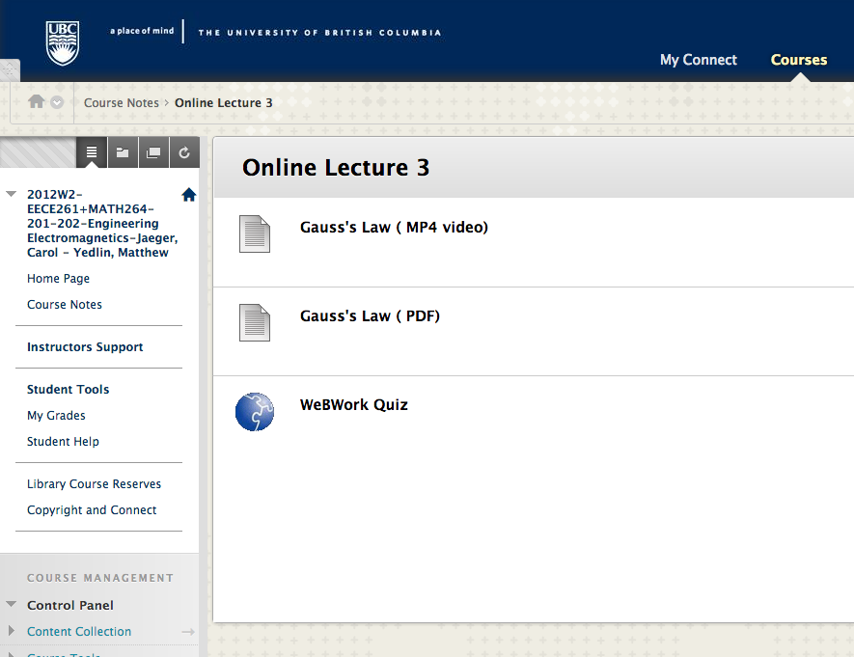

Slide 11
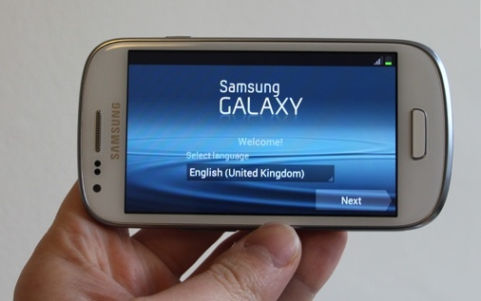

Slide 12
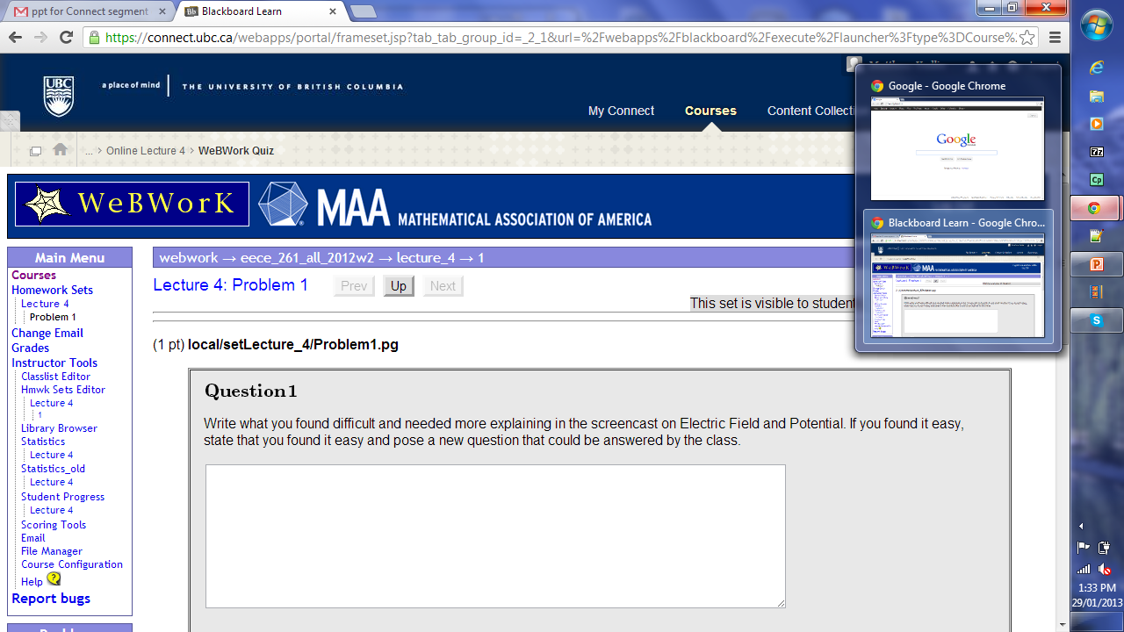

Slide 13
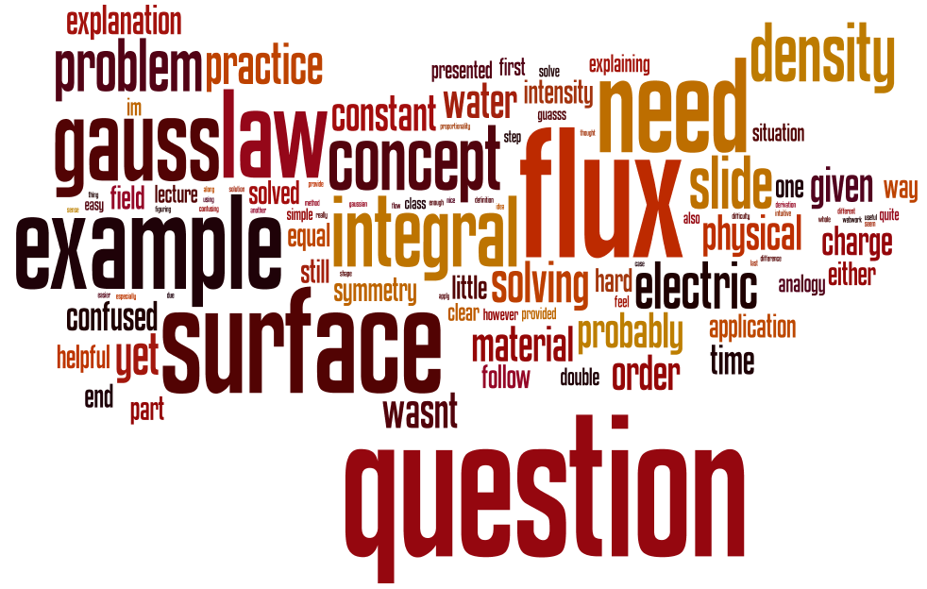
Essay question summaries
Figuring out what gauss surface to use is hard. The ease part is that the method is very systematic and can be mastered if one understands the steps that we should take to find the integrals.')
"I'm still confused about flux vs flow.
Especially when you mentioned flux can be seen as a form of flow,
but how can it have units of C?")
Found it all pretty straight forward')
We see differentiation!

Slide 14
Observations and Next Steps.
a) Amazing to probe student understanding during classroom activities
for discussion – better than clickers.
b) Hardware improvements – CONNECT Bandwidth
c) Software improvements – WebWork quizzes, browser
compatibilities
d) Expand to other Classes
e) Scalabiliy and Feasiblity
Respect for time available to instructor
Re-use available content – instructor focusses on platform and
classroom activities – paradigm shift in instructor focus
Exploit efficiencies – basic design is done, simple, best practices

Slide 15
The Team ( all individuals involved at different levels – including initial discussions):
EECE – Dr. Andre Ivanov, Darla La Pierre, Joe Yan, Julia Scrimgeour, Derek Poon, Chris Dumont, Roozbeh Mehrabadi
CIS – Jim Sibley, Sophie Spirodonoff, Akshat Divekar, Yelnil Gabo, Aaron Prosch:
CTLT -- Michelle Lamberson, Simon Bates, Pan Luo, John Hsu;
CS – Paul Carter
Statistics – Djun Kim

Slide 16
Thank you !
Thank you !

