Slide 1
Flowing Values: The Evolution of Water Governance.
John Janmaat
I.K. Barber School of Arts and Sciences
The University of British Columbia

Slide 2
Governance
“the sum of the many ways individuals and institutions, public and private, manage their common affairs. It is a continuing process through which conflicting or diverse interests may be accommodated and cooperative action may be taken.” (The Commission on Global Governance, 1995: 2).
Governance ≠ Government

Slide 3
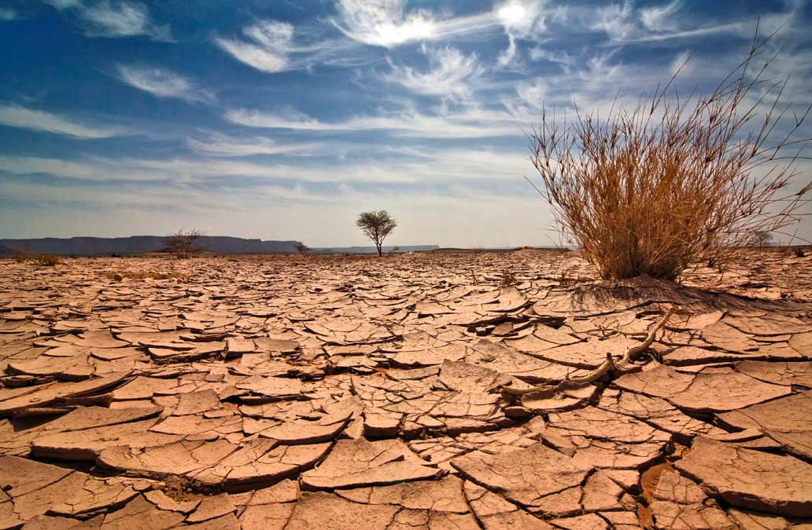
Scarcity
Scarcity is the fundamental economic problem of having seemingly unlimited human wants in a world of limited resources.
Without scarcity, don’t need governance

Slide 4
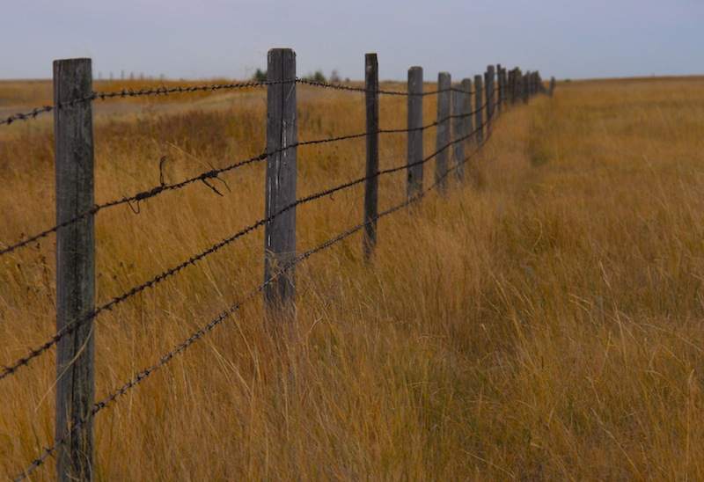
Rights
Laws created by governments in regards to how individuals can control, benefit from and transfer property.
One solution to scarcity dilemma

Slide 5
Since Time Immemorial …
Homo sapiens ~100,000 years.
Around globe by ~10,000 BP.
First written history ~4,000 BP.
For many, after contact.
Adapted to local environments
Became ‘indigenous’.
Culture – stories, religion, language, etc. – embodied local knowledge.

Slide 6
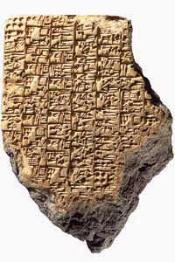
Mesopotamia
Cradle of civilization (irrigation)
Very fertile, with irrigation
Need organized society.
Needed allocation method
Communally owned
Arbitrator appointed to allocate and arbitrate.
Liability laws for delinquent system care
Customary law dominant
Collapse(s) from soil degradation.

Slide 7
Maya
Hot dry season
Irrigation and storage to sustain population.
Dynastic leaders and managerial bureaucracy.
Water controlled to support political goals.
Compensation for unintended damages
Self sacrifice for intended rule violation
Collapse with drought

Slide 8
Islam
Little written in Quran.
Water gift from God, humans stewards.
Must not withhold from those in need.
Sharia as guiding principles, not precepts
Sharia = the place from which one descends to water and is the law of water.
Custom, analogy and consensus important for settling conflict.

Slide 9
Judeism
Water as gift from God – rain from heaven
Torah source of principles
Details by interpretation
Common law, precedent, etc.
“Two Jews, three opinions.”
Historic laws on ownership, sharing, and protection of quality.
No single, unified code.

Slide 10
Roman
Quaedam naturali jure communia sunt omnium, quaedam universitatis, quaedam nullius, pleraque singulorum, quae variis ex causis acquiruntur. Et quidem naturali jure omnium communia sunt illa: aer, aqua profluens, et mare, et per hoc littora maris. [Marcian, Dig.1.8.2]

Slide 11
Roman
Some of the things are common to all men by jus naturale, some of the things belong to a community, some of the things are common, some of the things belong to individuals who have acquired them for various reasons. And indeed by jus naturale these things are common to all men: flowing water, the sea, and the shores of the sea. [Translation by D N MacCormick]

Slide 12
Roman
Principles in legislation and jurisprudence
While all perennial water in a source is not appropriated, perennial flowing water can be appropriated provided the appropriator did not appropriate water already appropriated by someone.
When all the perennial water from a public river is appropriated, that water is divided amongst the properties in proportion to the extent of their irrigated lands.

Slide 13
Roman
Water from springs and water from wells, fishponds and lakes were divided according to priorities in time, except private springs or rights fixed by agreement.
Non-perennial water, while on his land, could be appropriated by the owner of the land.
The right to draw perennial water for irrigation was always coupled to the owner of land.

Slide 14
Roman
The Roman farmers always had a permanent and assured right to water while they were using that water.
Anyone drawing water from a scheme had to have the permission of the owner of the scheme.
Users of flowing water, other than irrigation, ranked in priority in the same order as the users for irrigation.

Slide 15
Spanish
Derived from Roman, adapted to arid NA
Water property of crown
Specific rights granted to users
Frontage on source only permits domestic.
Diversion rights for irrigators by grant.
Almost absolute for springs and wells.
Dispute resolution principles: (1) just title, (2) prior use, (3) need, (4) legal right, (5) intent, (6) noninjury, and (7) equity and the common good.

Slide 16
England and Eastern USA
Riparian principle (1827 / 1833).
All riparians right to equal share
Can’t unreasonably diminish available to others.
Issues:
New riparians diminish rights of others
No rights for uses away from stream
Impractical for long/large sources
Now regulated riparian rights

Slide 17
Western NA
California, Oregon, humid areas, settled first.
Adopted riparian rights.
California gold rush (1848 – 1855)
No real government
Miners needed water, often little available
First in time, first in right emerged.
Hybrid system emerged
Complicated, sometimes unwieldy

Slide 18
Western NA
Prior appropriation principle (1882, Colorado).
Court decided first in time, first in right.
States expressly suspended riparian rights
Left with single water law.

Slide 19
Aboriginal
Large irrigation societies gone or absent
Aztec conquered by Spanish
Anasazi collapsed
Codified water rights mostly absent
Relation in culture, legends, traditions, etc.
Embodied ‘right’ relationship to ‘earth’.
Rules for sharing bounty among communities.
Enforcement of areas of exclusive domain.
Colonization ignored existing system.

Slide 20
Aboriginal
Winters doctrine (USA, 1908)
Reservation lands have implicit right to water sufficient for agricultural use of land.
Aboriginal rights (Canadian Constitution)
Being decided, essentially retained rights that were not ceded by treaty.
Aboriginal title (Canadian Constitution)
Tsilhqot'in case, title to lands where community excluded others.

Slide 21
Things of Note
Equity key for early and customary law.
Industrialization, law favours exploitation.
Missing … environment
Early societies, limited knowledge, scale.
Couldn’t modify environment, so adapted.
Industrial age, environment not considered.
Modern age, environment important, but shackled by old laws.
Reaching environmental limits, must adapt.

Slide 22
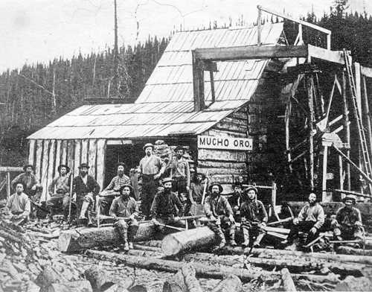
British Columbia
English common law
Riparian rights
Gold Fields Act (1859)
Recognized diversion
Established rights by order of registration
Land Ordinances Act (1870)
Allow diversions for agricultural purposes
Priority by order of registration

Slide 23
British Columbia
Water Privileges Act (1892)
Ownership of water vested in crown.
Water Clauses Consolidation Act (1897)
Cannot divert water without provincial permission
Right appurtenant to land or mine
Beneficial use requirement

Slide 24
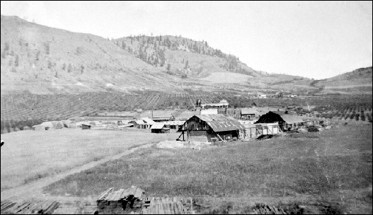
British Columbia
Water Act (1909)
Board of Investigation
Hearings for new licences
Established priorities and quantities for claimants on same source.
Power to order improvements to works.
One system of administration

Slide 25
British Columbia
Water Act (1914)
Abrogated riparian rights, except domestic
Water Act (1939)
Replace Board of Inquiry with Comptroller of Water Rights.
Application procedures and expropriation.
Water Act (1960)
Inclusion of groundwater.

Slide 26
British Columbia
Statutes and Amendments (1981 - 1982)
Link to Environmental Management Act
Regional Water Manager (RWM) defined
Grant approvals, issue and amend licences, transfer appurtenancy.
Water Amendment Act (1992)
RWM can cancel, appeal process
Regulations for works around source

Slide 27
British Columbia
Water Protection Act (1995)
Prohibit bulk exports
Prohibit large inter-basin transfers
Amendments (1997)
All appeals to Environmental Appeal Board
Link to Fish Protection Act
Amendments (2003)
More powers to RWM

Slide 28
British Columbia
Amendments (2004)
More groundwater provisions
Water management plans
Amendments (2005)
Adjustments to rental rates and processes

Slide 29
British Columbia
Water Act Modernization
Process began late 2009.
Initial plan for legislation in 2012.
Extensive consultations
Regional forums, focus on First Nations
No scope for input after first reading
First reading, March 11, 2014
Third reading, April 29, 2014 (no amendments)
Royal ascent, May 29, 2014.

Slide 30
Energy Prices

Slide 31
Trends
Concern for environment
Demands for participation
Diminishing government role

Slide 32
Dublin Principles
Fresh water is a finite and vulnerable resource, essential to sustain life, development and the environment
Water development and management should be based on a participatory approach, involving users, planners and policy-makers at all levels
Women play a central part in the provision, management and safeguarding of water
Water has an economic value in all its competing uses and should be recognized as an economic good

Slide 33
An Economic Good?
Water has multiple uses.
Uses generate value.
Using water for one purpose makes it unavailable for other purposes.
There is an ‘opportunity cost’

Slide 34
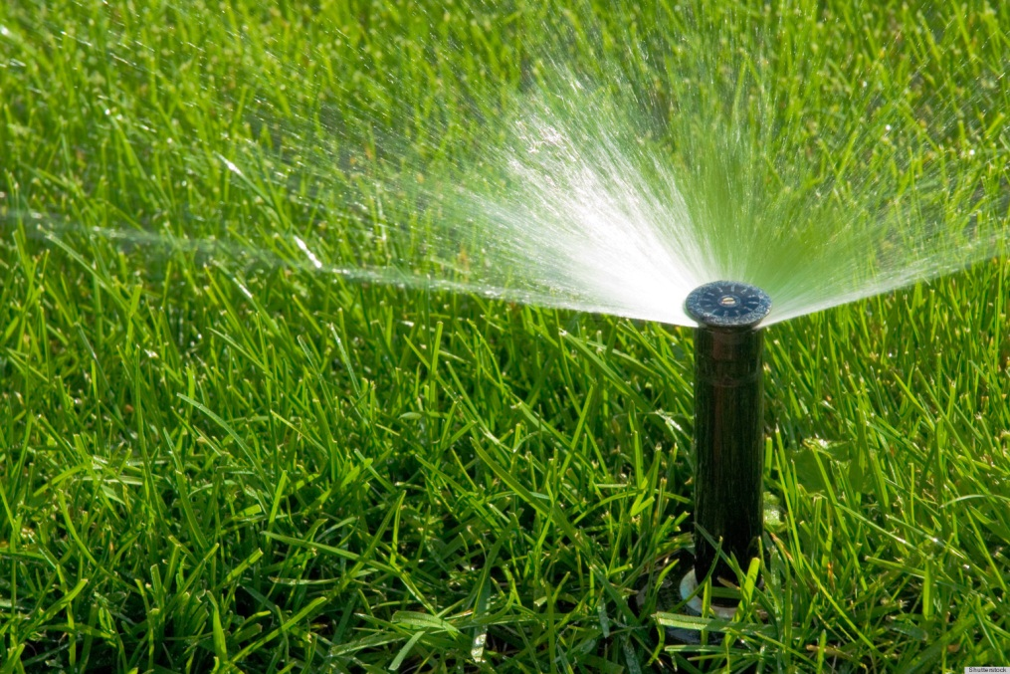
An Economic Good?
Water for urban use not available for agriculture.

Slide 35
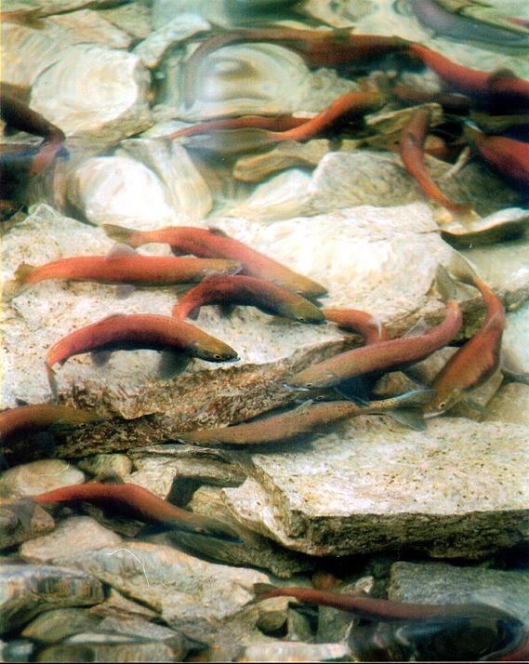
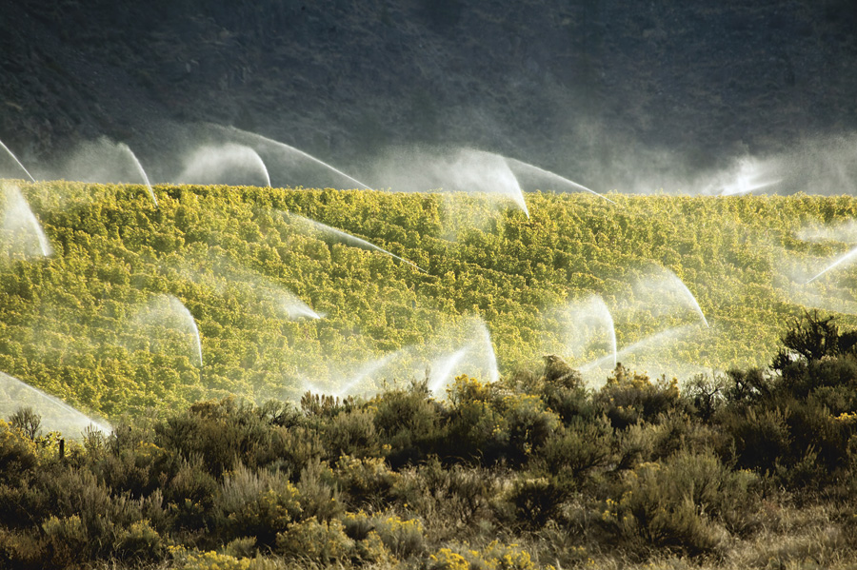
An Economic Good?
Water for irrigation not available for fish.

Slide 36
An Economic Good?
Putting water to its ‘best’ use.
Figure out value in different uses.
Pick use with highest value.
Figuring out highest value use.
Opinion poll
Referendum
Representatives
Regulations
Valuation study
Donations
Market

Slide 37
Water Sustainability Act
Protect stream health and aquatic environments
Environmental Flow Needs
Strengthen water quality protection
Consider water in land use decisions
Water objectives
Water sustainability plans
Regulate groundwater use
Groundwater integrated with surface water (FITFIR)
Exemptions for deep or saline water

Slide 38
Water Sustainability Act
Regulate during scarcity
FITFIR largely maintained
Provisions to protect basic ecological needs
Improve security, efficiency and conservation
Maintained beneficial use
Licences reviewable after 30 years
Some protection for agriculture
Enable a range of governance approaches
Scope for substantial local control

Slide 39
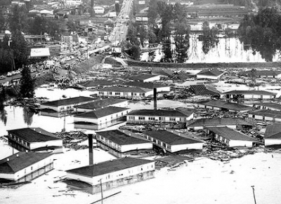
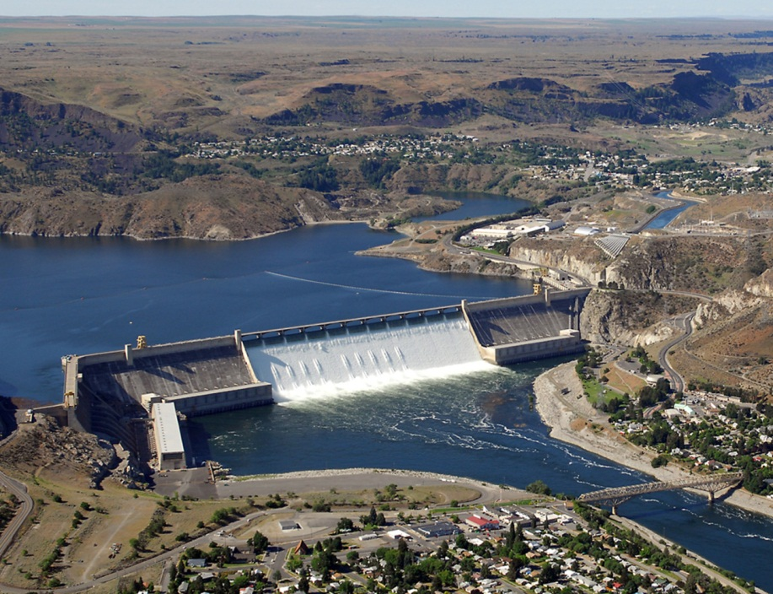
Columbia River Treaty
When signed, only flooding and electricity
Now, consumptive use, fish and environment, aboriginal rights, …

Slide 40
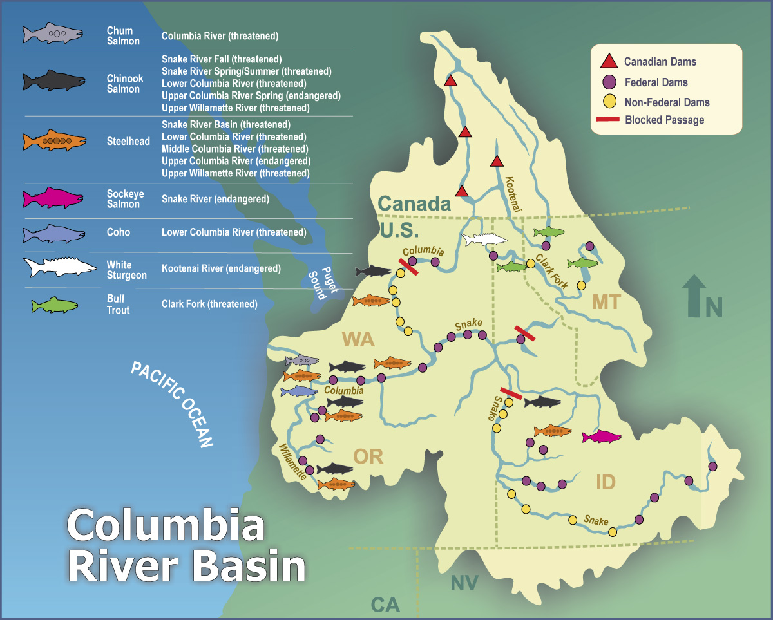

Slide 41
Themes
Long history of rules for sharing water.
Response to scarcity problem
Problem and solution defined by technology, culture, geography and climate
Rules need to evolve with context
Changing technology, culture, climate, …
Legal rules have changed.
Discretion important in application.

Slide 42
Sources
http://www.flowcanada.org/sites/default/files/documents/FLOW%20Co-governance%20Paper%20FINAL%20formatted%20May%202014.pdf
Marlow Sam, Syilx, http://www.obwb.ca/fileadmin/docs/080515_presentation.pdf
Dellapenna, Joseph W., and Gupta, Joyeeta, eds. Evolution of the Law and Politics of Water. Dordrecht, NLD: Springer, 2009

Slide 43
Sources
Caponera, Dante A., and Marcella Nanni. Principles of Water Law and Administration: National and International 2nd edition, revised and updated by Marcella Nanni. Vol. 1. CRC Press, 1992.
http://www.daviddfriedman.com/Academic/Course_Pages/Legal_Systems_Very_Different_13/LegalSysPapers2Discuss13/Rudoy_Maya.htm
Alewyn Burger. 2006. “A Study of Roman Water Law, with Specific Reference to Water Allocations and Prior Appropriation.” WRC Report No TT 279/06 August 2006

Slide 44
Sources
http://plainshumanities.unl.edu/encyclopedia/doc/egp.wat.030
Commons, Great Britain Parliament House of. 1861. Reports from Commissioners.
http://gsdl.ubcic.bc.ca/collect/firstna1/import/legislation/1870-06-01-Ordinance_Laws_Crown_Lands.pdf
http://www.obwb.ca/fileadmin/docs/Water_Governance_Oct_2006.pdf

