Slide 1
Managing Water Shortages
John Janmaat
Regional Innovation Chair in Water Resources and Ecosystem Sustainability
UBC Okanagan

Slide 2
Abundant Water
In BC, water normally not ‘scarce’.
Scarce: Not enough water for all ‘recognized’ users to have all the water they want.
Environment and/or people concerned about environment may not be ‘recognized’ users.
Beyond some minimum flow, water left in nature not seen as producing value.
With abundant water, some left for nature.

Slide 3
Abundant Water

Slide 4
Scarce Water
Not enough water to satisfy all users.
Drought.
Event (treatment failure, etc.)
How do we share what we have?

Slide 5
Scarce Water
?
?
?
?
?

Slide 6
Water Sustainability Act
Licence Administration
Application, conditions, enforcement
Shortage Management
FITFIR, attenuated.
Alternative Shortage Management
Water Sustainability Plans.
Water Shortages Act?
No need for act if no shortages!

Slide 7
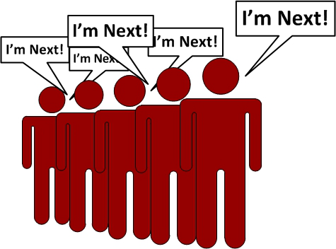
FITFIR
First In Time, First In Right.
Right based on date licence issued.
Lower priority, first cut off.
FITFIR is a water shortage plan!
In WSA, attenuated FITFIR.
Water Sustainability Plan
Alternative, all buy in!
IF

Slide 8
FITFIR
Vernon Water District
Purpose | Total Volume (Ml) | Weighted Priority Date
Agriculture | 276,207 | 1924
Residential | 196,492 | 1963
Industrial | 26,524 | 1969
Environment | 79,165 | 1972
First Nations | 5,918 | 1951
Power Generation and Land Improvement not included.

Slide 9
Attenuated FITFIR
Minimum Stream Flow requirements
Basic environmental needs have highest priority.
Arguing about what they are!
Essential Household Needs
Household needs and animals for household use.
Otherwise, FITFIR

Slide 10
Water Sustainability Plans
Scope to do things differently.
Must be ‘better’ than WSA.
Reduce conflict and/or better for environment.
Key elements
All rights holders involved, compensation for those affected.
Maybe new regulations for plan area.
May reserve water for agriculture.

Slide 11
Water Sustainability Plans
74 (2) If a proposed plan … recommends a significant change in respect of a licence … and the holder … has consented to the change, the proposed plan must be accompanied by
(a) a copy of the written consent of the holder of the licence …, and
(b) a detailed proposal assigning to each person or other entity who would benefit … some or all of the responsibility for compensating the licensee …, consented to in writing by each such person.

Slide 12
Water Sustainability Plans
74 (3) If a proposed plan … recommends a significant change in respect of a licence … and the holder … has not consented to the change, the proposed plan must be accompanied by
(a) a list of the affected licences … ,
(b) a statement of the public benefit …
(c) a statement of any available source of funding to pay compensation or for compensatory measures for the involuntary significant changes

Slide 13
Dealing with Shortages
In WSPs, can’t force licence holders to change actions without compensation plan acceptable to minister.
Not a way to force water users to change behavior.
If want something other than WSA default, need everyone on board.

Slide 14
Compensation
Everyone affected by WSP must see themselves as better off than without WSP.
Abundant water, no problem, nobody affected.
Water shortage, plan in WSP must be better for everyone than attenuated FITFIR of WSA.
Compensation plan critical for users who take hit during shortage.

Slide 15
Mechanisms
Buy out rights.
Develop drought plan.
Pay those affected enough to participate.
Holdouts, ‘expropriate’.
Determine expected loss.
Propose better than fair payment in plan.
High cost up front!

Slide 16
Mechanisms
Water market.
Pay users to give up use of water during shortage.
Need source of money during shortage.
Demanded payment may be large.
No up front cost.
Cost during shortage unknown.

Slide 17
Mechanisms
Dry year contracts
Seller agrees to forego water use in dry year.
Buyer pays if dry year occurs.
Low up front cost.
Not dealing in shortage.
Know costs for water.
Seller knows payment and conditions.

Slide 18
Mechanisms
Payments for Ecosystem Services
Pay landowners to not use/protect natural areas.
Not shortage plan.
Protect wetlands, etc.
Pay owner enough that benefit of use less than benefit from no use.

Slide 19
Conclusion
Have WSA because of water shortages.
WSA is plan for managing shortages.
WSPs enable locally ‘better’ plans to manage shortages.
WSPs need everyone on board.
Compensation plans must be worked out up front.

