Slide 1
What People Say They Do vs What they Do
John Janmaat Economics, IK Barber School of Arts and Science UBC Okanagan Campus Kelowna, BC

Slide 2
Why Conserve Water?
Moral considerations
Conserve so others, now and tomorrow, can have.
Limit our use for good of ecosystem.
Economic considerations
I save money if I use less water.
My purveyor won’t have to expand and raise my rates as soon.
Policy question
Economics dominate, raise price to conserve.
Morals dominate, educate and persuade.

Slide 3
What People Say They Do
Survey of Kelowna households.
516 responses , telephone, internet and mail.
Began summer 2009, telephone and internet.
Concluded summer 2010, mail and internet.
Sample designed to focus on boundary areas between purveyors.

Slide 4
What People Say They Do
Actions:
Changes in behavior to reduce water use
Investments:
Purchase and installation of equipment that reduces water use, even absent behavior change.
Questions:
What actions and investments are being made?
What influences these?

Slide 5
Reported Indoor Investments

Slide 6
Reported Outdoor Investments
But does timed irrigation reduce water use?

Slide 7
Reported Behaviors
People seem to be getting the ‘turn of the tap when soaping / brushing’ message

Slide 8
Conservation Choice Relationships
In = 1.70 + 0.33 Out, R² = 0.14
In = 1.12 + 0.35 Act, R² = 0.12
Out = 0.81 + 0.43 Act, R² = 0.14
Looks like people who invest indoors may not invest outdoors, and neither type really changes behavior.

Slide 9
Comparing Water Purveyors
Place your bets!
Money
vs
Morals
Kelowna, five water purveyors.
City and RWW customers pay by volume used.
SEKID, BMID, GEID customers pay by connection.
Explaining conservation.
If price dominant, City and RWW customers should do more to conserve water.
If moral considerations dominant and no difference in moral inclination, no difference.

Slide 10
Comparing Water Purveyors
Does what you say you do have any relationship to who you get your water from?

Slide 11
Comparing Water Purveyors
Money Loses!
Who your purveyor is doesn’t seem to matter.
Therefore
Pricing differences between purveyors don’t seem to matter.
Attitudes
No difference in environmental attitudes.
Same perspectives and knowledge about OK water issues
Except in SEKID, more concerned with availability.
Behaviors
SEKID customers use other sources more.
ID customers have more quality complaints.
No difference in conservation behavior.

Slide 12
Explaining Conservation
Morals Lose!
Are people with more pro-environmental values more likely to conserve?
Using NEP, no support!
And awareness of Okanagan water issues?
Only for outdoor investments.
And number of ways receive information about conservation?
Yes for all three types of conservation!
Attitudes, values and knowledge are less important than just telling them as many ways as possible that they should conserve water.

Slide 13
Explaining Conservation
Combined and interaction effects.
Outdoor investments explained best (>10%)
Indoor investment: messages, pro-environmental values and income.
Outdoor investment: messages and income.
Actions: messages, water conservation values, weakly education.
Knowledge about Okanagan and belief Okanagan facing crisis never important!
People with more money (can) invest in water conservation. However, constant is still the more you bug them, the more likely they are to conserve.

Slide 14
Qualifications
Neither one of money or morals is clearly dominant.
Policy implications:
Don’t expect metering and pricing by volume to result in huge savings.
But it is a way of rewarding those who save!
Doesn’t look like caring for the earth matters much to behavior.
But those who care may vote for meters, etc.

Slide 15
What People Do.
Kelowna (and RWW) charge by volume.
Data (for Kelowna):
Monthly water meter measurements.
Augmented with property data from Landcor™
Augmented with spatial data using GIS.
Analysis:
Econometric model allowing for spatial lag and spatial error processes.
Translation:
Is there any evidence that people act like their neighbours?

Slide 16
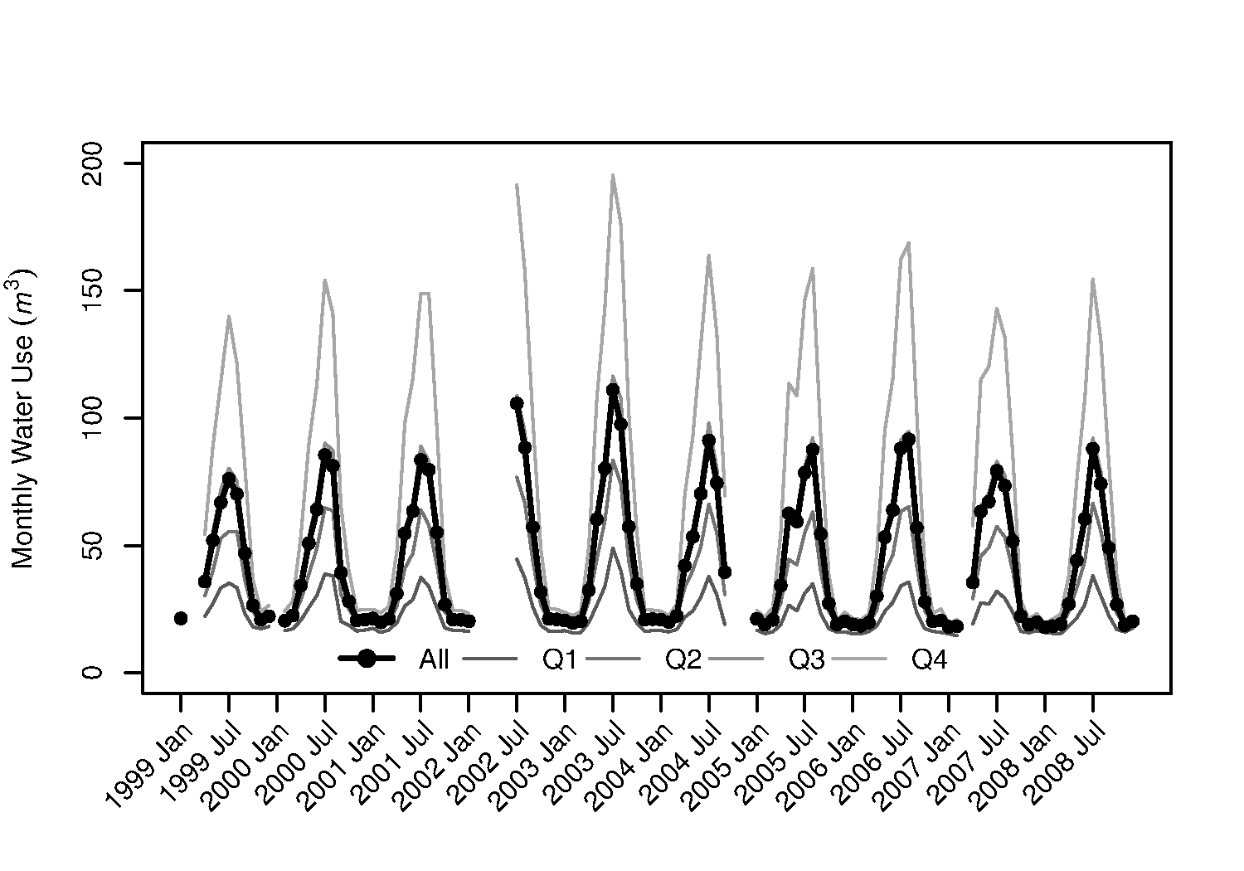
Temporal Patterns
Some use much more water than others.
Are they likely to be close together?

Slide 17
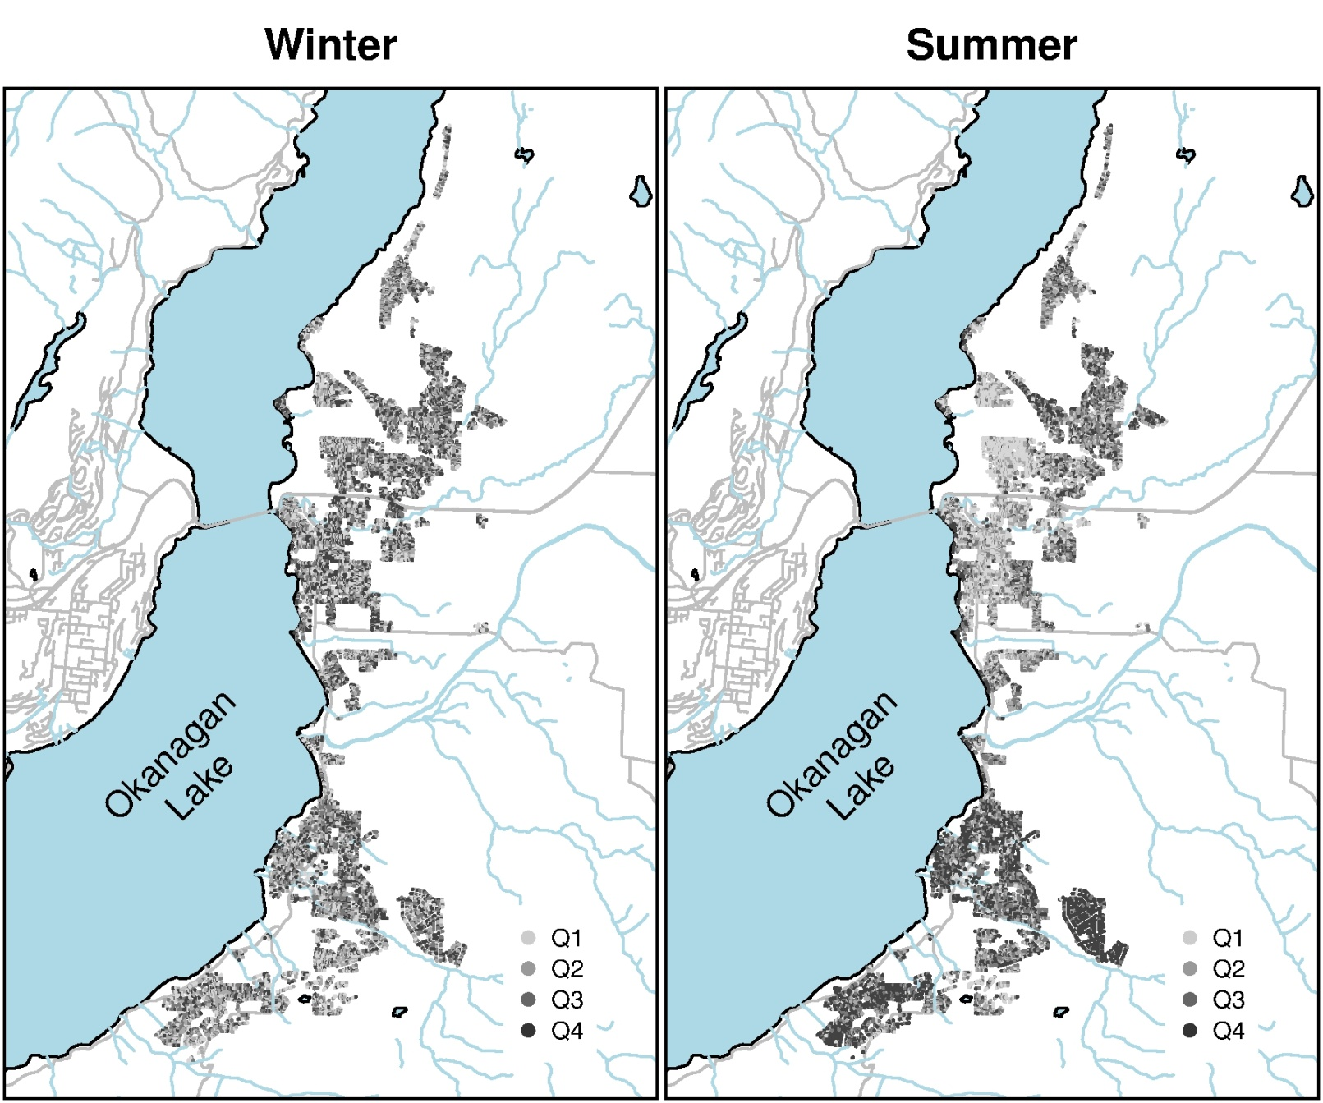
Spatial Patterns
In Summer, people seem to act like their neighbours.
Are they mimicing, or are they just on similar lots?

Slide 18
Spatial Regression Results
Important variables:
Lot size, building size, presence of pool, increase water use.
Higher assessed value, more water use (income?).
Spatial effect.
Strong spatial lag.
Implied spatial multiplier.
Aggregate influence of innovations depends on location of innovations.
People seem to be influenced by what their neighbours do.

Slide 19
Money Loses!
Keep telling people, as many ways as possible, to conserve water.
Conclusions
Morals Lose!
Recognize that people learn from their neighbours.

Slide 20
Reprise
There is no magic bullet!
Metering and volumetric pricing provide people with information and reward water savings.
Subsidies for water savings investments offsets income effect – poor can afford it.
Changes in values may open people to support conservation policies.

