Slide 1
Notes:
There are lots of ways to Go Global.
Most people know about exchange, but it’s just one of the ways.
The different programs

Slide 2
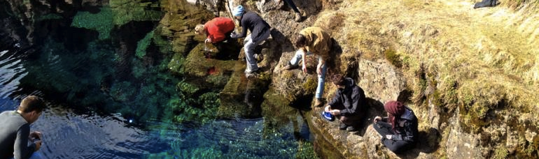
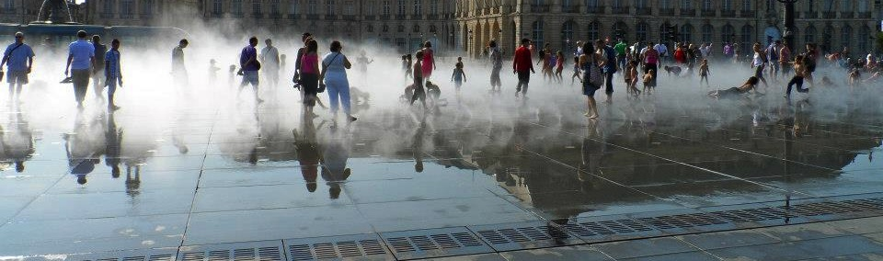


Ways to
Go Global

Slide 3
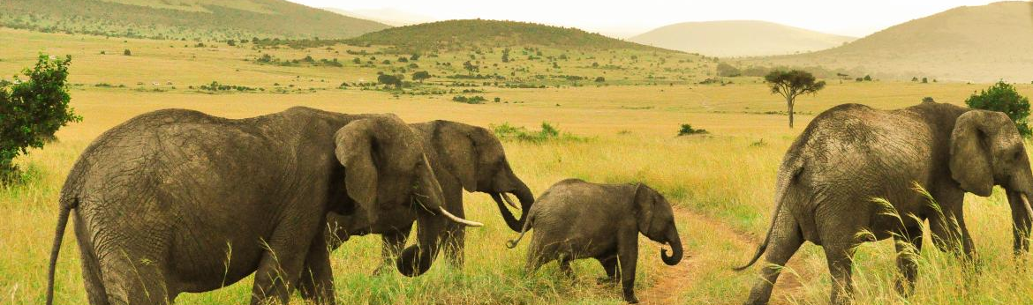
Pay tuition to UBC, stay eligible for loans + scholarships
Credits transfer back and count towards your UBC degree
Take courses or conduct research at one of 200 leading world universities

Slide 4
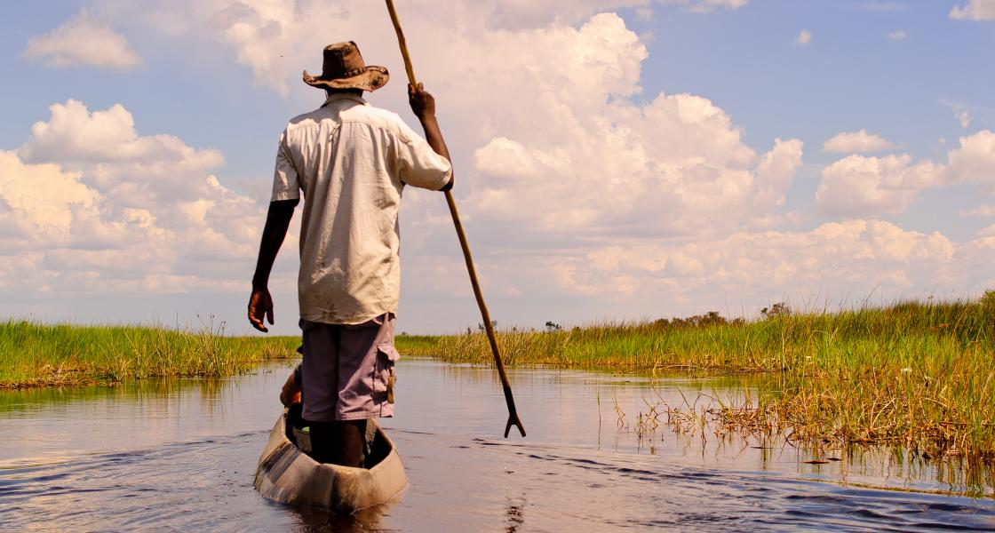
Notes:
Student story/experience

Slide 5
 | Exchange | Study Abroad | Research Abroad | International Internships | Global Seminars
What | Study at another school in the world. Transfer credits back | Study at another school in the world. Transfer credits back. Often a set of courses as part of a program | Self-directed or structured programs based on area of study | Work experience placements with organizations and universities around the world | A UBC course taught by a UBC prof in a location that highlights the content. Get UBC credit
Timing | 1 term, 2 terms or summer options | Lots of summer options, and 1 and/or 2 terms | 1 term, 2 terms or summer options | Summer | Mostly seminars run in the summer
Costs | You pay UBC tuition rates for a full course load | You pay fees and tuition to the partner university | You pay fees directly to the partner university | Costs vary. Depends on location, and whether housing is included | You pay program fees to UBC. Varies between programs, check what they include and exclude
Awards | Automatically considered for the Go Global award. Eligible to apply for other awards. | Automatically considered for the Go Global award. Eligible to apply for other awards. | Automatically considered for the Go Global award. Eligible to apply for other awards. | Automatically considered for the Go Global award. Eligible to apply for other awards. | Automatically considered for the Go Global award. Eligible to apply for other awards.

Slide 6
 | Exchange | Study Abroad | Research Abroad | International Internships | Global Seminars
What | Study at another school in the world. Transfer credits back | Study at another school in the world. Transfer credits back. Often a set of courses as part of a program | Self-directed or structured programs based on area of study | Work experience placements with organizations and universities around the world | A UBC course taught by a UBC prof in a location that highlights the content. Get UBC credit
Timing | 1 term, 2 terms or summer options | Lots of summer options, and 1 and/or 2 terms | 1 term, 2 terms or summer options | Summer | Mostly seminars run in the summer
Costs | You pay UBC tuition rates for a full course load | You pay fees and tuition to the partner university | You pay fees directly to the partner university | Costs vary. Depends on location, and whether housing is included | You pay program fees to UBC. Varies between programs, check what they include and exclude
Awards | Automatically considered for the Go Global award. Eligible to apply for other awards. | Automatically considered for the Go Global award. Eligible to apply for other awards. | Automatically considered for the Go Global award. Eligible to apply for other awards. | Automatically considered for the Go Global award. Eligible to apply for other awards. | Automatically considered for the Go Global award. Eligible to apply for other awards.

Slide 7
 | Exchange | Study Abroad | Research Abroad | International Internships | Global Seminars
What | Study at another school in the world. Transfer credits back | Study at another school in the world. Transfer credits back. Often a set of courses as part of a program | Self-directed or structured programs based on area of study | Work experience placements with organizations and universities around the world | A UBC course taught by a UBC prof in a location that highlights the content. Get UBC credit
Timing | 1 term, 2 terms or summer options | Lots of summer options, and 1 and/or 2 terms | 1 term, 2 terms or summer options | Summer | Mostly seminars run in the summer
Costs | You pay UBC tuition rates for a full course load | You pay fees and tuition to the partner university | You pay fees directly to the partner university | Costs vary. Depends on location, and whether housing is included | You pay program fees to UBC. Varies between programs, check what they include and exclude
Awards | Automatically considered for the Go Global award. Eligible to apply for other awards. | Automatically considered for the Go Global award. Eligible to apply for other awards. | Automatically considered for the Go Global award. Eligible to apply for other awards. | Automatically considered for the Go Global award. Eligible to apply for other awards. | Automatically considered for the Go Global award. Eligible to apply for other awards.

Slide 8
 | Exchange | Study Abroad | Research Abroad | International Internships | Global Seminars
What | Study at another school in the world. Transfer credits back | Study at another school in the world. Transfer credits back. Often a set of courses as part of a program | Self-directed or structured programs based on area of study | Work experience placements with organizations and universities around the world | A UBC course taught by a UBC prof in a location that highlights the content. Get UBC credit
Timing | 1 term, 2 terms or summer options | Lots of summer options, and 1 and/or 2 terms | 1 term, 2 terms or summer options | Summer | Mostly seminars run in the summer
Costs | You pay UBC tuition rates for a full course load | You pay fees and tuition to the partner university | You pay fees directly to the partner university | Costs vary. Depends on location, and whether housing is included | You pay program fees to UBC. Varies between programs, check what they include and exclude
Awards | Automatically considered for the Go Global award. Eligible to apply for other awards. | Automatically considered for the Go Global award. Eligible to apply for other awards. | Automatically considered for the Go Global award. Eligible to apply for other awards. | Automatically considered for the Go Global award. Eligible to apply for other awards. | Automatically considered for the Go Global award. Eligible to apply for other awards.

Slide 9
 | Exchange | Study Abroad | Research Abroad | International Internships | Global Seminars
What | Study at another school in the world. Transfer credits back | Study at another school in the world. Transfer credits back. Often a set of courses as part of a program | Self-directed or structured programs based on area of study | Work experience placements with organizations and universities around the world | A UBC course taught by a UBC prof in a location that highlights the content. Get UBC credit
Timing | 1 term, 2 terms or summer options | Lots of summer options, and 1 and/or 2 terms | 1 term, 2 terms or summer options | Summer | Mostly seminars run in the summer
Costs | You pay UBC tuition rates for a full course load | You pay fees and tuition to the partner university | You pay fees directly to the partner university | Costs vary. Depends on location, and whether housing is included | You pay program fees to UBC. Varies between programs, check what they include and exclude
Awards | Automatically considered for the Go Global award. Eligible to apply for other awards. | Automatically considered for the Go Global award. Eligible to apply for other awards. | Automatically considered for the Go Global award. Eligible to apply for other awards. | Automatically considered for the Go Global award. Eligible to apply for other awards. | Automatically considered for the Go Global award. Eligible to apply for other awards.

Slide 10
 | Exchange | Study Abroad | Research Abroad | International Internships | Global Seminars
What | Study at another school in the world. Transfer credits back | Study at another school in the world. Transfer credits back. Often a set of courses as part of a program | Self-directed or structured programs based on area of study | Work experience placements with organizations and universities around the world | A UBC course taught by a UBC prof in a location that highlights the content. Get UBC credit
Timing | 1 term, 2 terms or summer options | Lots of summer options, and 1 and/or 2 terms | 1 term, 2 terms or summer options | Summer | Mostly seminars run in the summer
Costs | You pay UBC tuition rates for a full course load | You pay fees and tuition to the partner university | You pay fees directly to the partner university | Costs vary. Depends on location, and whether housing is included | You pay program fees to UBC. Varies between programs, check what they include and exclude
Awards | Automatically considered for the Go Global award. Eligible to apply for other awards. | Automatically considered for the Go Global award. Eligible to apply for other awards. | Automatically considered for the Go Global award. Eligible to apply for other awards. | Automatically considered for the Go Global award. Eligible to apply for other awards. | Automatically considered for the Go Global award. Eligible to apply for other awards.

Slide 11

A PERSONAL GUIDE
What do you want to learn from exchange? List:
What do you want to see, learn and experience?
What about your goals beyond exchange?
How do these fit?
Notes:
This is your own personalize map to guide you as you navigate through the decision making process of picking a university
You’ve all had pretty significant experiential learning experiences already. Think back to your first year at UBC or maybe this is your first year. Beginning university is jam-packed with experiential learning opportunities. Ex. Learning at university v. learning in high school.
Think about some examples in your own life where you have learned from experience. In other words, you have lived through something that enable you to see things differently and as a result, changed your perspective and future actions. An international learning experience is one of those unique learning opportunities that are also jam-packed with opportunities for growth and learning through experience…
Walk through Cycle
Your learning experience does not begin when you get on or off the plane. It begins right now as your are exploring your options, continues through your preparation and beyond your return home as you make sense of that experience.
As a Go Global exchange students you will participate in a pre-departure program designed to prepare you for not only logistical preparation but your learning experience. On your return, student leaders will offer you a range of options to reconnect and continue your exchange through the returned student program.

Slide 12

SOCI recommended schools for exchange
Asia
Ewha Woman’s University
Korea University
National University of Singapore
Ritsumeikan University
University of Hong Kong
Europe
Koc University
Lunds Universitet
Sciences Po Paris
Universita di Bologna
University of Amsterdam
University of Copenhagen
Australia / New Zealand
Macquarie University
University of Auckland
University of Melbourne
University of New South Wales
England/ United Kingdom
University of Bristol
University of Edinburgh
University of Manchester
University of Nottingham
University of Sussex
Notes:
What does this mean?
Pre-articulated courses, the department has worked with Go Global to recommend these schools as academically relevant for psych students

Slide 13
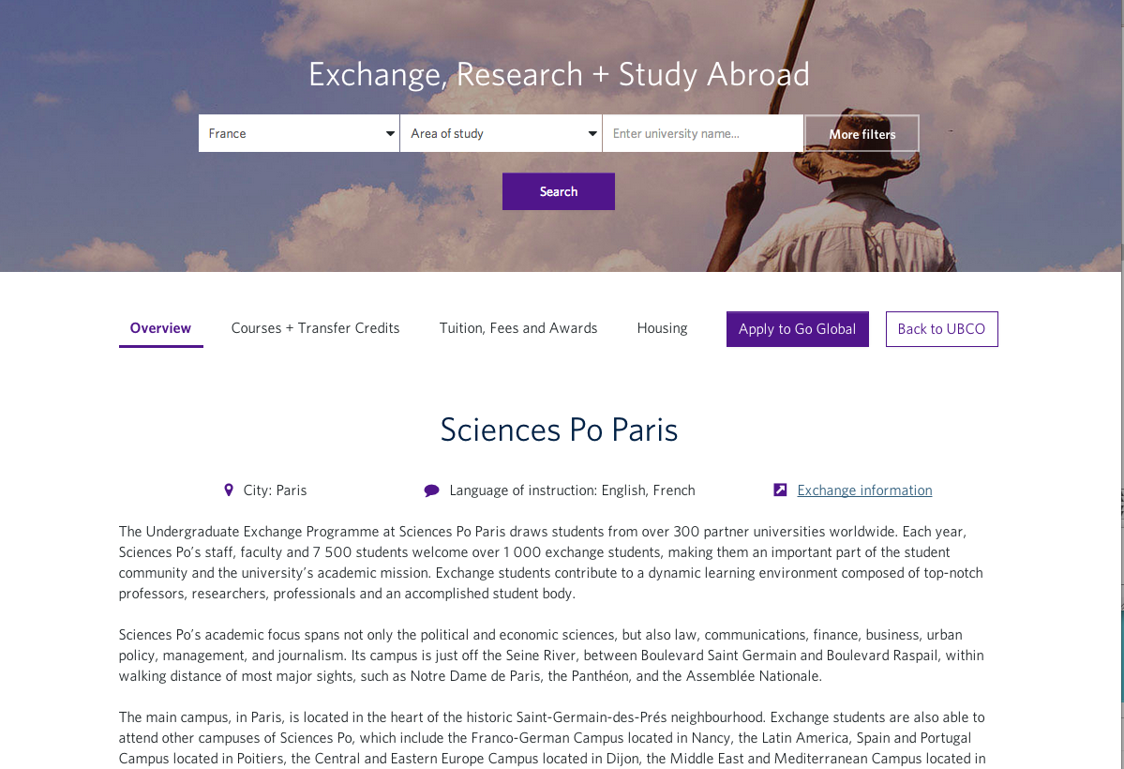

Slide 14
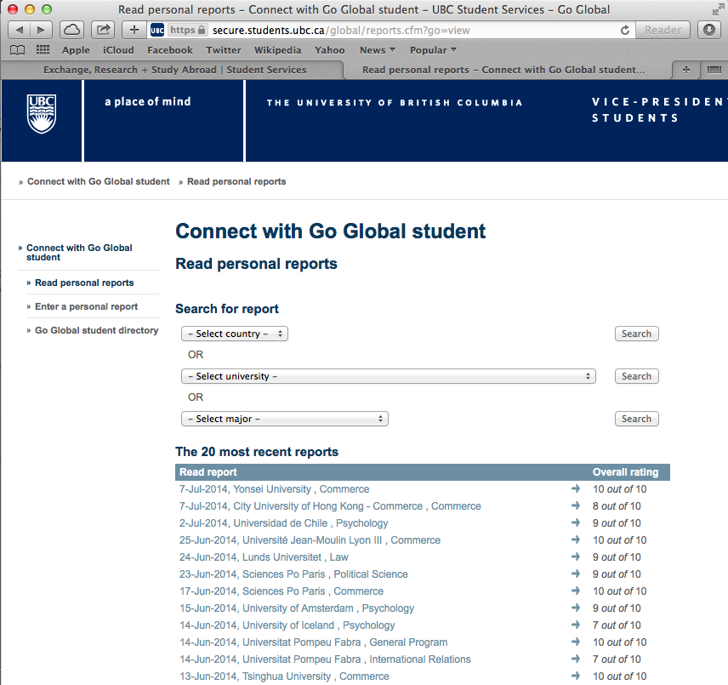
Notes:
You can access student reports from the overview section of each partner page (the purple button takes you right to the reports for that partner)

Slide 15
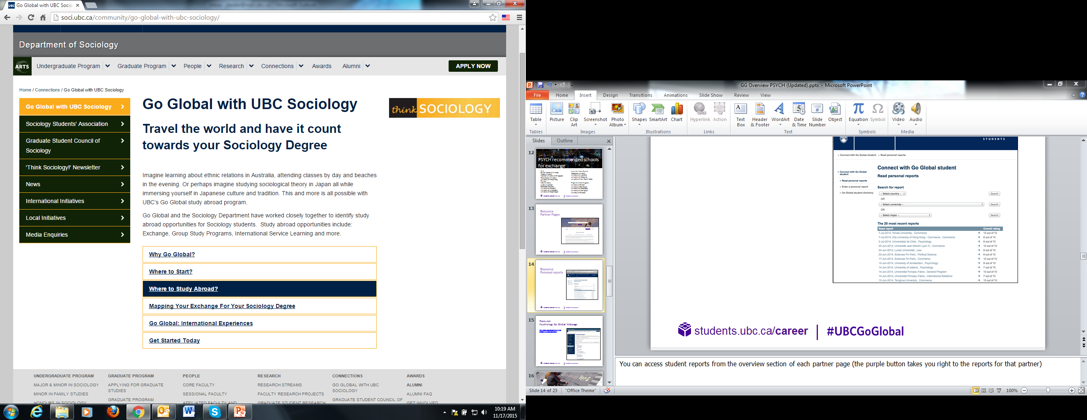
Resource:
Psychology Go Global Webpage
http://soci.ubc.ca/community/go-global-with-ubc-sociology/

Slide 16

Exchange credit can transfer as:
  Unassigned faculty credit (e.g., third-year ARTS)
  Unassigned dpt. credit (e.g., third-year SOCI)
  Specific course credit (e.g., SOCI 358)
You are expected to take the equivalent full-time course load at the partner university
and will be assessed for a full UBC 15 credits worth of tuition.
Exchange grades transfer as Pass/Fail, but transcripts with specific grades
considered for scholarships or post-graduate programs
Check out the Credit Equivalency Database on our website for guidelines on how courses transfer & talk to your PSYC program advisor once you’ve created a study plan.
Notes:
Receive credit at UBC for academic courses you take at the partner university
Your program advisor determines how the credit will be applied to your degree requirements.
Pre-approving your courses
Required for Applied Science, Land & Food Systems, Forestry, and Human Kinetics
Recommended for Arts and Science students seeking credit for a specific course

Slide 17
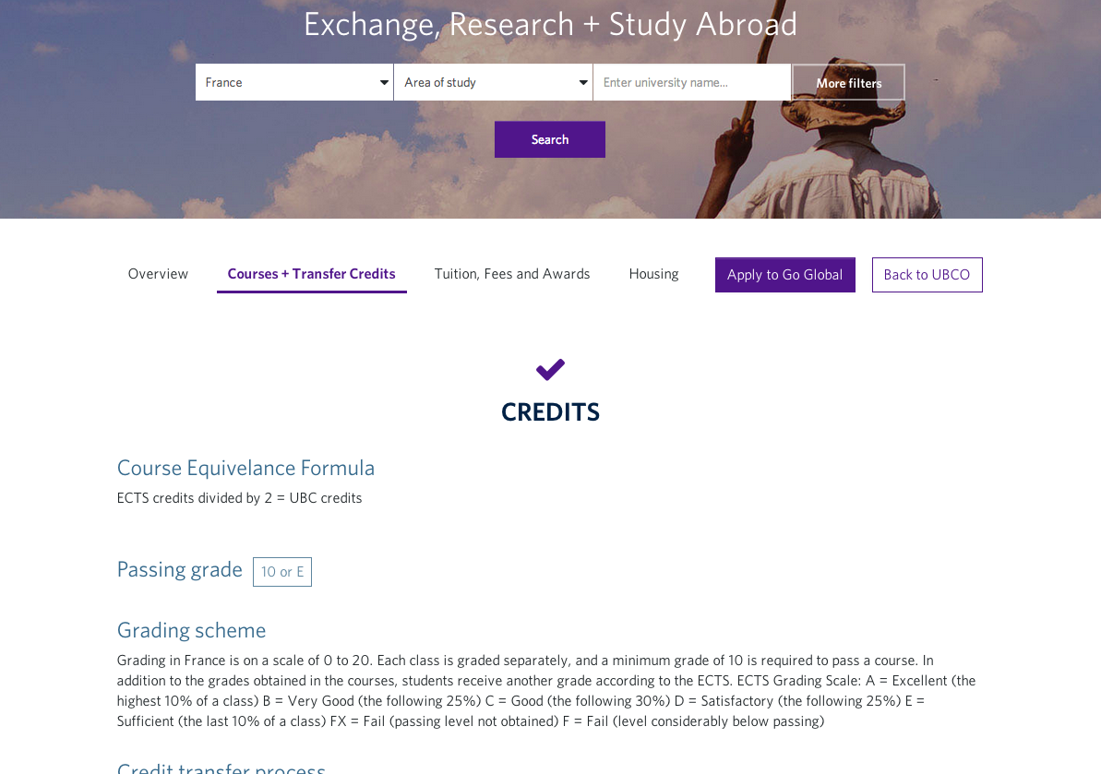
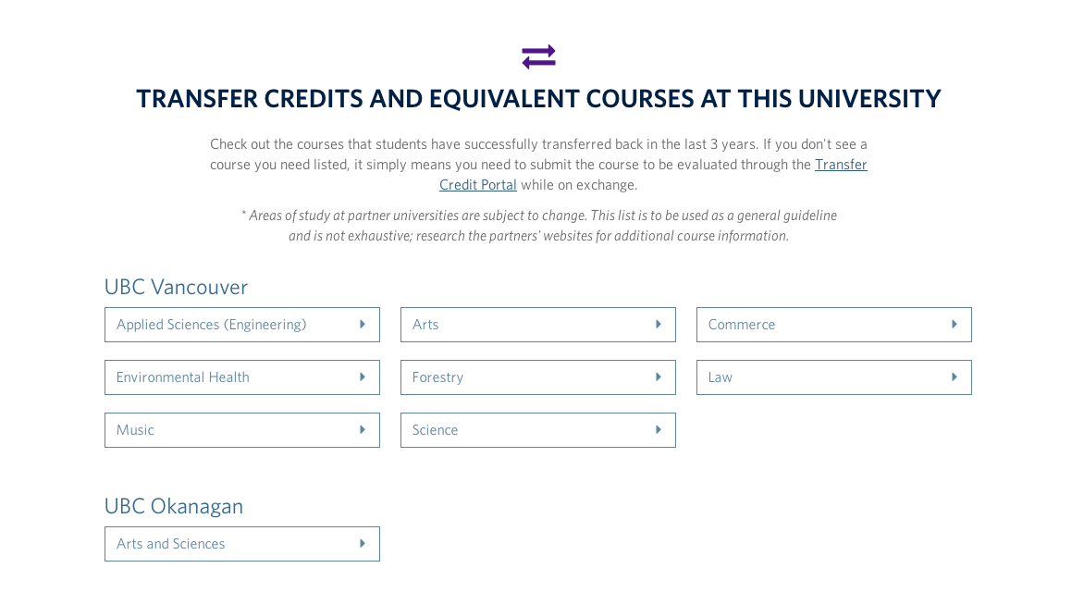
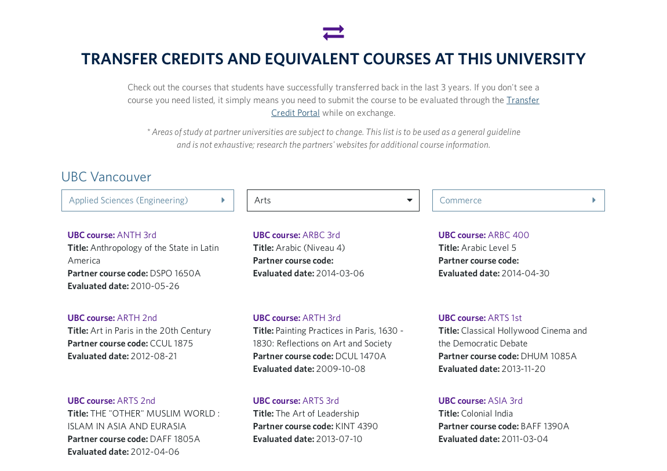

Slide 18

Have a 70% average the year that you apply
Be a full-time student in good standing in your faculty
Have completed at least one year of study at UBC before you leave
Arts and Law students can go in their 2nd year
Arts students must satisfy their 1st year English requirement before departing
Grad students must be in good standing in their program and have approval from their graduate supervisor
Notes:
Term 2
Split year February – November
Application deadlines for full year, Term 1, and summer will be announced in September
Dates vary depending on the partner university.

Slide 19

DECEMBER 10, 2015
United States of America
Japan
Iceland
Katholieke Universiteit Leuven
Technische Universitat Darmstadt
JANUARY 21, 2016
Asia, Africa, Australia, Canada, Europe, Latin America, New Zealand, UK & Ireland

Slide 20
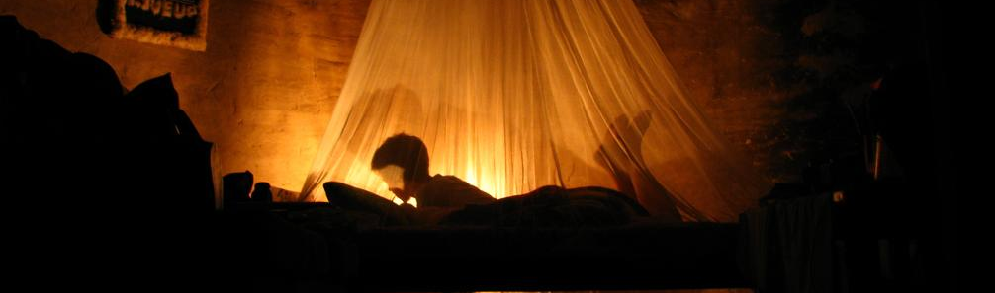
UBC annually administers over $1.4 million in international learning awards.
You are automatically considered for many of the awards when you apply.
Most students leave with at least $1,000, some with up to $10,000
In most cases you remain a UBC student and are eligible for UBC awards, scholarships, and financial assistance.

Slide 21

Go online: students.ubc.ca/career/international-experiences
Explore your degree program requirements and see which Go Global best meets your needs
Come to International House to get your questions answered by someone at the front desk, or by an advisor
Review ‘how to apply’ (takes 1-2 months to gather some of the supporting documents)
Apply!

Slide 22

Notes:
Questions

