Slide 1
Sustainable scholarly communication. Is it possible?
A view from a provost’s office
Daniel Greenstein, Vice Provost, Academic Planning and Programs, University of California
March 21, 2010

Slide 2
I want to tackle this question from the purview of the institution – the university or maybe the college

Slide 3
And amend the question to ask…
…about the investments the university needs to make in scholarly communication:
to support the creation, production, and dissemination of knowledge and
to advance its tripartite research, teaching, and service missions
How can those investments be made in a sustainable way

Slide 4
The university or college is the unit of analysis here…
…because it is the organizational entity that is
principally responsible for sustaining our system(s) of scholarly communication
the employer both of the producers and the consumers of scholarly knowledge
it is through this organization that funding flows into vehicles that support the production and dissemination of that knowledge

Slide 5
I am self consciously NOT asking
About the future of the university’s library or its presses or its information (IT) services
  in the age of Google, WorldCat, rapid consolidation in the academic journals and databases markets, declining monographs sales, the challenge of e-books, of outsourced information services (gmail, Peoplesoft, RSmart)
They all form part of the university or college reprsenting its investment in and in service of scholarly communication (a fact we sometimes forget)
To think sustainably about the university’s investment in scholarly communication, we need to look across, and plan across and budget across their top(s)

Slide 6
So the future of a university’s library, press, IT organization, museums
ought properly reflect choices made at a broader level about the university’s mission and the strategic choices and frankly quite difficult trade-off decisions that will be taken to advance it through its investments in scholarly communication

Slide 7
Why this is necessary is the focus of this talk
How to pull it off, I leave to you

Slide 8
But first a word about the financial context in which sustainability will be sought

Slide 9
It will not be sought with all the university’s dollars – only with those “high-value funds” that also support instruction and our Professors of Celtic Poetry, Chemistry, and Economics
Revenue by Source, 2003-04 to 2007-08

Slide 10
And those dollars are going to be highly sought after as we fundamentally transform the university’s financial model
Budget gap projections for the University of California. Showing all costs / total costs and assuming annual state augmentations and fee increases of 4% , respectively, beginning 2011-12
Notes:
Here the earlier model (showing the increase in costs due to obligations and Regental priorities) is modified to include assumptions that the State will increase funding for UC by 4% annually and that the University will raise student fees by 4% annually beginning in 2011-12. These increases in revenue would reduce the earlier budget gap of $4.9 billion to $2.9 billion.
Note: Expenditures in this scenario are higher than the earlier model due to additional financial aid expenditures related to fee increases.

Slide 11
To address a long-term secular trend
CA state support for UC has declined 51% over 19 years
  Per-Student Average Expenditures for Education from Student Fees and General Funds
  (2009-10 Dollars)
$16,430
State General Funds
$7,570
$6,330
Student Fees
$2,630
Student fee amounts are net of financial aid.
Notes:
Since 1990-91, average inflation-adjusted (HEPI) expenditures for educating UC students declined by 25% due to the erosion of State support.
The State’s share of per-student expenditures plunged steeply — by 54%.
Over this period, the student share, net of financial aid, has more than tripled, from 13% to 40%.
The University is rapidly approaching a time when the State’s contribution for UC students will be lower than the contribution made by the students themselves.

Slide 12
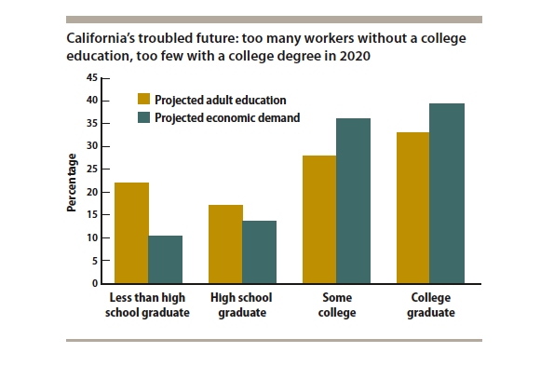
While meeting growing demand for higher education

Slide 13
My approach to this question is tripartite and, I’m afraid, ruthless
What does the university need from its investment in scholarly to advance its mission
Of that how much can be put off onto fund sources other than those that support core instruction
Can we leverage any part of that investment to address the revenue side of the equation
So… some desiderata and then a bit about their implications

Slide 14
The University needs persistent access to the information scholars and students need for research, teaching, and learning

Slide 15
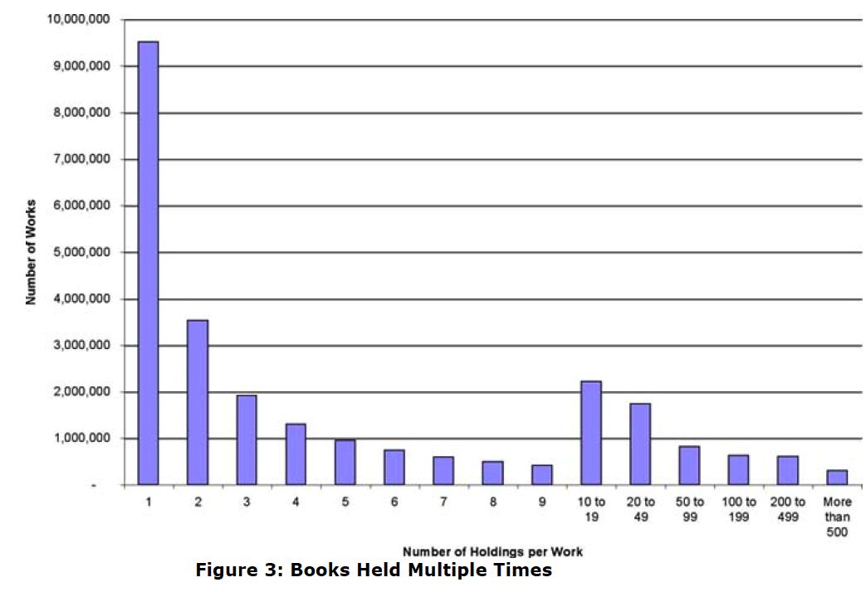
From this purview and in a digital age redundant management of print is insane

Slide 16

So by the way
is the starvation of the special and unique in favor of the general and redundant

Slide 17
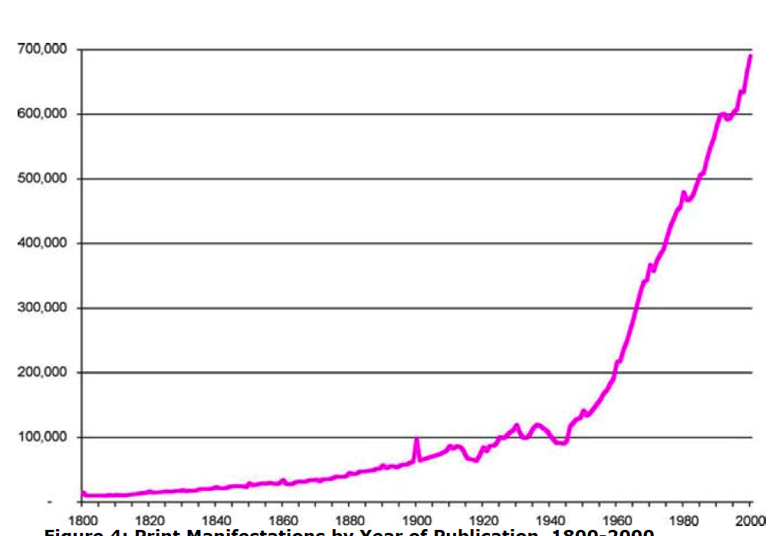
E-books hold forth enormous promise

Slide 18
Expenditure on open access publications doesn’t make sense unless…
…it is made from the university’s collections budgets and grows in direct proportion to the reductions achieved in more traditional subscriptions

Slide 19
On other digital collections?
Okay, so I get it

Slide 20


…when we are managing digital as a means of controlling costs and guaranteeing access to what was once, wholly in print…

Slide 21


…or in response to the well articulated needs of particular scholarly communities which organize resources necessary to support…
Surely our support for these activities flows through university collections budgets and reflects vigorous and well informed trade-off decisions

Slide 22
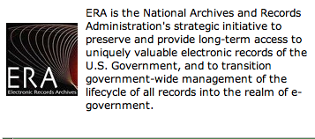
…or in response to a legal mandate

Slide 23


…and we value as anyone must those patrons of our academy…
Individuals and institutions who have emerged as 21st century de Medicis
And believe it or not, I can also identify incentives for a university or college to join in their ranks, recognizing that belonging draws on scarce funds and detracts directly from instruction in anthropology
I will return to this point in a moment

Slide 24
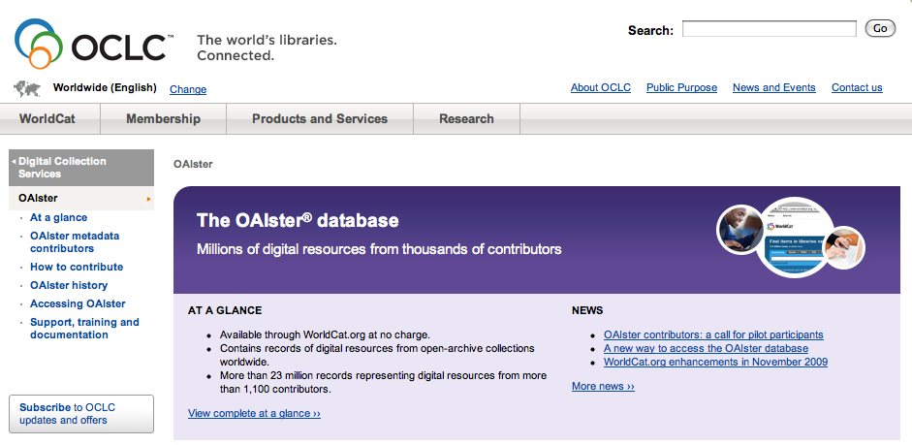
I am far less comfortable with our “cabinets of curiosities”

Slide 25
They are all of them wonderful, elegant and worthy in their way
but also, each of them mounted in response to demand on the supply side
to surface worthy and important and high quality information

Slide 26
In a university
These are not criteria that enable selection or the trade off decisions essential in a financially constrained environment
They don’t leave you any wiser about what not to digitize, distribute, support

Slide 27
So we either clean our all our cabinets (turn off funding for them) or…
identify, as an institution, very good reasons selectively to invest in some but not others.
And here we are looking for reasons that are
attached to our institution’s strategic plan
AND
That are grounded in some well articulated business model – even it is is the well known philanthropic one (itself a trade off)

Slide 28
Who makes that call on your campuses, I wonder?

Slide 29
And we need to support our faculty and students in their discovery, creation, and dissemination of knowledge
Now, perhaps more than ever

Slide 30
But I want to look comprehensively across the need for that support…
…than I can at present when responsibility for it is so fragmented
I want to know that scarce dollars are invested where the need is greatest and in a way that advances the institution’s strategic mission
My guess (but it is only a guess) is…

Slide 31
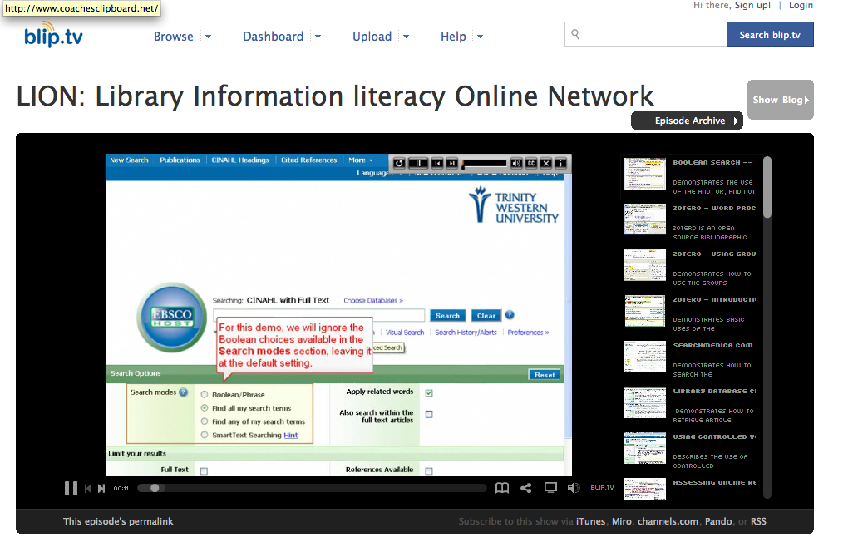
…that demand for “traditional” information literacy diminishes substantially

Slide 32
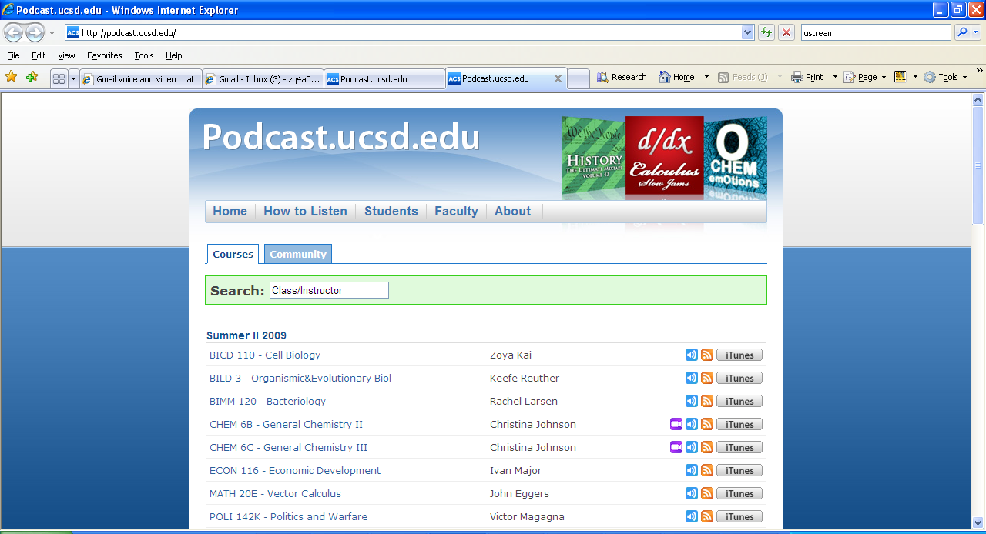
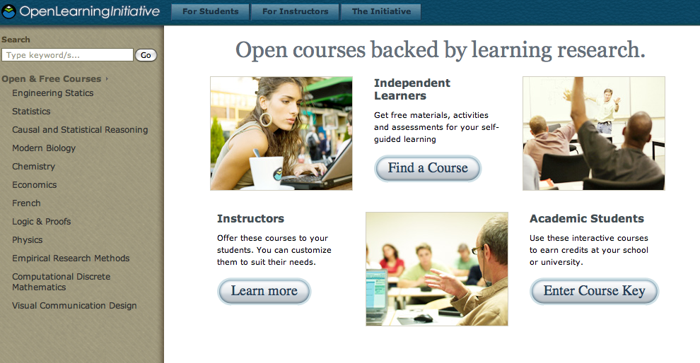
Demand for support with hybrid or online instruction is growing

Slide 33
As is demand for support with
transformative uses of technology
new forms of scholarly publishing and maybe even
some research data curation
But I would want to be very careful here too for surely this is another wall of curious cabinets?

Slide 34
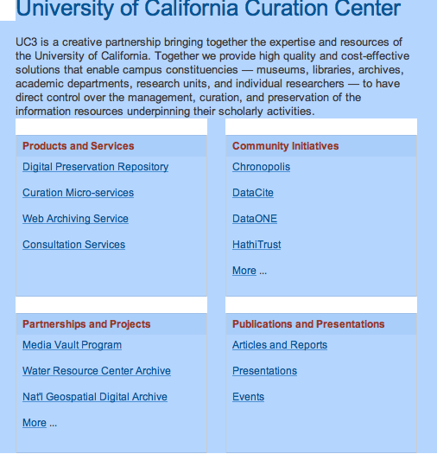
Let’s pause for a moment to consider data curation

Slide 35
So what does the university require of its investments in scholarly communication to support dissemination of knowledge?
What does it require of its “publisher”?

Slide 36
Let me sharpen focus here with three questions
And apologies if they are too brutally put

Slide 37
Question 1
If we eliminated our investments in publishing, if we closed our university presses….
…would we harm our faculty?
Don’t our faculty always have peer-reviewed outlets for their research?

Slide 38
Question 2
If we shut our institutional repositories today…
…would our faculty’s research and conference, and seminar papers, and their data, and simulations, and images – at least those destined anyway to be distributed widely via the Internet –find their way to the Internet?

Slide 39
Question 3
In light of this… is there much of a point in publishing anything?
Well… yes, but first

Slide 40
A health advisory
the following reflections are even more half baked as they are based on strategic review of the UC Press – a review that begins with the question – what does the university want/need from its publisher

Slide 41
The university may publish in the interest of discipline building and gap filling
Not in all areas of human knowledge but in a selected few areas
that make sense to the institution given its strategy and mission, its unique location, history, and discipline and research strengths
and that it can afford

Slide 42
…such focused publishing initiatives can
support scholarship
build brand
competitively position faculty
They may also sustain themselves financially

Slide 43



Choosing wisely is as much an art as a science

Slide 44
Publicly oriented publishing (aka next-gen trade publishing)…
…makes the institution’s research and even teaching outputs accessible to a non-scholarly audience
demonstrating relevance
improving advocacy
advancing a public service mission

Slide 45
If aligned with the selective discipline building and gap filling efforts
publicly oriented or next-generation trade publishing can leverage and in turn be leveraged by the more scholarly variety
Done wisely, it can begin to address the revenue side of the equation and also provide a framework that can help transform cabinets of curiosity into something with greater purpose

Slide 46
Introducing continuum publishing

Slide 47
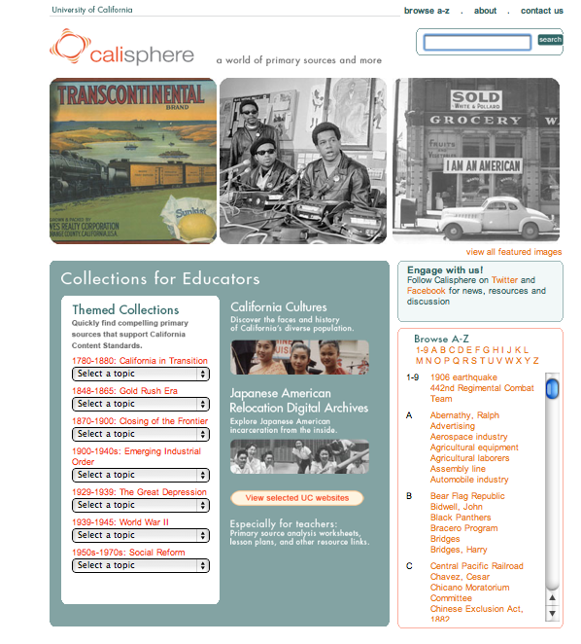
So… imagine a digital library collection – a cabinet of curiosities

Slide 48
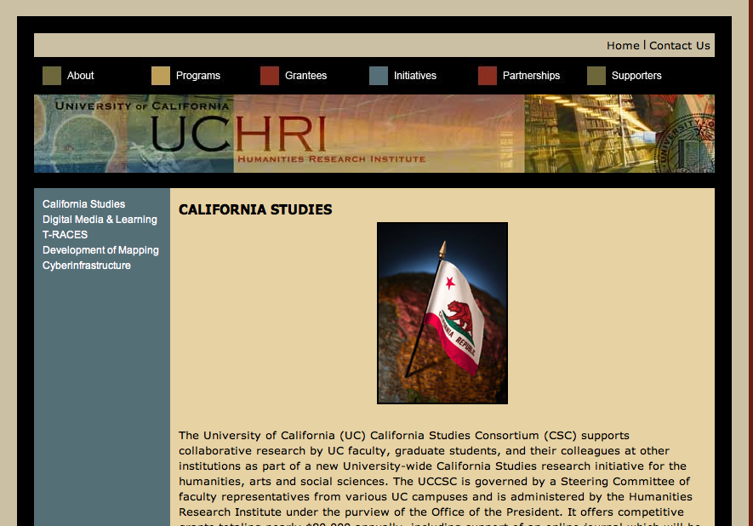
that supports and reflects the evolution of a new discipline

Slide 49
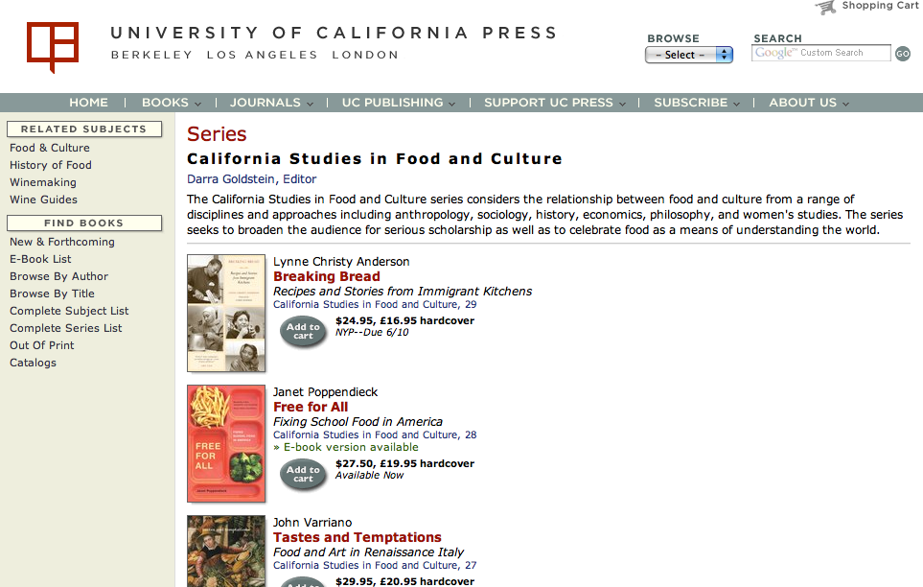
and a range of publications (revenue generating in the traditional way)

Slide 50
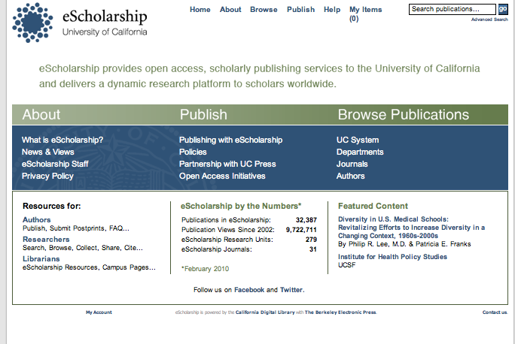
Could even be supported in part by an IR that surface content & identifies new disciplines

Slide 51
Run the same scenario, focusing on a science discipline
selected because it is an area of university research strength
that can be brought to bear on issues of interest publicly, regionally, and politically

Slide 52
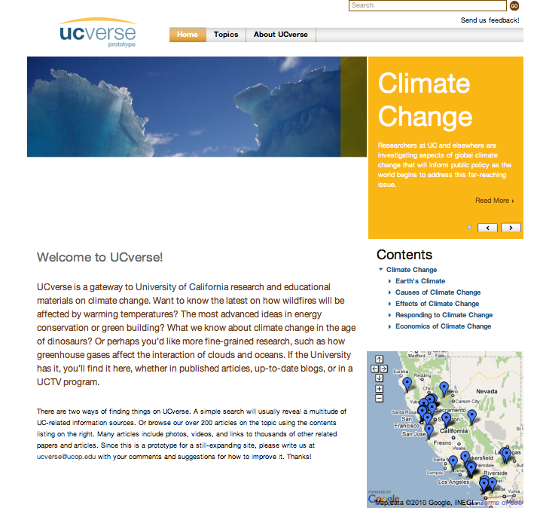

Slide 53
This focus for continuum publishing promises to
improve external relations
orient metadata harvesting, IR and even data repositing efforts
orient revenue-generating trade publications
potentially support revenue-generating relations with research funders and industry

Slide 54
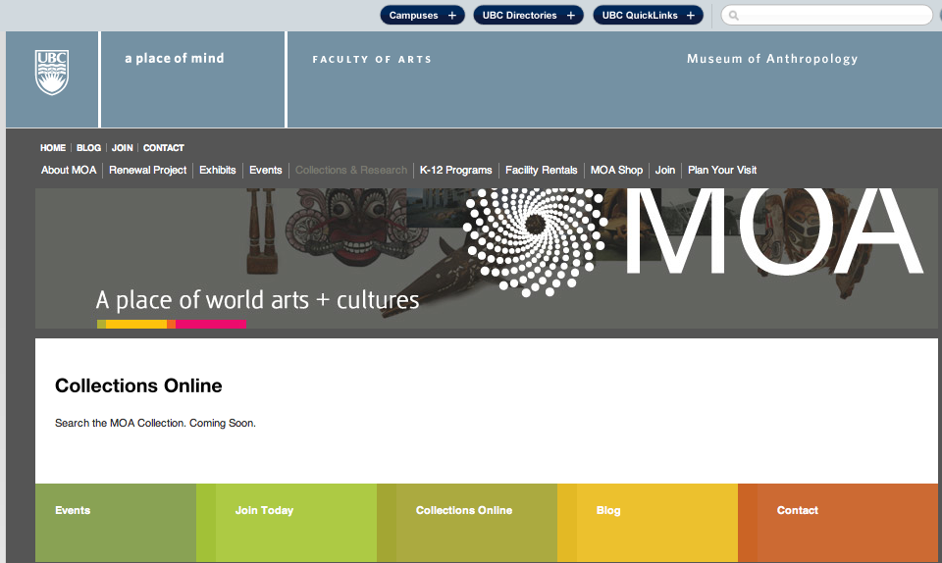
Imagine a museum collection that is digitized

Slide 55
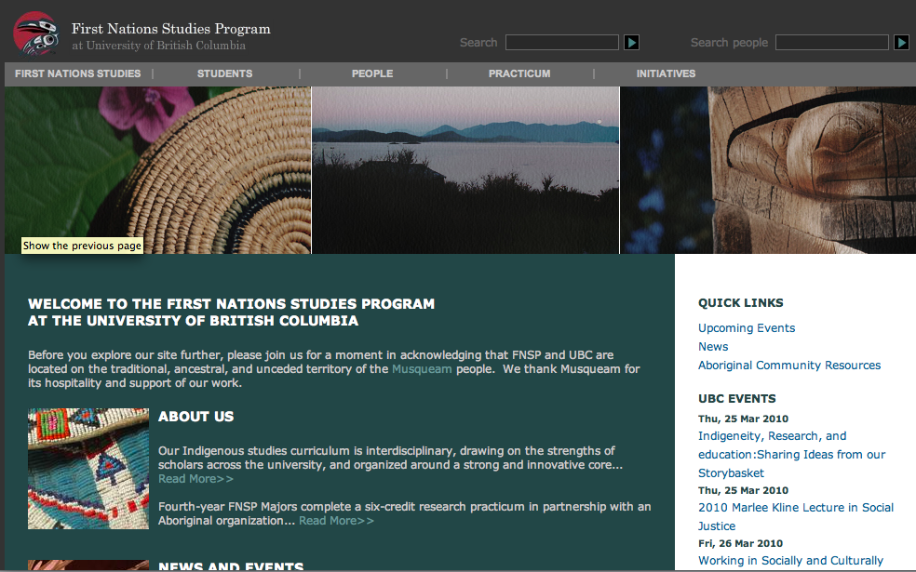
to reflect and support an area of research strength

Slide 56
This approach to continuum publishing promises to
leverage and at the same time build brand internationally for an institution
create a market for research, educational, and general audience publications
open out onto whole new areas for scholarship and crucially
advance cultural understanding and respect

Slide 57
Some further reflections on organizational and business issues

Slide 58
Organizational forms that we know and love make less sense
as historic functions (of libraries, presses, and other information services) are performed at the network level
they bump into each other (info lit) and can
Result in uncoordinated competing investments (e.g. “publishing services)
in services or platforms that aren’t rationally provided in house (repositories, web 2.0, harvesting) or
in content that has

Slide 59
The university begins to look for
a uniform strategy to guide related investments of scarce “high value” funds
and difficult trade-off decisions in an appropriately and broadly scoped field of choices

Slide 60
It wants to see
a range of business models in use (from the philanthropic to the revenue generating) optimizing their implementation to reduce pressure on scarce “high-value” funds
and someone able finally to make the call

Slide 61
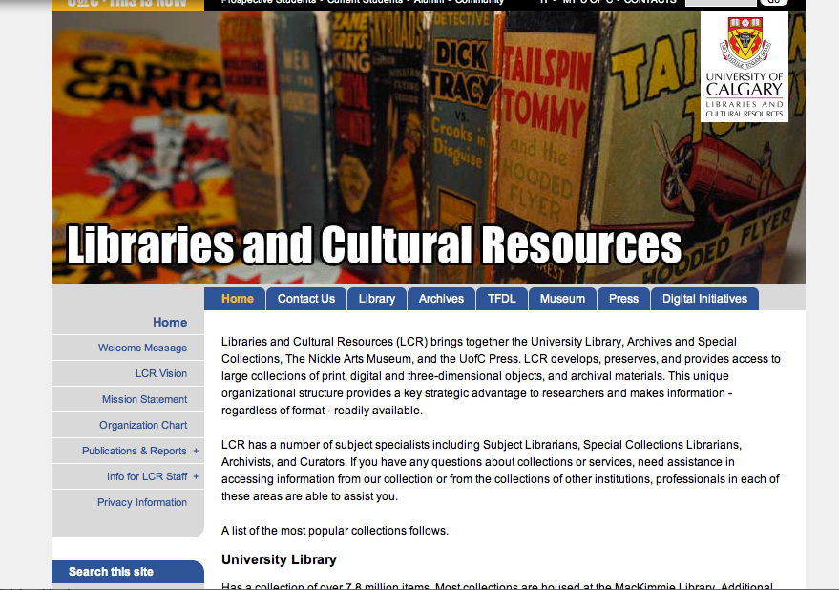
The move to integration is not entirely unknown

Slide 62
The university also looks for ways to reduce cost in everything…
And may exhibit a preference for outsourcing or collaboratively developing parts of the scholarly communications infrastructure that incurs cost without adding distinctive value
Examples might include
print repositories
technical services
publishing platforms

Slide 63
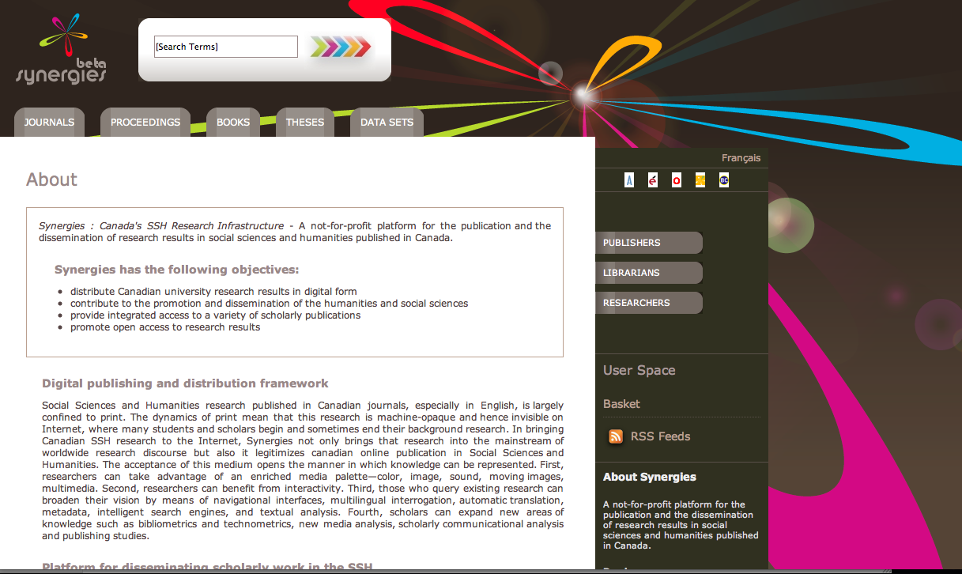
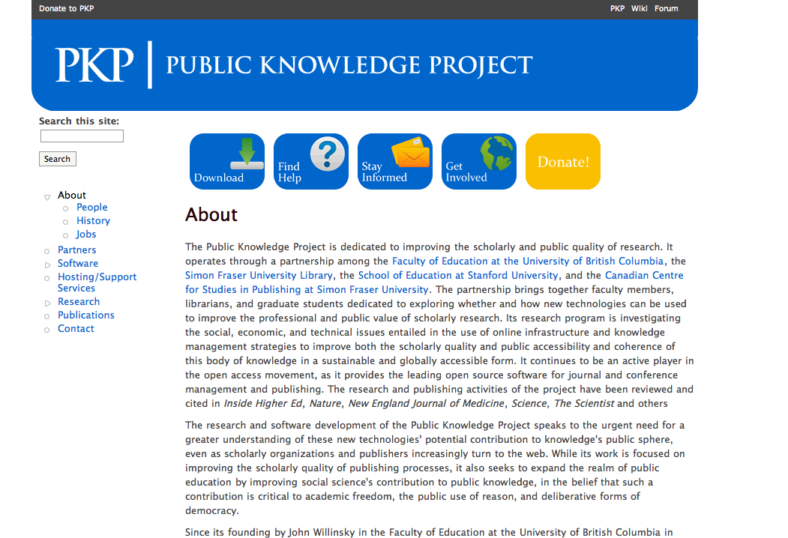
This opens up opportunities for some to offer services as third parties, but the market is only so big

Slide 64
And finally… the university will recognize and begin to address the limits of collaboration

