Slide 1

“If Picasso had painted a round object..”
Part A “Creating” | Talk 1
Video Game Law 2013
UBC Law @ Allard Hall
Jon Festinger Q.C.
Centre for Digital Media
Festinger Law & Strategy LLP
@gamebizlaw
jon_festinger@thecdm.ca

Slide 2
Origins & Intro
5 years taught
Originally a book; but a course outline before a book..
2005/2006 UBC/UVic video experiment
This year – started from scratch
Video Game Law: Unique area? Digital Media catch-up?
Relationship to Media & Entertainment course – physics analogy – Newtonian to string theory
Will not quote from “Video Game Law”

Slide 3
Are Video Games a “ Mass Media” (& does it matter)?
D.L Shaw, “The Rise and Fall of American Mass Media: Roles of Technology and Leadership”, April 1991 “Roy W. Howard Lecture” Indiana University.
Some conclusions:
“No medium, once it has lost it’s dominant position has ever returned to the top”
“Audience choice, made possible by modern technologies, has made the concept of “mass media” obsolete; and audiences are not necessarily loyal, exercising choices when available to obtain information and entertainment in the most efficient way possible.”
“Historically mass media seem to play the role of Trojan Horse to social change. That seems to be an effect of evolving communication technologies.”
Limitation – does not foresee audience as creator

Slide 4
Video Game Leadership
Firsts & furthers as well as barriers broken:
interactivity (multiplayer “Spacewar”)
“Control” – voice, mouse to Kinect to Google Glass
On-line “community”
social
voice over IP
open world
avatars (zeitgeist, memes, identity & equality)
3D
Virtual reality
Portability (handhelds)

Slide 5
What is a game?
Roots in play (fun)
+ Creativity
Always interactive
The digital journey “From documents to data“
Antecedents: comic books, pinball, D&D
Main metaphor: initiating content rather then receiving content (Television as “transmitter” to gamer as “transmitter’).
Strange thought: Gaming as Evolution (not the evolution of gaming) – The Human Legacy (1984)

Slide 6
Video games as the return of the oral narrative?
Conrad Leibel, U of Alberta student: “Mass Effect and Orality: Video Games as Transitional Literature”
http://ualberta.academia.edu/ConradLeibel
“Ultimately, video games stand as the successor of the original oral culture; revitalizing itself through the use of written text in order to make itself relatable to the player/reader yet also giving new life to the written tradition through enabling a level of interactivity between the text and reader only seen in the oral tradition……... Video games are a form of transitional literature that give new life to both written and oral traditions.”
Worth noting – the challenges to IP posed by oral storytelling cultures

Slide 7
Application of real world laws to virtual environments
Is there a virtual world?
Is WoW its own country?
Ben Duranske “Virtual Law” (2008): “This chapter will argue that the law needs to acknowledge and provide protection for virtual property, but that it must do so in a way that preserves virtual worlds and games as play spaces, at least to the extent that the developers desire their worlds to remain pure play spaces. On one hand, many game and virtual world providers seek to avoid real-life implications in their social and play spaces. Where providers take reasonable steps to draw a line between the real and the virtual, the world or game should be protected by the “magic circle” that protects other play spaces (from theme parks to family Monopoly games) from taking on inadvertent real-world implications. On the other hand, it is both inevitable and desirable that some game and virtual world designers will seek to include real money trade (RMT) and offer a real cash economy (RCE) in their platforms. Users of these platforms need the protection of virtual property law.”
http://www.amazon.com/Benjamin-Tyson-Duranske/e/B001JP104A
EULA/ToS: The “real world law” is the law of contracts.

Slide 8
Video Games: Road to Legitimacy?
“Games and Other Uncopyrightable Systems” Bruce Boyden (2011) http://www.georgemasonlawreview.org/doc/Boyden_18-2_2011.pdf
“Games therefore pose a number of challenges for copyright and patent law. Yet to date, intellectual property doctrine and scholarship has not really grappled with the slippery nature of games. Indeed, copyright has developed a very simple black-letter rule to handle them: games are not copyrightable. That rule begins to fall apart on close examination, however. It turns out that while games per se are not copyrightable, most of their constituent elements are: the board, pieces, cards, and even the particular expression of the rules. What could be the purpose of such a rule?”
Video games if art…. would attract copyright……

Slide 9
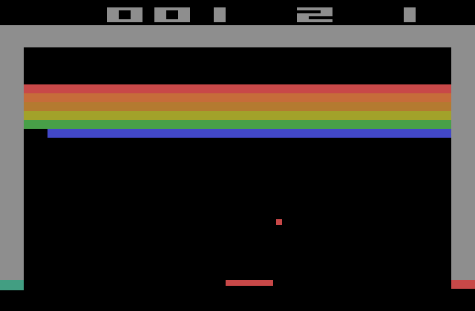
BREAKOUT
Issue: The “creativity standard” in copyright.

Slide 10
Atari v. Oman -1992 USCA
“BREAKOUT's audiovisual display features a wall formed by red, amber, green, and blue layers of rectangles representing bricks. A player maneuvers a control knob that causes a rectangular-shaped representation of a paddle to hit a square-shaped representation of a ball against the brick wall. When the ball hits a brick, that brick disappears from its row, the player scores points, and a brick on a higher row becomes exposed. A "breakout" occurs when the ball penetrates through all rows of bricks and moves into the space between the wall and the top of the screen; the ball then ricochets in a zig-zag pattern off the sides of the screen and the top layer of the wall, removing bricks upon contact and adding more points to the player's score. Various tones sound as the ball touches different objects or places on the screen. The size of the paddle diminishes and the motion of the ball accelerates as the game is played.”
District court judge asked counsel for the Register, "If Picasso had painted a round object on a canvas, would you say because it depicts a familiar subject--namely, something that's round--it can't be copyrighted?”

Slide 11
Irony 1
While eligibility for copyright meant a certain legal recognition…..
…it brought with it the limitations of IP law
Impact on mods, genre issues etc….
Deeply related: Query how the interactive nature of the “art” impacts its “ownership”…..
…..Stern v. Kaufman (1982 USCA) – “Scramble” knockoff case – “kitchen sink” arguments included that “each play of the game is an original work because of the player’s participation.”

Slide 12

Irony 1 (con’d)
The Problem with Stern
Defendants point - that player participation meant no “fixation” = Scramble not protected.
Court rejected argument. Found “Someone first conceived what the audiovisual display would look like and sound like. Originality occurred at that point.”
Consider since that time: 1.massively multiplayer; 2. open world; 3. (effectively) crowd sourced; 4……

Slide 13
Irony 2: Legal Recognition May Not Equal Respect
Easier to target, censor & oppress the disrespected (symptoms):
Refrain of blame without causality?
Based on belief not data?
Related to being “different”?
Related to being “new” (technology)?
Virtual guns more to blame then real ones???
Double standard issue: methodology to measure impact of video games on disposition to violence also to be equally applied to High School Football, ROTC etc.

Slide 14
Next Class
Why expression/speech are not paramount.
Are the real censors legal concepts we might not at all expect…

Slide 15
Our Academic Partners

