Slide 1

John Milton Plays Grand Prix Legends:
Legal Constraints on Digital Creativity
Part A “Creating” | Talk 2
Video Game Law 2013
UBC Law @ Allard Hall
Jon Festinger Q.C.
Centre for Digital Media
Festinger Law & Strategy LLP
@gamebizlaw
jon_festinger@thecdm.ca

Slide 2

Follow-up on Talk 1: (a)
Gaming as having an evolutionary purpose in the Darwinian sense?
Dr. Kimberly Voll (CDM/UBC) – From “Game Design” – DMED 521:
1. “neurons that fire together, wire together” (Donald Hebb, aka “Hebbian Learning”)
2. “..so “fun” seems to be something our brains use to keep us doing something to the point of mastery…makes sense if it is something that will help us live better and get our genes out into the gene pool again…”

Slide 3
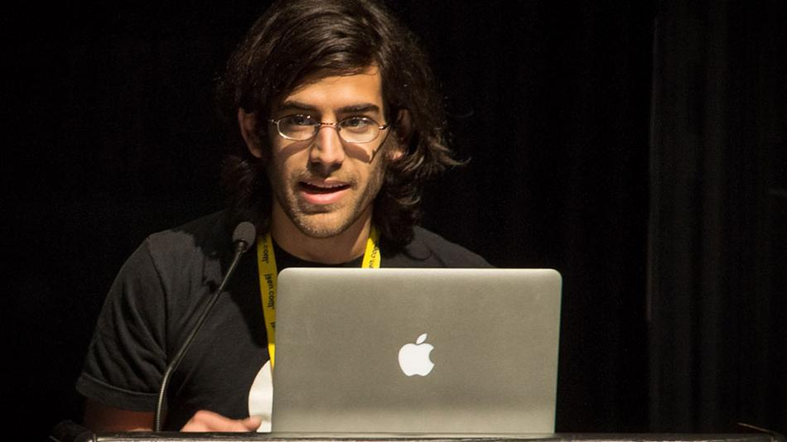
Follow-up on Talk 1: (b)
Video Games: Road to Legitimacy?
Fraught with “be careful what you wish for”: With legal legitimacy (Atari v. Oman) came many confusing and challenging consequences as a result of game creation moving from the garage to the Boardroom.
Hacktivist Aaron Swartz tragedy: the consequences of actions being taken (too?) seriously.
Prosecutor: “Stealing is stealing whether you use a computer command or a crowbar, and whether you take documents, data or dollars. It is equally harmful to the victim whether you sell what you have stolen or give it away.”
Paper? - Case in Canada given CCCode & SCC Pentology….

Slide 4
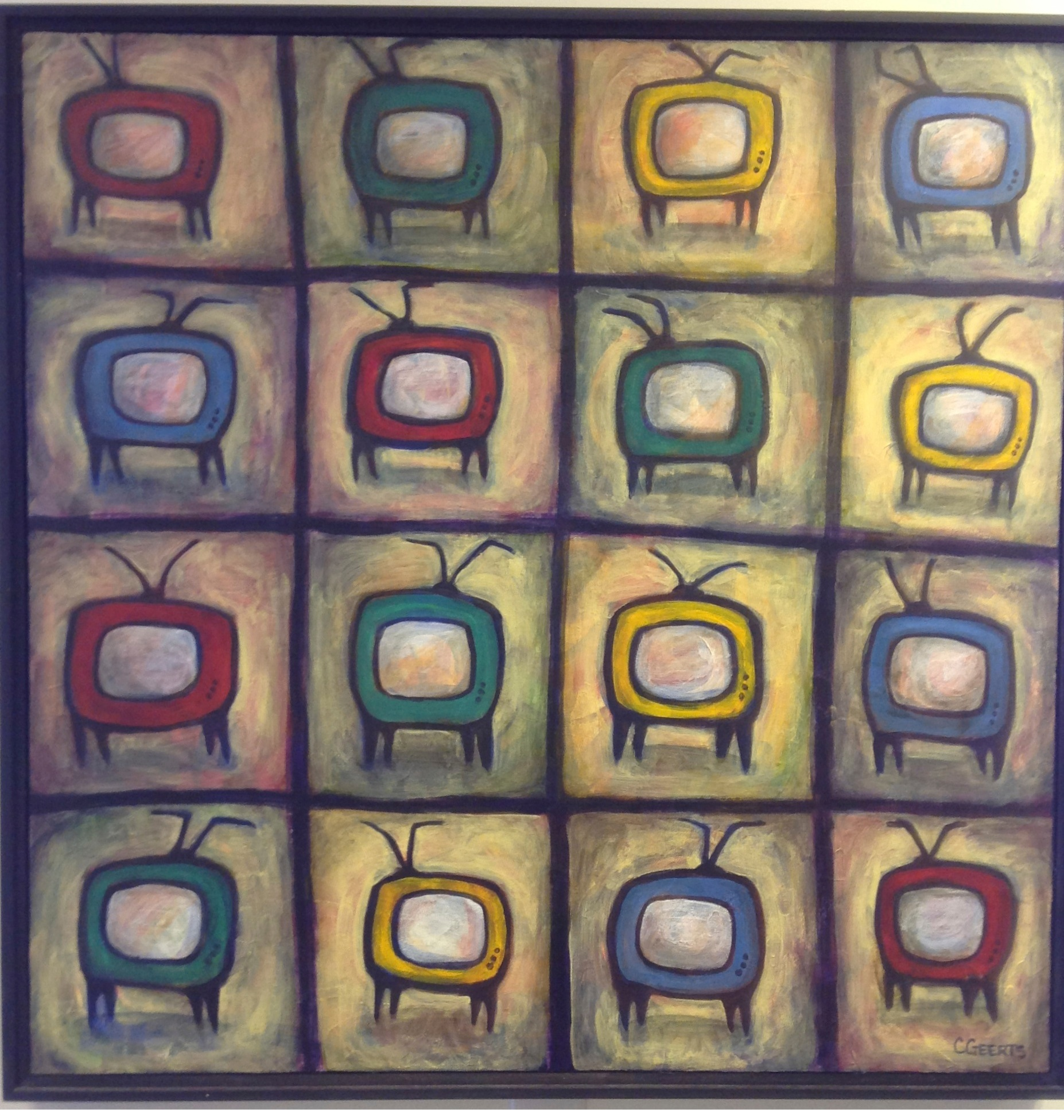
“..and now back to our regularly scheduled programming…..”
Last weeks final slide was:
“Next Class
Why expression/speech are not paramount.
Are the real censors legal concepts we might not at all expect…”

Slide 5
John Milton’s Principles
Areopagitica: A speech of Mr. John Milton for the Liberty of Unlicensed Printing to the Parliament of England (1644) by John Milton (“Paradise Lost”) John against censorship - which was ignored.
* Information “cannot defile…if the will and conscience not be defiled.”
“who ever knew Truth put to the worse, in a free and open encounter.” (Marketplace of Ideas)
* Evil manners “were perfectly learned” long before the printing press was invented.
* Criticizes those “who imagine to remove sin by removing the matter of sin.”

Slide 6
Charter of Rights (Canada)
1. The Canadian Charter of Rights and Freedoms guarantees the rights and freedoms set out in it subject only to such reasonable limits prescribed by law as can be demonstrably justified in a free and democratic society.
2. Everyone has the following fundamental freedoms:
(a) freedom of conscience and religion;
(b) freedom of thought, belief, opinion and expression, including freedom of the press and other media of communication;

Slide 7
U.S. Constitution, 1st Amendment
“Congress shall make no law respecting an establishment of religion, or prohibiting the free exercise thereof; or abridging the freedom of speech, or of the press; or the right of the people peaceably to assemble, and to petition the Government for a redress of grievances.”

Slide 8
The Usual Suspects
Winters v. New York, 68 S. Ct. 665 (U.S. 1948)
Interstate Circuit, Inc. v. Dallas, 88 S. Ct. 1298 (U.S. 1968)
Brown v. Entertainment Merchants Association, 131 S. Ct. 2729 (2011)
Montreal v. Arcade Amusements Inc., [1985] 1 SCR 368
R. v. Towne Cinema Theatres Ltd., [1986] S.C.J. No. 24 (SCC)

Slide 9
Legal Constraints on Digital Creativity:
Introductory Typology
Freedom of Speech/Expression measured against (?):
1. IP Law (copyright etc. – “user rights”)
2. Tort law (negligence > “causality”)
3. Privacy (& consumer protection – but mostly a contractual right)
4. Contract Law (& consumer protection)
5. Criminal/Societal Protection Laws
(obscenity > regulatory regimes > ratings)

Slide 10
Legal Constraints on Digital Creativity:
Advanced Typology
Freedom of Speech/Expression measured against (?):
Right to CREATe?
(includes right to mod, remix, machinima etc…)
Is there one?
As “speech”, “expression”, “thought”, “opinion”?
Implicates legal question of status of “un-enumerated rights”
“User Rights”: copyright defense or independent right?
Itself - Universal Declaration of Human Rights - Articles 18 & 19: freedom of thought, opinion, expression (tautological?)

Slide 11

Closest to establishing a “Right to CREATe”?
“Girls Lean Back Everywhere: The Law of Obscenity and the Assault on Genius” - Edward De Grazia

Slide 12
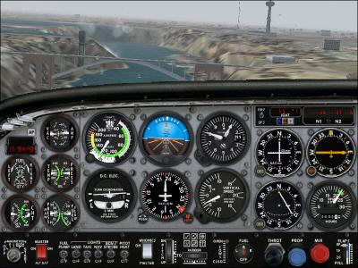
So much for fly-overs…..
The terrain can get obscured by the instruments and it can be hard to see…..

Slide 13
Reconciling creativity & responsibility
What is an idea?
When is it expressed? (fixation?)
What rights attach to the expression?
What responsibilities attach to the expression?
Concepts of “ownership/property”:
Bug or Feature

Slide 14
Reconciling creativity & responsibility: current conceptual framework
ISP immunity v. expressive freedoms protection
When a carrier/provider? v. When a publisher/creator?
--------------------------------------------------------------------------------------
Right to republish: S. 230 Communications Decency Act (U.S.):
“No provider or user of an interactive service shall be treated as the publisher or speaker of any information provided by another another information content provider.”
-----------------------------------------------------------------------------------------------
“First Amendment Protection for Search Engine Search Results”: Eugene Volokh/Donald Falk (Google White Paper)http://papers.ssrn.com/sol3/papers.cfm?abstract_id=2055364
Massively multiplayer games (WoW): Is developer provider, publisher & speaker? Does it make sense to separate these rights? What standard applies (highest, lowest or other…)?

Slide 15
Freedom Conundrum A:
THE LITTERALIST DICHOTOMY
The Symptom: Seemingly opposite positioning between privacy literalists and IP literalists – Double Standards Test
Privacy literalists tend to be more “open source” / “free info”
“IP literalists” tend to be more comfortable with commercial exploitation of personal data
IS THERE A Core Common Denominator?
"Feeling" those 1's and 0's "belong" to me.
= Common approach therefore possible? (hint: could it be - rhymes with “floral sights”….)

Slide 16
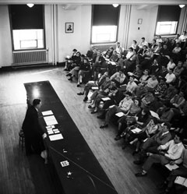
Freedom Conundrum B:
IDEA/EXPRESSION DICHOTOMY
Explanatory Paradox: The problem with law may not have anything to do with the Law
IDEA/EXPRESSION DICHOTOMY:
No IP in an idea.
Becomes IP as (fixated) expression.
Contrast this “talk” to 70 years ago:

Slide 17
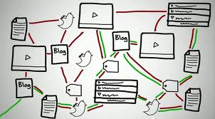
Now happens @ the speed of digital light….
Remember to post @:
http://blogs.ubc.ca/videogamelaw/

Slide 18
…..SO WHAT>>>>>>????
Conundrum A (Literalist Dichotomy) = Private v. Public
Conundrum B = Idea v. Expression
Once upon a time…a long time ago……
Private Public
Idea Expression

Slide 19
IN THE DIGITAL WORLD
idea
private
EXPRESSION
PUBLIC

Slide 20
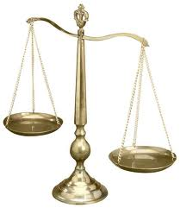
Not Failure of Law – Failure of Balance
Some Ways to Rebalance:
BY acknowledging the Right to CREATe….
Mod
Use
Share
AS PRIVATE RIGHTS OF INDIVIDUALS
User Rights = SCC “Pentalogy”
Right to Hyperlink = Crookes v. Newton (2011 SCC 47)

Slide 21


Can we (please)……
…….evolve a single standard:
For CREATORS as USERS, &
For USERS as CREATORS
…….to match reality…..

Slide 22
One more (wild & crazy) thing on freedoms..
Economic growth & IP freedoms (freedom from IP) – Where would a data-crunch take us?
“It seems simple, really” (Kevin Smith @ Duke)
http://blogs.library.duke.edu/scholcomm/2012/12/14/it-seems-simple-really/
CORRELATES STRONG ECONOMIES & WEAK IP LAWS
(BRIC – Brazil, India, Russia and China)

Slide 23
My Version
CAUTION: (entirely unscientific – gut and Google…)
1.The World Justice Project | Rule of Law Index 2012-2013 (241 pages): Highest Rankings in “Fundamental Rights” are Sweden, Denmark & Norway. Highest Rankings in “Open Government” are Sweden, Netherlands & Norway.
2. Worlds best economies in 2012 (World Economic Forum – Global Competitiveness Report): Finland (3rd), Sweden (4th) & the Netherlands (5th)
3. Global Creativity Index (Martin Prosperity Institute): Sweden (1st), Finland (3rd) & Denmark (4th)
WHAT LEVELS OF CREATIVE FREEDOMS ARE IN THOSE COUNTRIES IP/COPYRIGHT REGIMES?

Slide 24

Next Class
Now that we have creativity, content & contradictions (partially) accounted for, what is the next horizon?
Remixing in games…
Next week.

Slide 25
Our Academic Partners

