Slide 1

Right to CREATe or Rights of Creation
Part A “Creating” | Talk 3
Video Game Law 2013
UBC Law @ Allard Hall
Jon Festinger Q.C.
Centre for Digital Media
Festinger Law & Strategy LLP
@gamebizlaw
jon_festinger@thecdm.ca

Slide 2
Where Are We?
This is the 3rd and final Talk in Part A of the course under the rubric “Creating”.
Talk 1…Why & what are games…their role(s)…their road to legal recognition…& (unforeseen?) consequences
Talk 2…An introduction to legal constraints on digital (video game) creativity
Today:…(How) Can a Right to CREATe (Mod) be established?
Next class – beginning of Part B: “Connecting”
(Part C. “Controlling”, Part D. “Challenging”)

Slide 3
Follow-up on Talk 2
“Wild & crazy” (& entirely unscientific) attempt to correlate Economic Success & Facilitating Creativity but add respect for Fundamental Rights
Suggested that certain Norwegian countries (especially Sweden ranked highly in all 3 categories)
Variation on (others) correlating of strong economies & weak IP laws (BRIC – Brazil, India, Russia and China)
See: Internet freedom in Sweden (2012) Stefan Geenshttp://www.sweden.se/eng/Home/Society/Government-politics/Reading/Internet-freedom-in-Sweden--a-closer-look/ternet%20freedom%20in%20Sweden%20—%20a%20closer%20look
& A Pirate’s Life in Sweden (2011 Yale Law & Tech)http://www.yalelawtech.org/p2p-law-piracy/a-pirates-life-in-sweden/

Slide 4
Today: Right to Mod/Right to CREATe
Topic: Can these “right(s)” be established; & if so through which legal pathways?
Core of anti-mod sentiment + attitude to overcome:
“[W]e believe it is our duty to uphold the integrity of our work.”
Statement by general manager of Tecmo Inc. re action against online forum members who released mod “skins” for (among other games) “Dead or Alive Xtreme Beach Volleyball”.

Slide 5
Concepts to Reflect On (for the next hour...)
PERSONAL CREATiVITY
as part of an
INTERACTIVE ENVIRONMENT (Squared)
Same or different from books, TV, Film etc?
Same or different from sports, music etc?

Slide 6
Cases to overcome*…
Micro Star v. FormGen 1998 USCA:
Micro Star commercially sold “Nuke It” – CD Rom collection of 300 user created levels for Duke Nukem 3D
Did so without permission of community creators who had previously released those levels for free.
EULA allowing “non-commercial” mods existed between FormGen & Duke Nukem 3D purchasers.
Micro Star’s fair use argument failed.
2. Davidson & Associates, Inc. v. Internet Gateway
2005 USCA (D&A = Blizzard):
Free Battle.net community created competitor ‘bnetd”
EULA & TOU prohibited “reverse engineering”
“Blizzard” succeeds
* & one not to: Lewis Galoob Toys v. Nintendo of America 1992 USCA: “Game Genie” device allowed gameplay features to be modified (e.g. # of lives) but did not change data in Nintendo cartridge. Court found “fair use” in alternative to “no use”.

Slide 7
Cases to overcome (con’d)
3. iRacing v. Robinson (2007 Mass. Dist. Ct.):
“Nascar 2003” mod which modified the “.exe” source code file contrary to EULA.
“No CD” patch also made available by Robinson.
iRacing “wins” but Court found: “A defendant may successfully raise a fair use defense against a copyright infringement claim while still being found in breach of a contract not to copy.”
4. MDY Industries, LLC v. Blizzard Entertainment, Inc. (2010 USCA):
Blizzard used technological protection measure (“TPM” to prevent “bots” in WoW and effectively prohibited them by TOU.
MDY developed & sold “Glider” which circumvented the TPM and allowed bots into the game.
USCA affirmed Dist. Ct. finding that MDY violated DMCA’s copy control (anti-circumvention) provisions…

Slide 8
MDY (con’d): Contract not Copyright
Court in MDY reaffirmed copyright/contract distinction:
“…A Glider user violates the covenants with Blizzard, but does not thereby commit copyright infringement because Glider does not infringe any of Blizzard’s exclusive rights. For instance, the use does not alter or copy WoW software…
We conclude that for a licensee’s violation of a contract to constitute copyright infringement, there must be a nexus between the condition and the licensor’s exclusive rights of copyright. Here, WoW players do not commit copyright infringement by using Glider in violation of the ToU. MDY is thus not liable for secondary copyright infringement, which requires the existence of direct copyright infringement. Grokster, 545 U.S. at 930.”
EFF: “A Mixed Ninth Circuit Ruling in MDY v. Blizzard: WoW Buyers Are Not Owners – But Glider Users Are Not Copyright Infringers” https://www.eff.org/deeplinks/2010/12/mixed-ninth-circuit-ruling-mdy-v-blizzard-wow

Slide 9
Notice any common denominators?
Creativity is never in issue in any of the cases
Copyright Law is only directly relevant in Microstar (& Galoob “Game Genie”)- no contractual nexus, so sole “copyright only” case.
“Fair Use” to create mods question avoided by:
Contract Law (Davidson, iRacing & MDY all decided on EULA, ToS or ToU terms & obligations).
Nothing creative in what Micro Star did – they did not create a mod – they usurped mod creators without permission
Conclusion: No current precedent that game mods are not “Fair Use”.

Slide 10
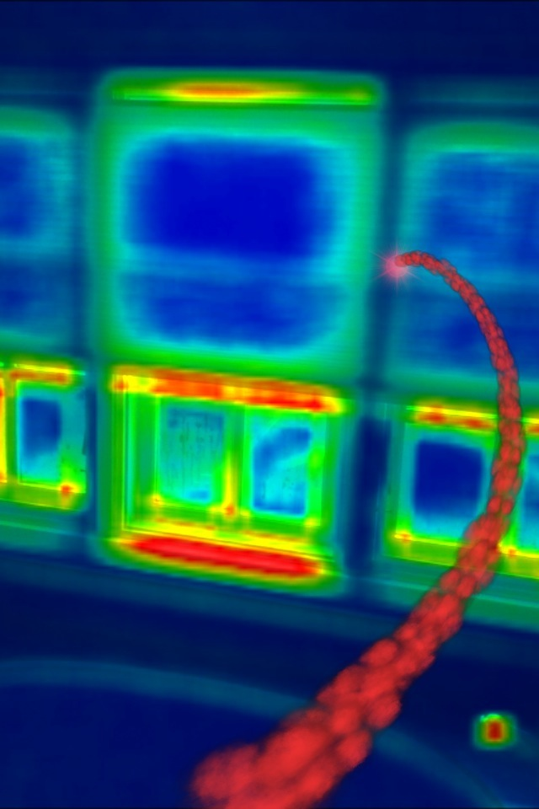
Does not mean Mods are “Fair Use”..
What is at stake?
Mods
Machinima
Fan Fiction
Re-mix
Multi-source content
& (of course) the Freedom to Create

Slide 11
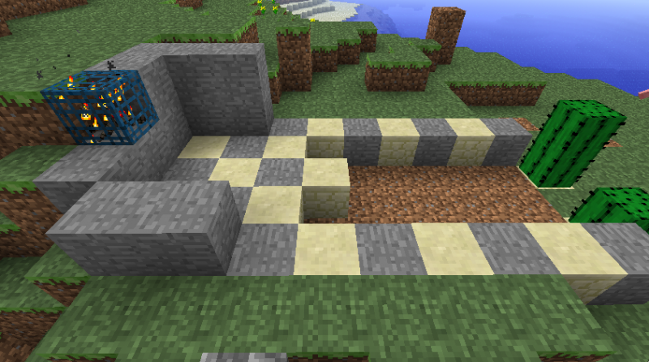
Establishing the Right to Mod: Questions of perspective
Does facilitating “true” INTERACTIVITY set Mods apart from other (one-way) art?
Does it make a difference in law that mods/games are a tool of other/further creativity?
Who owns SHARED CREATIVITY?
Is modding a “Right to CREATe” (expression/speech) or a “Creator’s Right” (part of/defense to: copyright)?
Are Users Rights a “Right of Creation” or “Right to CREATe”?
M
I
N
E
C
R
A
F
T

Slide 12
“Right to CREATe” v. “Rights of Creation”
Right to CREATe is a persons (inalienable) right to Create. Think Freedom of Speech/Expression. PERSONAL RIGHT (not a product right)
“Creators Right” is a right which in fact attaches to content – not a right to create but a “benefit” post facto creation. Think IP/copyright – attaches to the product, not the person (alienable by contract).
Which is to be preferred?
Double Standards Test suggests perhaps “Right to Mod/ CREATe”: See “Freedom for Users, Not for Software” by Benjamin Mako Hillhttp://mako.cc/writing/hill-freedom_for_users.html
& “Bob Dylan: People Claiming I Plagiarized Them Are...”http://www.techdirt.com/articles/20120923/23005020495/bob-dylan-people-claiming-i-plagiarized-them-are-pussies.shtml

Slide 13

Personal Core of the Creative
“We don’t create a fantasy world to escape reality, we create it to be able to stay. I believe we have always done this, used images to stand and understand what otherwise would be intolerable.” Lynda Barry in “What It Is”
“The Creative Act requires not only freedom but also this assumption of freedom. If the creative artist worries if he will still be free tomorrow, then he will not be free today.” Salman Rushdie “On Censorship”http://www.newyorker.com/online/blogs/books/2012/05/on-censorship-salman-rushdie.html

Slide 14
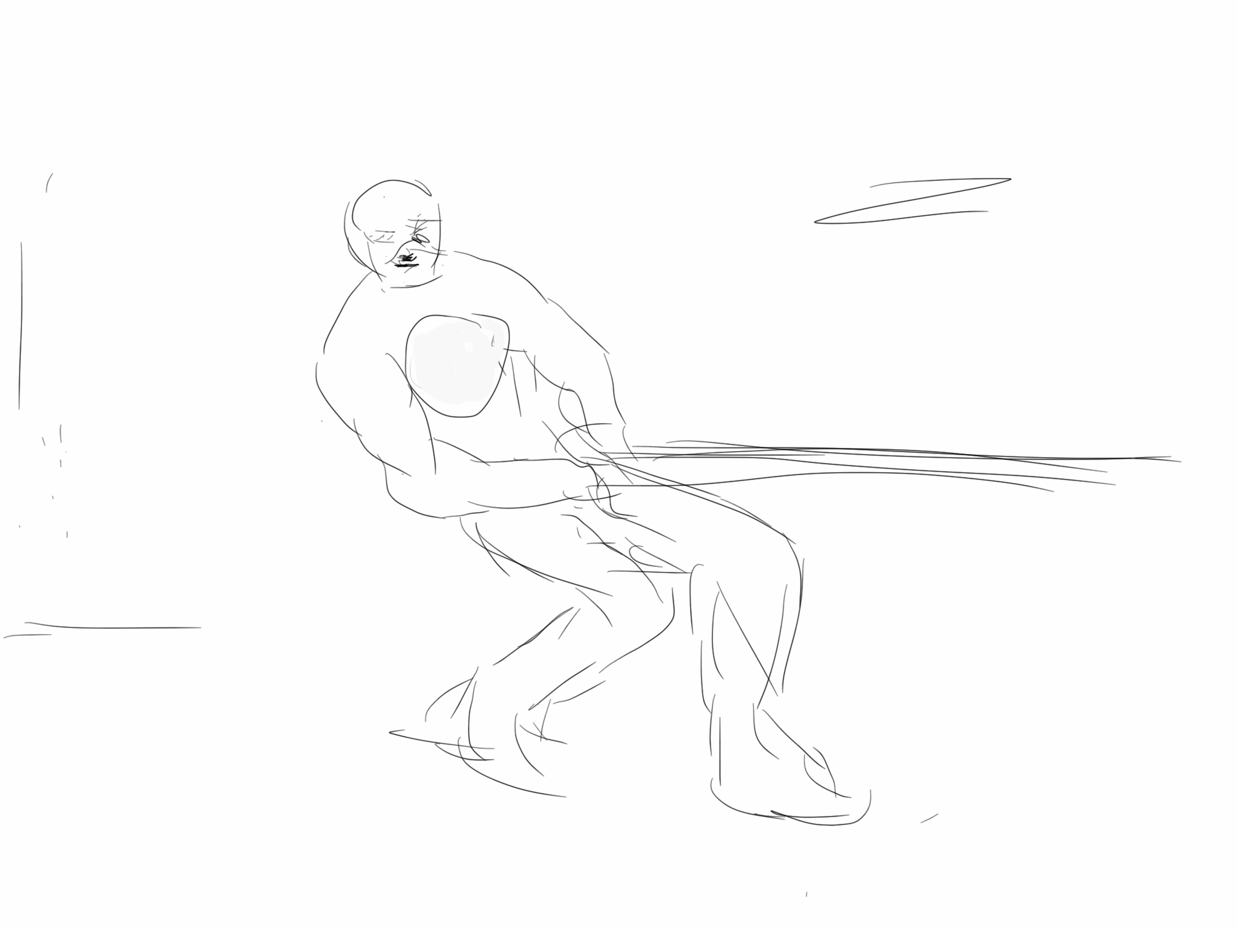
My (personal) moment…
Kreyo”….…sworn enemy of “The Trolls”…..

Slide 15
“Intellectual Property” Paradoxes?
“Intellectual” + “Property”: Misnomer, contradiction, odd, oxymoronic?
Printing press invented circa 1440; term “intellectual property arose in 1860’s.
Word “Intellectual” undermined by legal requirements of fixation/“actual-ness”?
Word “Property” somewhat undermined by statutory limitations of impermanence: Property which expires?
Word “Property” undermined by statutory statements of “larger purpose.” Whose property is it if ultimately it belongs to us all in order to serve “progress”?
Is copyright “property” or “right”? Copyright Act: “property” appears in ways unrelated to a “built in” right. Appears several times in true ownership context in Trade-marks Act and Patent Act.

Slide 16
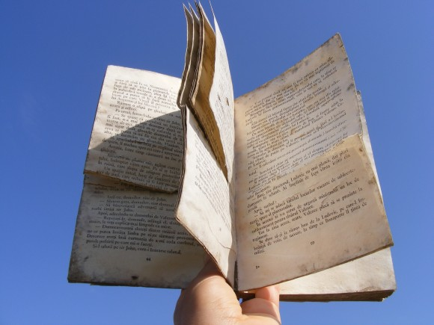
More reasons Copyright are not “Property”
Infinite slice-ability & dice-ability of IP makes it much less property like
Higher Purpose = To increase the knowledge of mankind:
* Statute of Anne, 1710: “An Act for the Encouragement of Learning”
* U.S. Constitution (Article 1, Section 8, Clause 8) – “To promote the Progress of Science and useful Arts, by securing for limited Times to Authors and Inventors the exclusive Right to their respective Writings and Discoveries;”

Slide 17
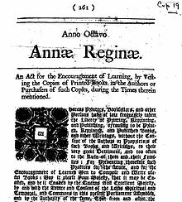
Did Copyright Grow Out of Free Speech?
The British Statute of Anne 1710: "An Act for the Encouragement of Learning, by Vesting the Copies of Printed Books in the Authors or Purchasers of Copies, during the Times therein mentioned".
First statute to provide for copyright regulated by the government and courts, rather than by private parties.

Slide 18
From King to Parliament
Star Chamber (UK) abolished July 1641 - de facto cessation of censorship.
Not freedom of speech and of the press; replacement of Royal censorship machinery with Parliaments.
Licensing Order of 1643: Parliament required authors to have a license approved by the government before their work could be published (pre-publication ban).
Areopagitica: A speech of Mr. John Milton for the Liberty of Unlicensed Printing to the Parliament of England; 1644.

Slide 19
From Regulator To Industry Self-Regulation
“The Licensing of the Press Act 1662”; "An Act for preventing the frequent Abuses in printing seditious treasonable and unlicensed Bookes and Pamphlets and for regulating of Printing and Printing Presses."
Restrictions enforced by the Stationers' Company, a guild of printers given the exclusive power to print—and the responsibility to censor—literary works.

Slide 20
And…Finally to the Creator
Then The Statute of Anne 1710 moved control to the publishers/authors….and there we more or less have stayed until now.
TRAJECTORY OF LIBERALIZATION & FREEDOM: Vesting power over media in the authors was a HUGE STEP towards the democratization of media/data. Not bad for 1710.
Arguably not a lot of consequence has happened since?
Note: Not much new to be created from a book in 1710? Little or no new creativity out of old creativity? Only unauthorized printing of the same work distributed at a lower cost…

Slide 21
Can Copyright be understood as part of the democratization of thought?
Is it not strange that Copyright constrains Speech?
Perhaps a Right to Mod/CREATe is the legitimate child of both Free Speech & Copyright Laws
Meaning that perhaps our understanding of copyright should prioritize the creative freedoms associated with content creation & use over the private ownership aspects.
= Right to Mod/CREATe?

Slide 22
SCC User Rights: Confirmation?
SCC Pentalogy (August 2013) - Confirmed: 1. User Rights as exception to Fair Dealing & 2.Technological Neutrality
Are User Rights as the next unfinished step in the devolution of control of the Right to CREATe ……
From King…to Parliament…to Government Regulator…to Industry Self Regulation…to Author…to User.
Or do we (effectively) stop @ 1710?

Slide 23
Are we evading the real question?
SHOULD NOT User Rights/Right to CREATe-Mod really be a creative/expressive right rather than an IP right/protection?
Part of Freedoms of Thought/Conscience?
Part of Free Expression (criticism & review/news reporting)
An expanded “public interest” based Fair Dealing/Fair Use?
NOT NOW..NOT YET*
*But if you are looking for the mechanics of how…see defamation/free expression precedent of Grant v. Torstar Corp. (2009 SCC) “responsible communication defense”

Slide 24
The Final Thread: Moral Rights?
Berne Convention for the Protection of Literary and Artistic Works (1886):
“(1) Independently of the author's economic rights, and even after the transfer of the said rights, the author shall have the right to claim authorship of the work and to object to any distortion, mutilation or other modification of, or other derogatory action in relation to, the said work, which would be prejudicial to his honor or reputation.”
Right of Authorship (= right to demand or deny Credit)
Right of Integrity (= right to prevent unwanted distortions)
Authorship & Integrity acknowledge collaborative nature of creativity: I.E. INTERACTIVITY
Can be waived, not assigned: I.E. PERSONAL
Snow v. The Eaton Centre (1982 Ont. H.C.J.)

Slide 25
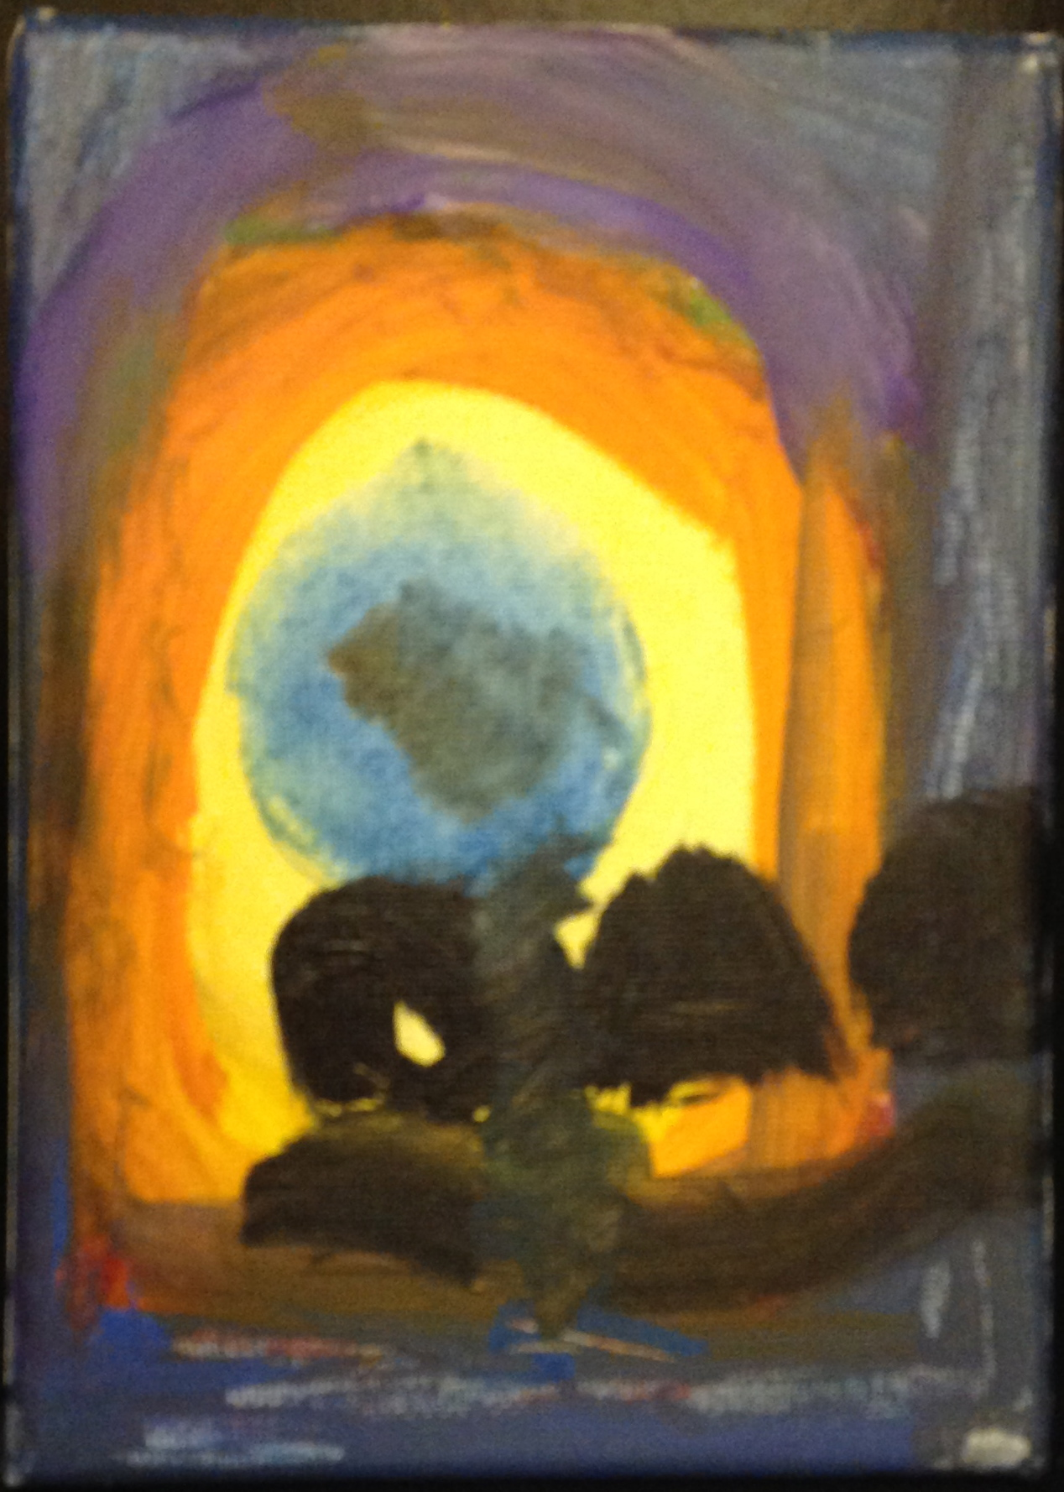
So…Think About…..
Using (strengthening) MORAL RIGHTS in concert with strong User Rights/Right to CREATe/Right to Mod
And Right to Remix, Right to Machinima, Right of Fan Fiction etc.
* Art by Avrel Festinger (Age 11)

Slide 26
Next Class
We now done Part A (meme # 1): “Creating”
Entering into (drumroll please…)
Part B (meme#2) of the course:
>>>>>>>>>>>>>>>“CONNECTING”>>>>>>>>>>>>>>>>>
Talk: Creators, Consumers & Users
(sub-nom: intro to contractual conundrums)

Slide 27
Our Academic Partners

