Slide 1
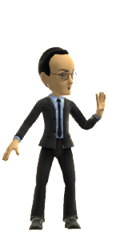
Adventures in Improvisation:
Law 450 – The Accidental MOOC
Open Courses. Open Pedagogies
2013 CTLT Institute
May 27,2013
Jon Festinger Q.C.
Centre for Digital Media
Festinger Law & Strategy LLP
@gamebizlaw
http://blogs.ubc.ca/videogamelaw/
jon_festinger@thecdm.ca

Slide 2
Law 450 Video Game Law
* Tech-y students (aren’t they all?)
*Snobbish Academic Concept: All intellectual property, freedom of expression, contract, privacy social and equality issues in digital media (including social media) originated in video games and are best explored through the lens of games, as games constitute the most cutting edge proving ground for legal and ethical exploration of these issues.
*Minecraft Based Pedagogic Concept: Teacher/aka game designer’s job is to:
Map and design the territories to be explored by the student/gamer;
Provide as many tools as possible for that exploration;
Be present to feedback/interact/prompt/respond/encourage
* No marks for student contributions (last semester).

Slide 3
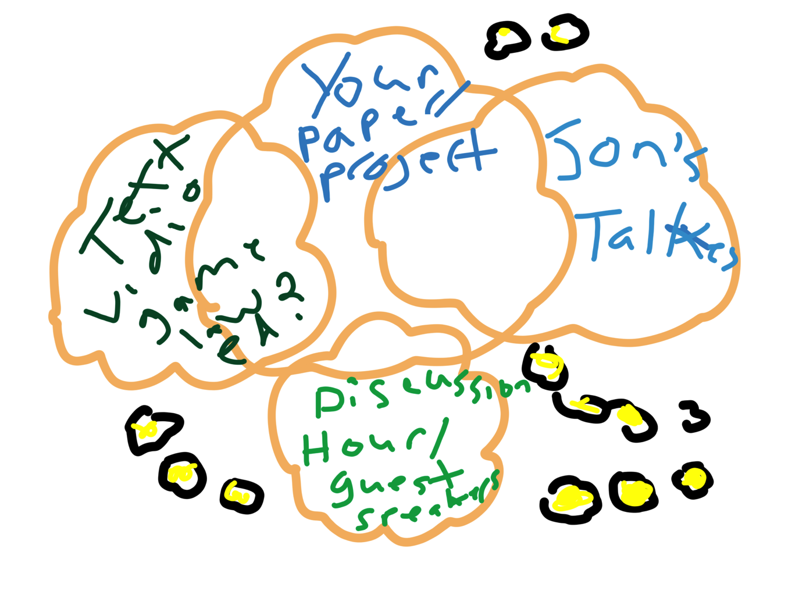
Well actually….the original concept…

Slide 4
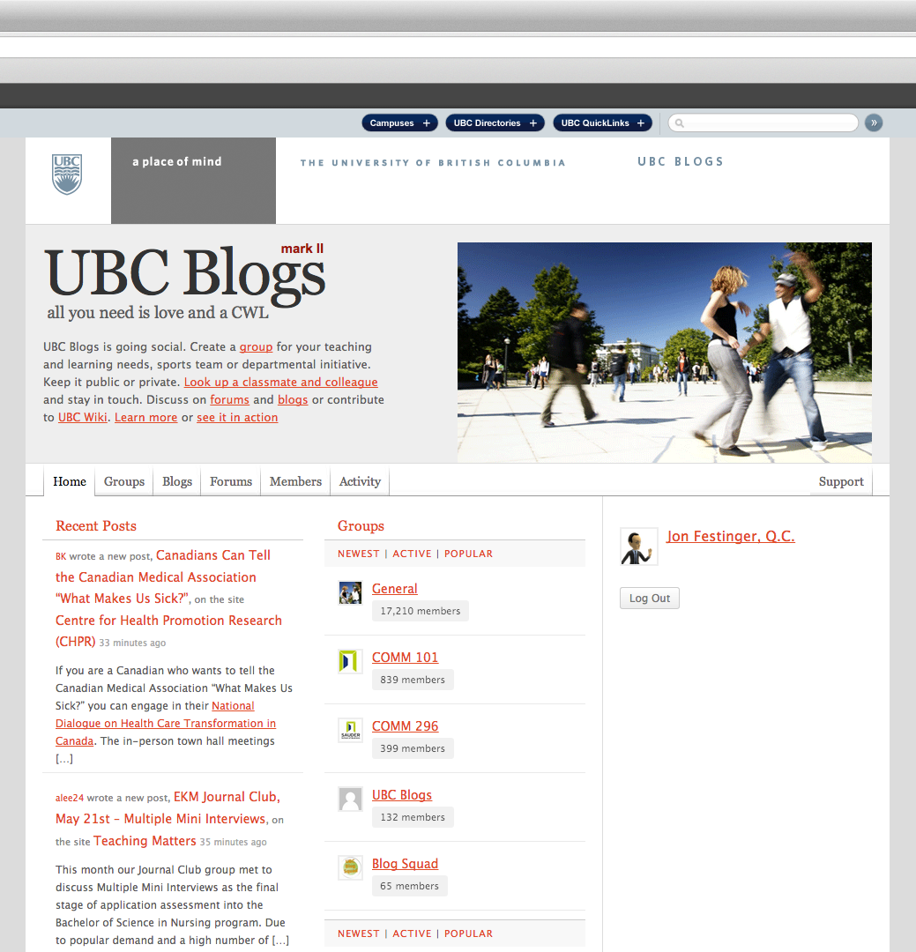
The UBC Blog
Brilliant
Easy to learn
Installed my own plug-ins
(made me a believer)
Open-source

Slide 5
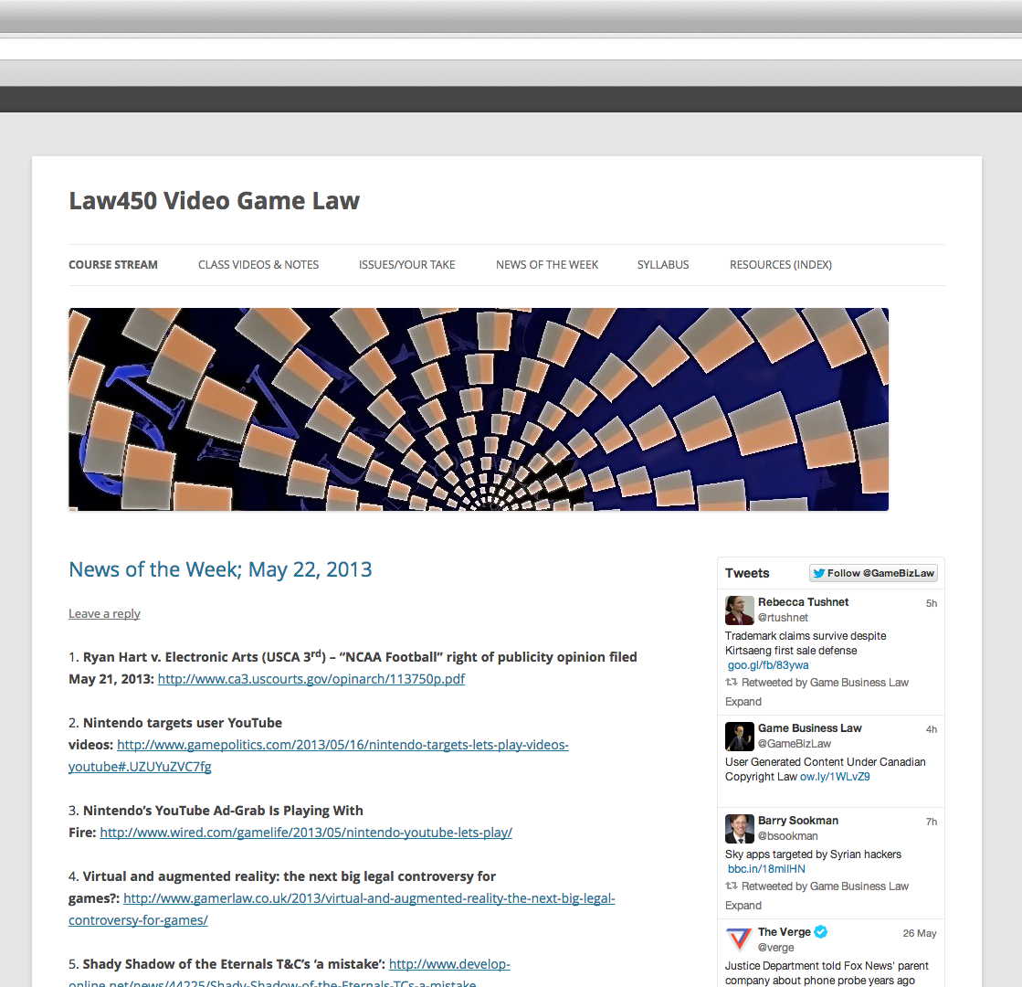
http://blogs.ubc.ca/videogamelaw/
Course Stream/Main Page

Slide 6
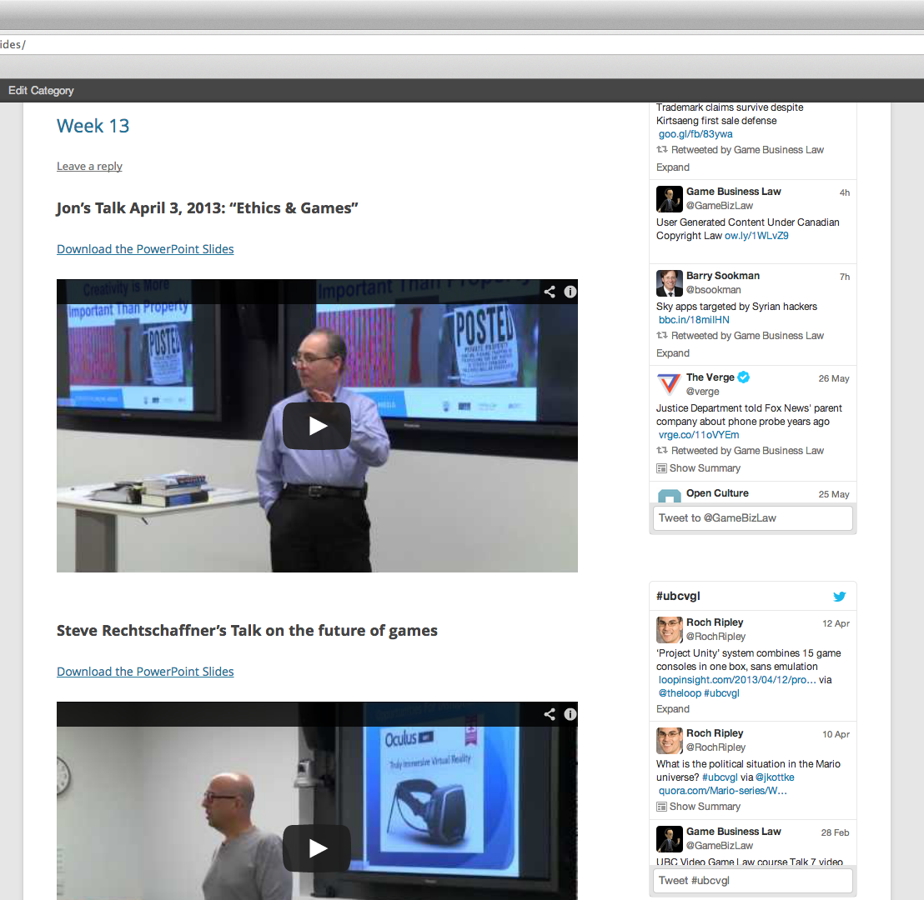
Class Videos & Notes

Slide 7
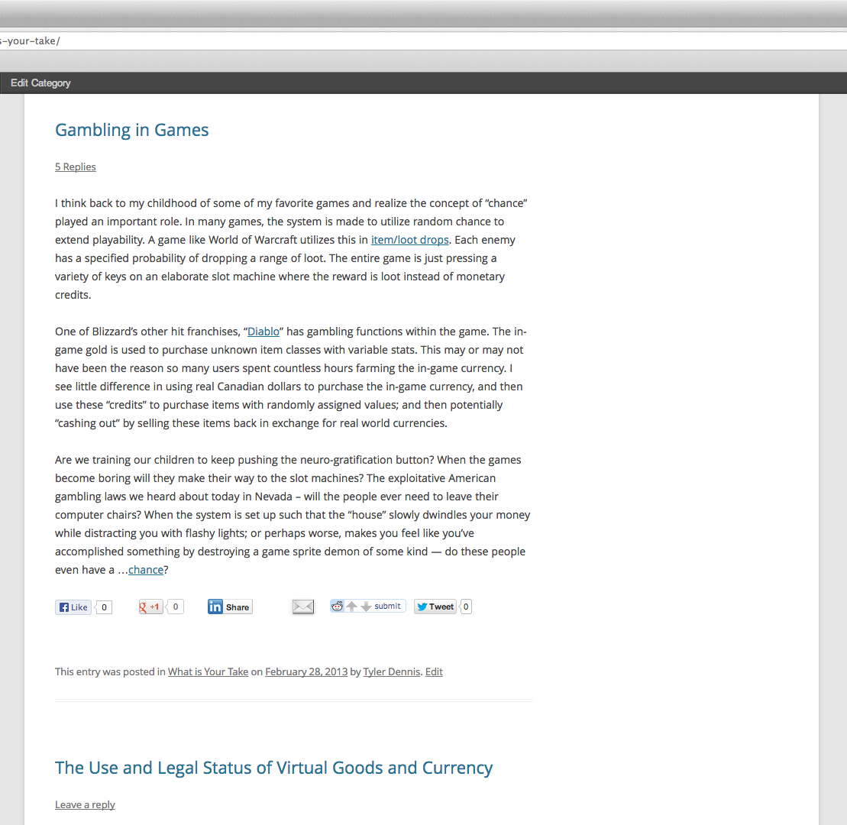
Issues/Your Take

Slide 8
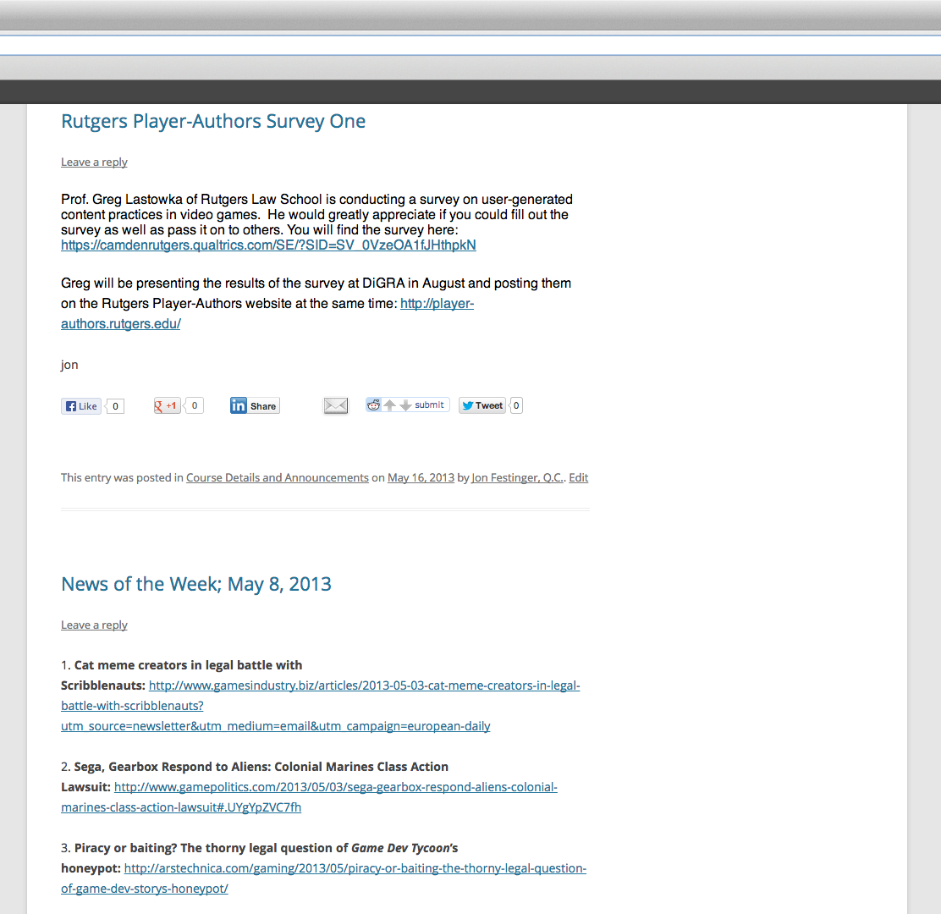
News of the Week

Slide 9
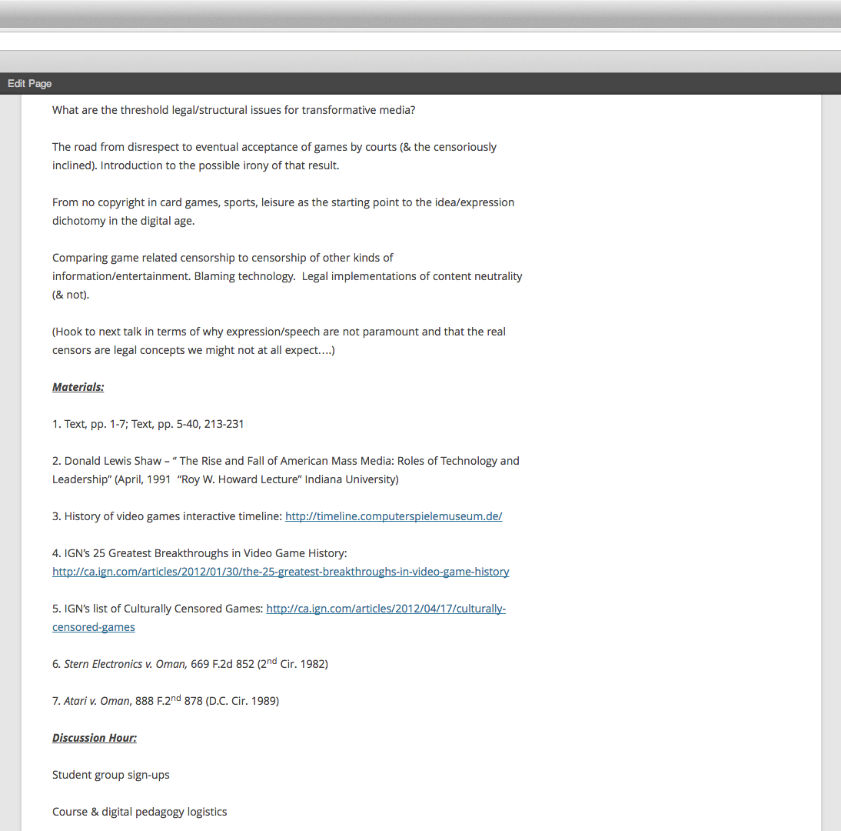
Syllabus (living)

Slide 10
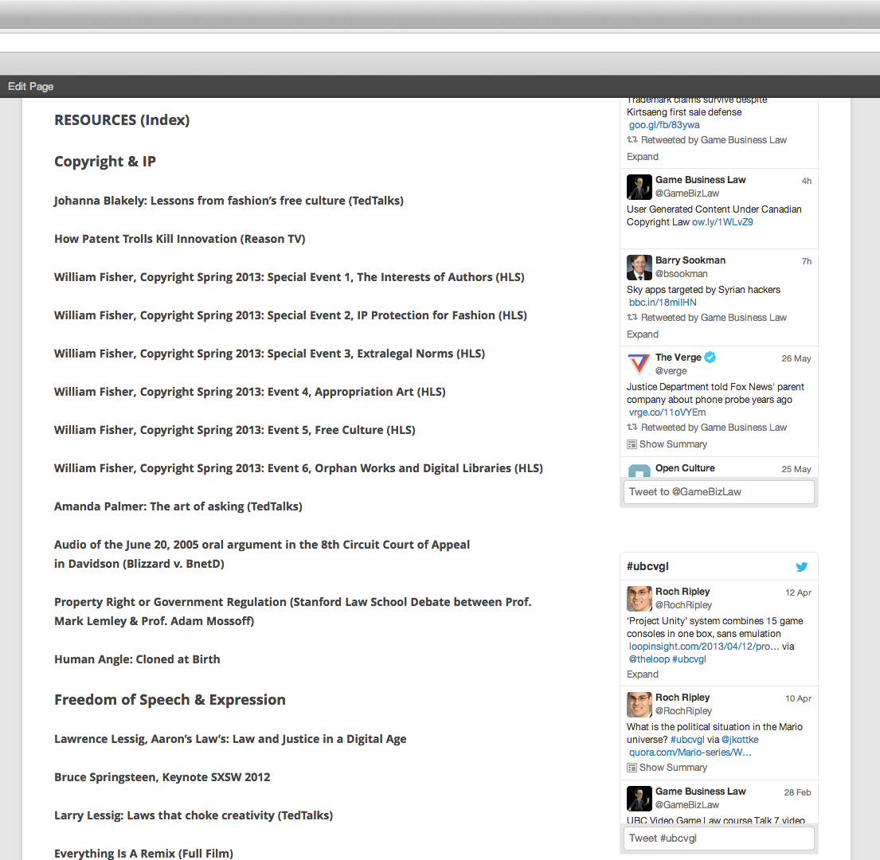
Resources Index
(including cases materials for reg’d students)

Slide 11
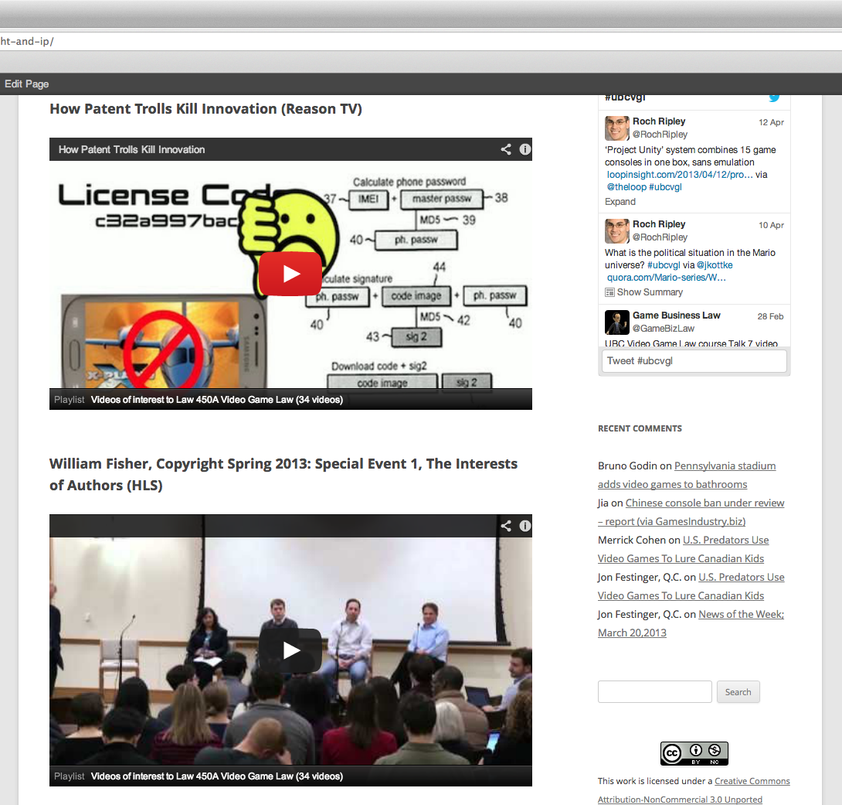
Sample Resources Page

Slide 12
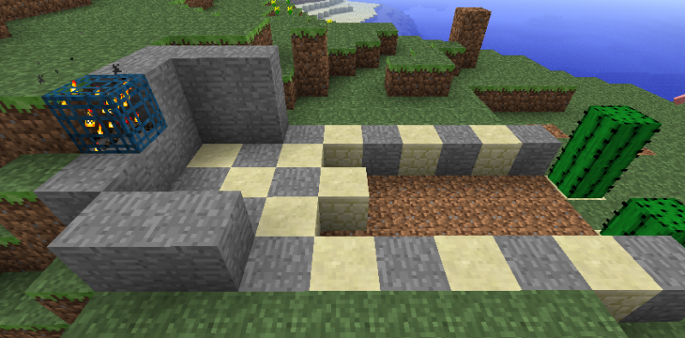
With Apologies to Inc.
“7 Surprising Secrets of Extreme Open Course-ability”
* “How to Live Without Irony” - Christy Wampole,
New York Times (Nov. 17, 2012)
http://opinionator.blogs.nytimes.com/2012/11/17/how-to-live-without-irony/

Slide 13


1. Don’t be Afraid
Oh really?
I cheated.

Slide 14
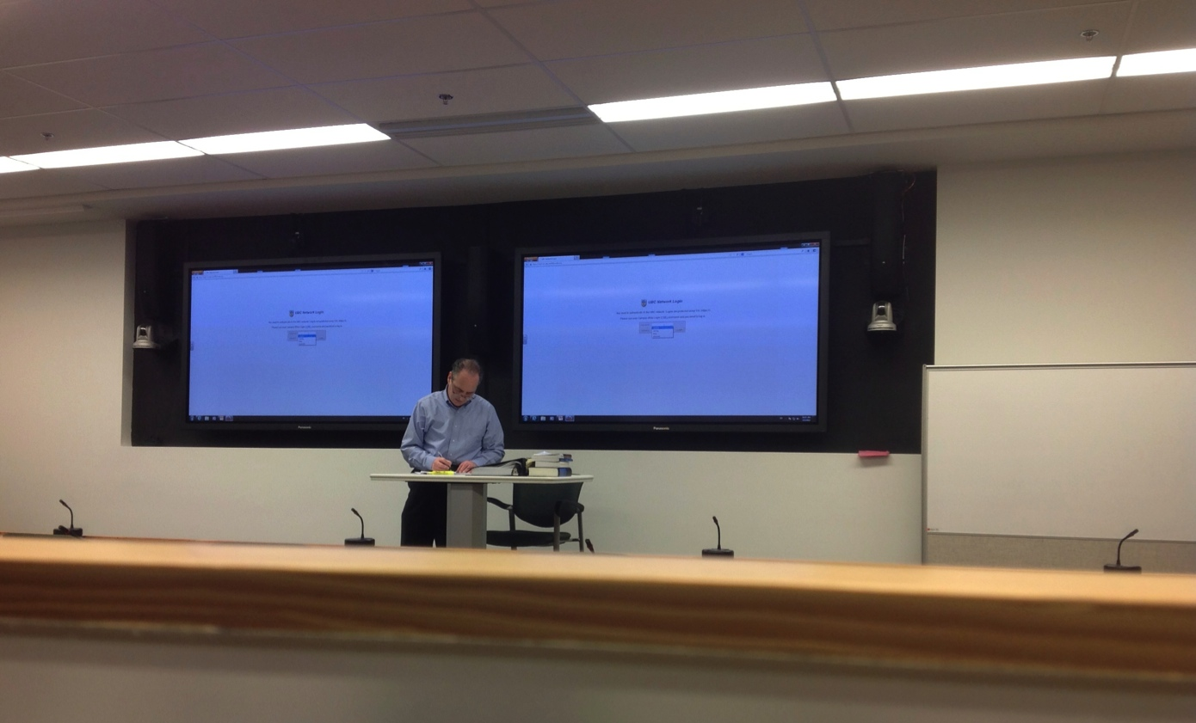
2. OMG – This Better be Good
Raises your teaching game.
You know the answer – prep:
Best papers ever…BUT what does that really say?

Slide 15

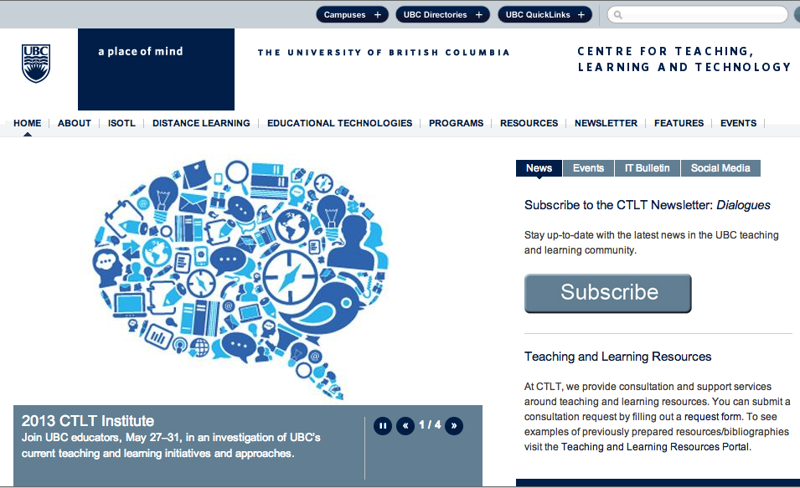
3. Find a Yogi
Novak Rogic
Vancouver, British Columbia, Canada (Vancouver, Canada Area) Higher Education

Slide 16

4. The Path is Not the Path…
Original notion: iTunes U
Novak’s question: “A website?”
Surprises: Amazing blog entries; Postings about guests arising as natural norms; Student to student dialogue on course subject matter
Novak’s current question: “A Wiki?”
My questions:
Live Twitter like feed (in class);
Student interaction/collaboration layer ( embedded tools to identify class mates on-line & video conference & collaborate)
Is student to student learning & teaching the most important thing to long term academic proficiency, commitment and learning rather then top down e.g. Call of Duty

Slide 17

5. Tinker, Tailor…
…BUT DON’T SOLDIER OR SPY…
+ Tinker = “Agile” -adjust as you learn
+ Tailor = Customize to your audience
- Soldier = Conscription/forced participation in digital (leave options)
- Spy = Privacy (respect it)

Slide 18

6. Appreciate the hidden themes
Mine:
1. Interconnectedness of course subjects & course tools
(freedom of expression & copyright; open v. closed, user generated content…)
2. Watching how I teach impact what I teach
(worth the price of admission)…

Slide 19
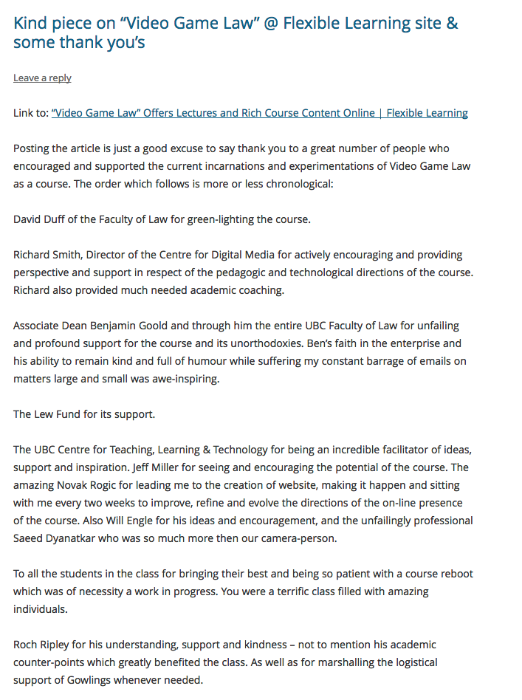
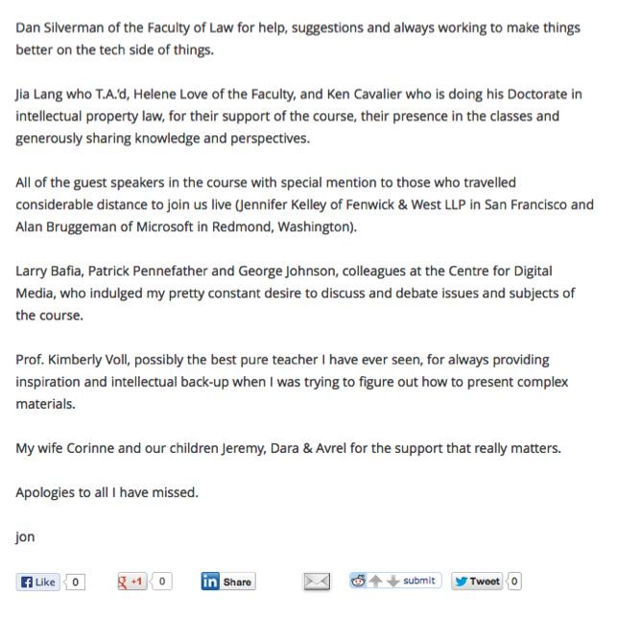
7. Just Appreciate
You never do it alone…

Slide 20

Finis
“I have learned much from my teachers, more from my peers, but from my students most of all” (Ta'anit 7a)
THANK YOU…

Slide 21
Our Academic Partners

