Slide 1
Video Games
Today & Tomorrow
Steven Rechtschaffner

Slide 2
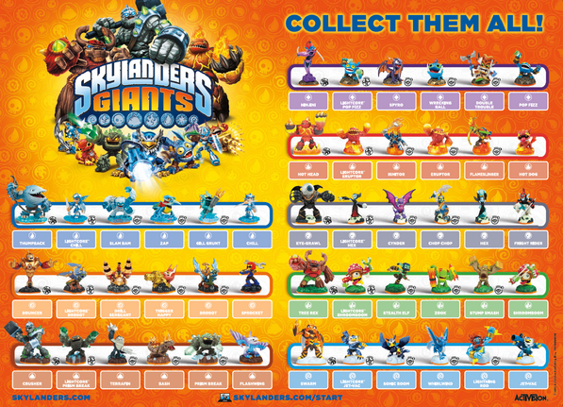
Today
More people are playing video games than ever before
Mobile gaming continues to grow
Current Gen console gaming is stagnant
Next Gen console value not yet established
Consoles are becoming entertainment portals

Slide 3
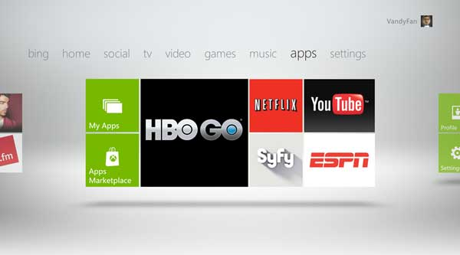
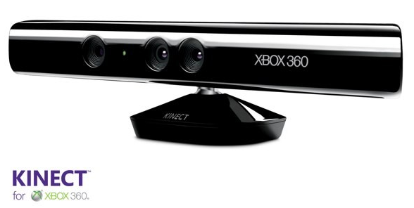
Today
Recent Console Disruptions:

Slide 4
Industry Pillars
Games
Platforms
Distribution Models
Business Models
Experience Models

Slide 5
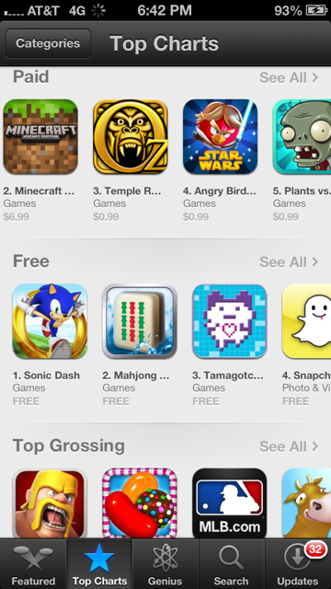
Mobile
Platforms
IOS
Android
Windows 8/Blackberry
Distribution
App Stores
Business Models
Paid
Free to Play
Micro transaction
Advertising supported
Gated or Premium

Slide 6
Current Trends
Netflix
iPad consumption & second screen
Smartphones
YouTube
Free to Play (micro-transaction)
Everything everywhere (authentication)
Premium Cable Channels
KICKSTARTER

Slide 7
The Future?

Slide 8
The Future
New Games
New Platforms
New Distribution Models
New Business Models
New Experience Models

Slide 9
The Future?
What’s the Netflix of Gaming?
Games everywhere?
Episodic Games?
FTP/MT on consoles?
Connected Digital Events?
Is there a YouTube of Games?
New devices?

Slide 10
Opportunities For Disruption?

Slide 11
Opportunities For Disruption?

Slide 12
Opportunities For Disruption?

Slide 13
Opportunities For Disruption?

Slide 14
Worth Remembering
Business models can migrate
Today’s big companies were once small companies
Trends tends to be cyclical
People want to feel connected
New platforms create new opportunities
Old platforms create new opportunities
Lower bars to entry create more innovation

