Slide 1
Convergence, Complexity and Luddites: The Interactive Digital Media World
Law Society of Upper Canada conference – April 2011
(some photos revised June 2013)

Slide 2
Re-Introduction
Lightening Strikes – a metaphor?
A view after wandering in the wilderness:
-VTV- Whatever may have made me a good lawyer made me a bad leader;
-Video-games-where the talent went;
-Sports-living in a non-fragmented world;
- canucks.com – integrating broadcast & web

Slide 3
It’s not about convergence; it’s about the new monsters in town.

Slide 4
Environmental Changes
Mobile data services are growing rapidly – easily surpassing previous ways to access internet content
Data traffic growing at CAGR of over 130%
By 2013, expect that video will constitute more than 60% of mobile traffic
Significant shift to “On Demand” – household usage of time shifted TV grew 33% in the U.S. from the 4th Q of 2007 to the 4th Q of 2008
Netflix has 25 million subs and a market cap of $12B

Slide 5
Context for OTT discussion
What is OTT? Access to video content provided to consumers over the internet or air...and lots of companies are participating, including Fox, NBC, ABC, Sony, Comcast, Walmart, Apple, Netflix, Hulu, HBO, YouTube, MLB.TV, Google, Vudu, xfinity, XBOX 360, FLO TV
Did you know...Hulu gets 1 billion visits per month? and serves 6-700M ads every month?
Netflix has 17M subscribers, is worth $9B and generates 20% of all evening Internet traffic in the US?
Wal-Mart, Sony, Microsoft, Apple, Google are all in the race to benefit from online video?

Slide 6
Social is a Killer App: Consumers are online & being social
Integration of CONTENT & CONTACT;
40% of media consumption is “new media”
30% of time online is using social networks
My first time: GPL shifts the paradigm;
Headline: “Long Distance Teenage Male Friendship Now Possible”
Why does it work?: content + contact = shared context = Meaning
Studies show happiness is about being with others

Slide 7
The Elements and Attributes of Digital Media.

Slide 8
Bits (digital media) are easily copied.
Copyright was a social contract that gave creators protection for a fixed time if they published the work.
Now replication and publication are simple.
And every copy is as good as the first.
Notes:
Increasingly the device used to “use” the work
can also reproduce it and even be a “factory” of copying.
By the way for the gardeners in the audience this is a “Bloom Mallow”, buttercup-like flower.
The photo was taken on the south wall of the Grand Canyon.

Slide 9
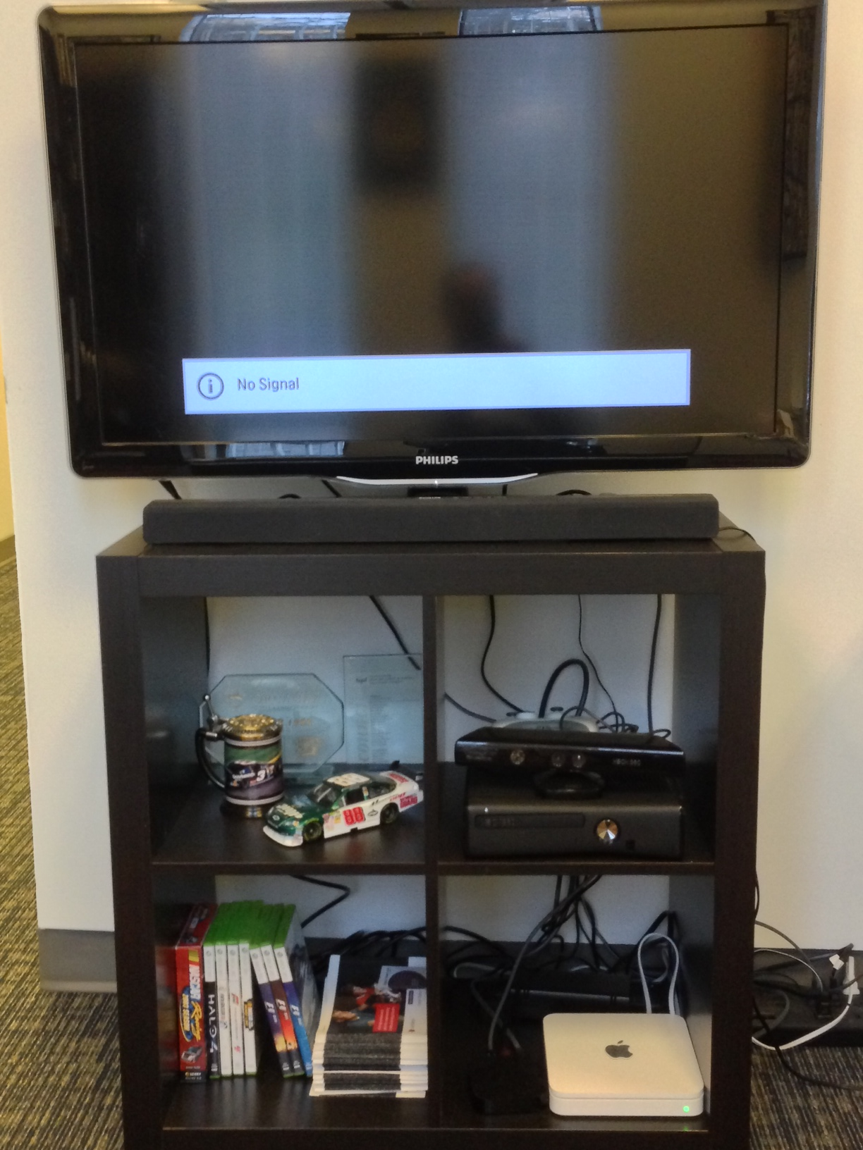
Ease of Transmission and Multiple Use
Ease of transmission means the end of scarcity.
Borderless: the end of distance.
What is a territory?
What is cultural protection?
Notes:
That phone call you receive at the dinner hour probably comes from a hemisphere away.
You can turn on the TV and watch a live street scene across the world.
What does this do to cultural protections?
What about job protections?

Slide 10
Plasticity of Digital Media
The ease with which you can manipulate, adapt, correct, re-align or re-interpret a work is often a liability to their owners (not always though).
The term “derivative work” has become more important.
In Video-Games: The vexing question of “mods”.
Notes:
All digital media are relatively “plastic” – they can be mixed, remixed, ‘mashed’, and
changed in some manner. The process is easy compared to the analog world.
(One prize bag for correct answers)
Indeed all “art” can be said to be derived in the broadest sense from
preceding works as artists build and learn

Slide 11
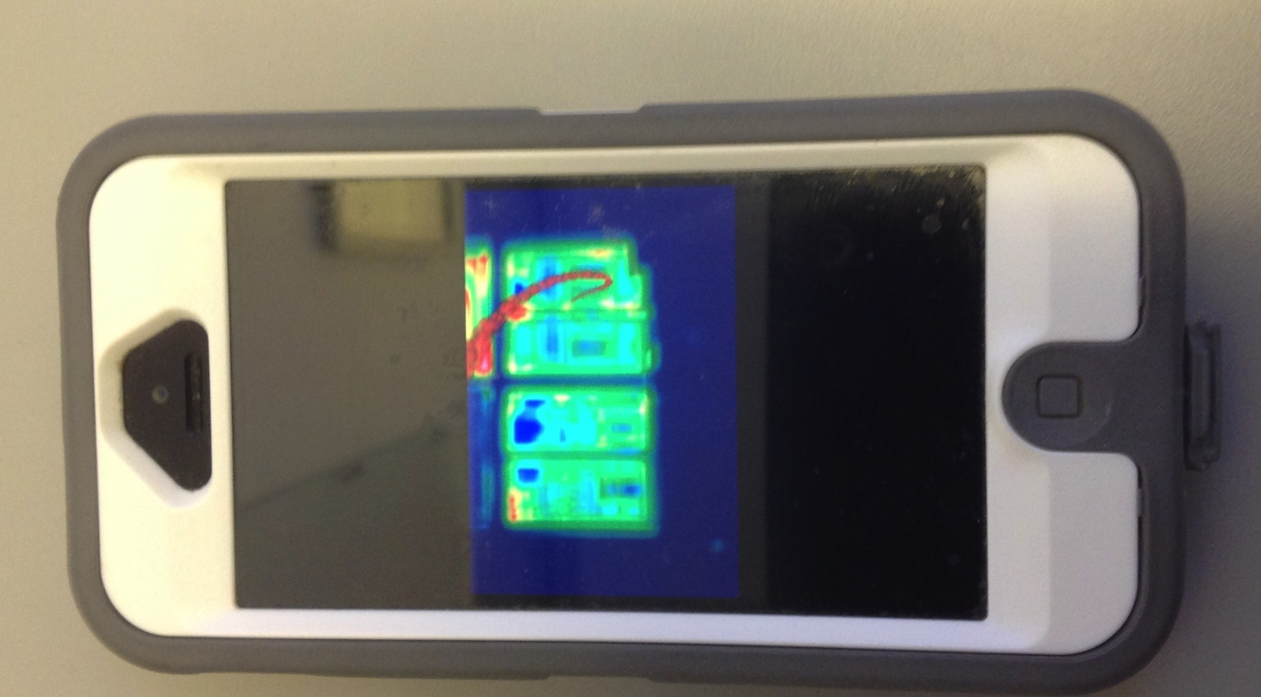
Compactness of Works in Digital Media
Digital works don’t occupy much space and space is cheap.
You can store big databases in ways unimaginable in the past.
You can keep everything.
Notes:
Storage of digital content is easy.
That shelf of tapes and disks you have at home becomes a drive the sixe of your thumb.
Everything can be stored and retrieved.
Did you know that every Google search that you have ever done is remembered
and that it is easy for anyone to retrieve them?
What are the legal implications of all of this?
What are the cultural and social impacts on society when something
you said on Facebook can be retrieved 50 years later?

Slide 12
Equivalence of Works in Digital Media
Historically works have generally protected and regulated by the nature of the work:
Books, photographs, musical works.
But when they are all just digital bits – databases with software – what protocols should guide how they are consumed?
Contrast Apple’s “walled garden” and the Ultraviolet Consortium who led by Microsoft aim to let consumers buy once, playback everywhere, always
How do we adapt the law?
Notes:
Analog works are protected by copyright law in distinctive ways
according to their form or how they came into being:
Literary works – life of the author plus 50 years.
Photographs – the commissioner or the owner of the film.
Records – the owner of the master recording.
How do we differentiate the protection of bits and why?

Slide 13
TV Value Chains: What’s Happened
From relative simplicity 35 years ago to mind-numbing complexity today
Where there once was conventional TV, Cable, Movie Theatres, Content Producers, Advertisers and Consumers
Now add Consumer Generated Content, Home Video, Specialty Channels, Pay TV, PPV, VOD, Web applications, Internet streaming, Internet storage, Set-top Boxes, Satellite Distribution, IPTV and File-sharing
Add on to this radical evolutions in the Marketing world
Equals Massive Complexity where Regulated and Unregulated media vie for consumers, audiences, mindshare, media-buys and anything/everything else

Slide 14
The Question Coming Back
In this new Mobile, On Demand, OTT, Socially Networked world of Digital Media which is easily copied, easily transmitted without scarcity or borders, simple to manipulate, incredibly compact, & which can be created by almost anyone…
…….WHAT DO WE NEED TO DO FOR MADE IN CANADA CONTENT TO SURVIVE & THRIVE?

Slide 15
A Brief Interlude: Looking Back at the Evolution of Content/Carriage Regimes
1. Printing Press – paternalistic – see Milton’s Areopagitica
2. Radio – nationalistic – Prime Minister R.B. Bennett 1932; “…this country must be assured of complete Canadian control of broadcasting from Canadian sources. Without such control, broadcasting can never be the agency by which national consciousness may be fostered and sustained and national unity still further strengthened….”
3. Television – “culturalistic” (sic) – Caplan/Sauvageau Task Force Report 1986
4. Cable – “industrialistic” (sic) IHAC, 1995

Slide 16
The Obvious Answer?
A NEW POLICY FILTER FOR THE NEW WORLD OF DIGITAL:
DO ONLY WHAT WILL RESULT IN THE MOST COMPELLING CANADIAN CREATIVE CONTENT.
TWO ANALYTICAL STEPS:
1. What impediments to Canadian creativity must be removed?
2. What measures must be taken to encourage the most compelling Canadian creative product?

Slide 17
Some Suggestions
ONE: Embrace the merits of fostering a Canadian-owned but globally competitive industry.
TWO: Increase the probability of success of the Canadian media industry by encouraging the creation of larger and stronger enterprises.
THREE: Develop a Canadian industrial strategy that supports the creation of high quality Canadian content from all Canadian producers including producers that are affiliated to Canadian broadcasters.
FOUR: Recognize that private media enterprise success is what will lead to a stronger cultural system, not the current system of progressive fees, conditions and tariffs.
FIVE: Allow Canadians to experiment.
SIX: Recognize that our small market requires that government continue its support of research and development in intellectual property.

Slide 18
The Obvious
It always come back to supporting the creation of CONTENT; particularly in the world of digital media:
A: “What’s Daddy doing?”
M: “He’s playing with his technology.”
A: “It may be tech-knowledge-y but it’s not knowledge”.
YOU have the knowledge – to figure this out – to make a difference.

