Slide 1
IP2 Tools of Intellect: Textbooks
From Tradition to Innovation
ETEC565B: METatheory
Yi Lu
2022.09

Slide 2
MCLUHAN’S TETRAD (McLuhan & McLuhan, 1988) on TEXTBOOK
Enhancement
Enhances accuracy, accessibility, flexibility and ease of education beyond time and space through written texts.
Obsolescence
Makes its predecessors obsolete: storytellers, traditional ancient bards who could sing Homer’s Epics, The Iliad and The Odyssey;
Since knowledge and stories are no longer needed to be memorized by brains.
.
Retrieval
Retrieves the transmission and documentation of historical knowledge and stories.
Reversal
Flips from convienet education to its digital and interactive successors: e-textbooks, podcasts, video lectures, audiobooks, forum, ....
.
Notes:
When, where, how and by whom has textbook been used as a learning tool?
The history of textbooks for educational purposes dates back to ancient civilizations. Before the invention of some earlist written language, such as the Greek alphabet (2,500 years ago), the Chinese characters (6000 years ago) and Sumerian Symbols (5000-6000 years ago), knowledge and stories were recited aloud, much like Homer's epic poems (Textbook, 2022). Early textbooks were used by tutors, teachers and parents, as well as by individuals who taught themselves.

Slide 3
What define us and the world?
-at the age of globalization
Culture and Value?
Geography and Nature？
1
2
3
4
Ethnicity and Nationality?
Or, ALL influcing factors! both human and non-human actors.
Notes:
After the 1990s, the impact of globalization and the increasing inter-regional social mobility have seriously called into question the "geographical" boundaries of a specific human or non-human belonging. The study of a common time, a single place, and a single society, once the hallmark of scientific research, has become increasingly rare, and the notion of a society or nation sharing a common culture has been completely destroyed. In such a theoretical dilemma, Bruno Latour's (1988) "actor-network theory," a theory derived from the study of scientific practice, becomes a powerful meta-tool for defining and studying tools, organizations, phenomena, or behaviors.

Slide 4
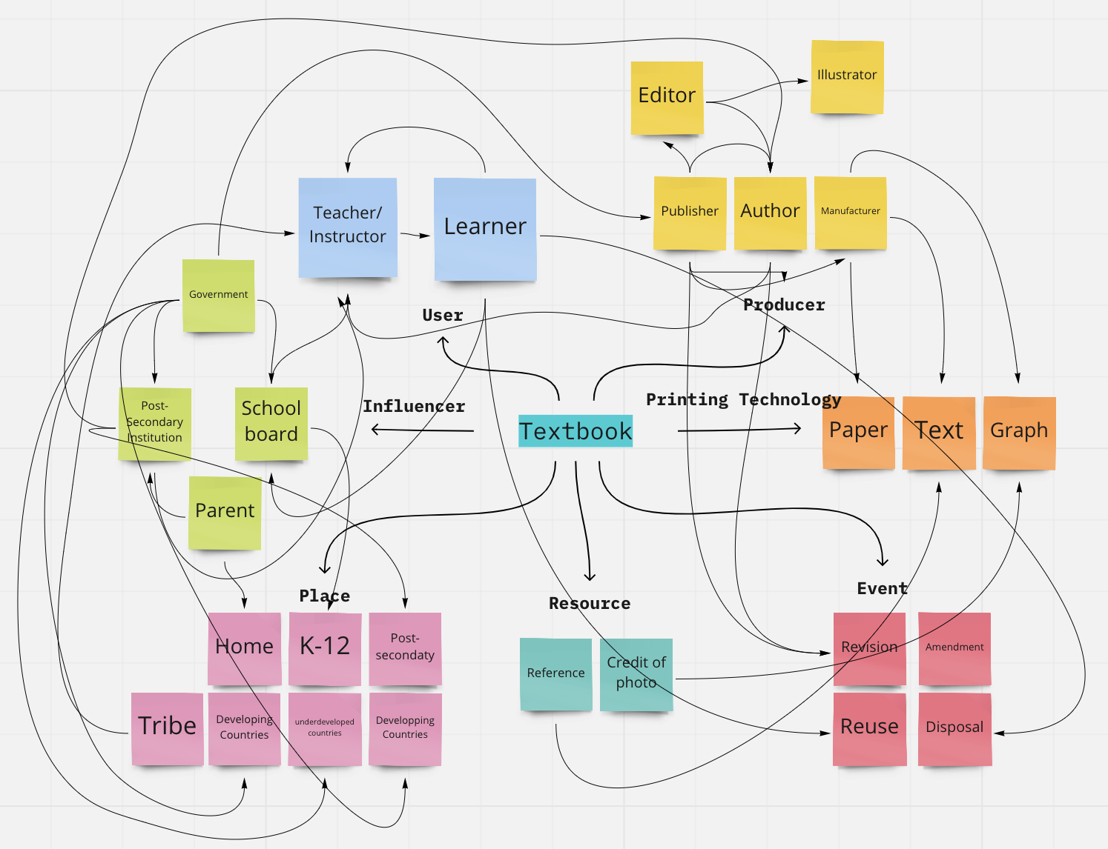
Actor-Network Theory (ANT)
by Latour (1992)
A possible
actor-network
for the Textbook
Notes:
In Latour’s terms, there are innumberable human and non-human actors in relate to a single subject. and their relationships to that subject constantly changes. I list some actors that interactively influce my chosen educational techonology - the textbook, and categrize them into 7 major types: users, producers, influcers, printing techonologies, resources, places, and events. As you can see, among these closely-related participants. there are only 2 types of human actors, while the rest of 5 actor types are all non-humans.

Slide 5
Applying ANT to describle textbooks
The delivery of knowledge has been delegated from teachers to textbooks, with ease of learning despite time and space. In turn, textbooks enable learners to retrieve accurate information at their pace, such as previewing, reviewing, proactive and extended learning. From a constructive perspective, textbook as an educational technology, changes the role of teachers to facilitators of learning rather than instructors, storytellers or ancient bards.

Slide 6
Latour’s “Parliament of Things” (1993)
Latour argues that objects themselves are judges; objects themselves engage in reflexive judgement, in the weaving of morphisms.
objects vs. things
matters of fact vs. matters of concern

Slide 7
References
Hirschman, D. (2013). The Sociology of the Door-Closer Redux. A Sociologit’s Commonplace Book. https://asociologist.com/2013/08/30/the-sociology-of-the-door-closer-redux/
Johnson, J. (1988). Mixing Humans and Nonhumans Together: The Sociology of the Door Closer. Social Problems.
Latour, B. (1992). 'Where are the missing masses? The sociology of a few mundane artifacts', in Bijker, W. E. and Law, J. (eds) Shaping Technology/Building Society: Studies in Sociotechnical Change, Cambridge, MA, MIT Press, pp. 225-58.
Latour, B. (1993). We Have Never Been Modern. Translated by Porter, Catherine. Harvard University Press. ISBN: 978-0-674-94839-6.
McLuhan, M., & McLuhan, E. (1988). Laws of the Media: The New Science. University of Toronto Press.
Textbook. (2022). Wikipedia. https://en.wikipedia.org/wiki/Textbook

Slide 8
THANKS

