Slide 1
Diabetes Mellitus and A1C Levels
THE CASE OF MS. KG
-
BELINDA YIP
APRIL 12, 2018
DHYG 310
-

Slide 2
THE CASE OF MS. KG
Diabetes Mellitus
  General Characteristics
  A1C Levels
  Oral Considerations
Client Case
  Assessment
  Diagnosis
  Planning
  Implementation
  Evaluation
Conclusion
References
DIABETES & A1C LEVELS

Slide 3
THE CASE OF MS. KG
Diabetes Mellitus
  General Characteristics
  A1C Levels
  Oral Considerations
Client Case
  Assessment
  Diagnosis
  Planning
  Implementation
  Evaluation
Conclusion
References
DIABETES & A1C LEVELS

Slide 4
THE CASE OF MS. KG
Diabetes Mellitus
  General Characteristics
  A1C Levels
  Oral Considerations
Client Case
  Assessment
  Diagnosis
  Planning
  Implementation
  Evaluation
Conclusion
References
DIABETES & A1C LEVELS

Slide 5
Diabetes – General Characteristics
A group of chronic metabolic diseases characterized by hyperglycemia and the inability to produce or utilize insulin, affects all ages
Four types (American Diabetes Association, 2011)
  Type 1: Immune mediated: islet cell or insulin antibodies identifies autoimmune process → beta cell destruction → absolute insulin deficiency
  Type 2: Insulin resistance – relative deficiency or secretory defect with resistance (genetic, aging, or environmental factors)
  Other specific types: Defects of beta cell function or insulin action, impaired or abnormalities of fasting glucose
  Gestational: Any abnormal glucose tolerance during pregnancy
(Little JW, Miller CS, Rhodus NL, 2018)
Notes:
Hyperglycemia – high blood glucose
Presence of islet cell or insulin antibodies → usually leads to absolute insulin deficiency
Other specific types: genetic defects of beta cell function or insulin action, diseases of exocrine pancreas, endocrinopathies, drug- or chemical-induced diabetes, infections, uncommon forms of immune mediated diabetes, other genetic syndromes, impaired or abnormal glucose tolerance

Slide 6
Diabetes – General Characteristics
A group of chronic metabolic diseases characterized by hyperglycemia and the inability to produce or utilize insulin, affects all ages
Four types (American Diabetes Association, 2011)
  Type 1: Immune mediated: islet cell or insulin antibodies identifies autoimmune process → beta cell destruction → absolute insulin deficiency
  Type 2: Insulin resistance – relative deficiency or secretory defect with resistance (genetic, aging, or environmental factors)
  Other specific types: Defects of beta cell function or insulin action, impaired or abnormalities of fasting glucose
  Gestational: Any abnormal glucose tolerance during pregnancy
(Little JW, Miller CS, Rhodus NL, 2018)
Notes:
Hyperglycemia – high blood glucose
Presence of islet cell or insulin antibodies → usually leads to absolute insulin deficiency
Other specific types: genetic defects of beta cell function or insulin action, diseases of exocrine pancreas, endocrinopathies, drug- or chemical-induced diabetes, infections, uncommon forms of immune mediated diabetes, other genetic syndromes, impaired or abnormal glucose tolerance
A positive family history confers a lifetime risk of 38% to the offspring if one parent is affected and 60% if both parents are affected. ⁵⁶ Identical twin concordance rates approach 100%
Together the genetic and environmental factors contribute to defects in insulin receptor function, insulin receptor signal transduction, insulin secretion, glucose transport and phosphorylation, glycogen synthesis, glucose oxidation that contribute to insulin resistance, and accelerated endogenous glucose production. Obesity and lack of physical activity are the primary environmental factors involved in the pathogenesis of type 2 diabetes.

Slide 7
Diabetes – Diagnosis
Criteria relies on plasma glucose level, at (WHO, 2010)
  Random sampling
  After fasting or
  After a 75 gram glucose test (oral glucose tolerance test)
Fasting plasma glucose (FPG) levels is the primary diagnostic criterion
  Impaired fasting glucose: 100 – 125 mg/dL
  Diabetes >126mg/dL (on two occasions)
(Little JW, Miller CS, Rhodus NL, 2018)
Notes:
levels of blood glucose are influenced by the source of blood (venous vs capillary), the age of the patient, the nature of the diet, the physical activity level of the patient, and the method used to measure the amount of sugar present in the blood sample. ³¹³² Abnormalities in diet (e.g., diet poor in carbohydrate for several days) can lead to misdiagnoses. To minimize this possibility, the diet should contain at least 250 to 300 g of carbohydrate on each of the 3 days before testing. Patients whose blood glucose level is going to be assessed should not participate in excessive physical activity because exercise tends to lower blood glucose levels.
FASTING – no caloric intake for 8 hours
OGTT – not recommended in clinical practice --- - WHYYYY?
The OGTT reflects how quickly glucose is cleared from the blood, taking into consideration the rate of absorption, uptake by tissues, and excretion in urine. ³¹³² Glucose load is usually given as Glucola, which contains 75 g of glucose in a 7–fl oz bottle. Venous blood samples are drawn from the arm just before and most often at 2 hours after ingestion of the glucose. Urine samples also are collected at each interval. The most characteristic alterations seen in diabetes are an increased fasting blood glucose (≥126 mg/100 mL), an increased peak value (≥200 mg/100 mL), and a delayed return to normal in the 2-hour sample. Hypoglycemia may develop in persons with early, mild diabetes 3 to 5 hours after ingestion of glucose. For this reason, some physicians extend the glucose tolerance test period to 5 hours for some patients. Urine samples should not contain glucose at any point during the test.

Slide 8
THE CASE OF MS. KG
Diabetes
  General Characteristics
  A1C Levels
  Current Research
Client Case
  Assessment
  Diagnosis
  Planning
  Implementation
  Evaluation
Conclusion
References
DIABETES & A1C LEVELS

Slide 9
A_{1C} Levels
Hemoglobin A is a non-enzymatic addition in glucose
Its’ glycosylation in red blood cells is a result of the formation of HbA_{1C}
Measurement is used to assess long-term level and control of hyperglycemia in diabetes patients
  A1C assay measures the amount of sugar attached to hemoglobin
  Measures over the 3 preceding months, lifespan of erythrocytes
  Should be measured twice a year for those with stable glycemic control and quarterly for those who are not
(Little JW, Miller CS, Rhodus NL, 2018)
Notes:
Define glycosylation
HbA1c = glycated hemoglobin
Presence of hyperglycemia elevates a1c levels
How is a1c assay carried out?

Slide 10
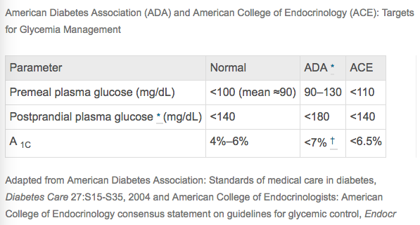
A_{1C} Levels
(Little JW, Miller CS, Rhodus NL, 2018)

Slide 11
THE CASE OF MS. KG
Diabetes
  General Characteristics
  A1C Levels
  Oral Considerations
Client Case
  Assessment
  Diagnosis
  Planning
  Implementation
  Evaluation
References
Conclusion
DIABETES & A1C LEVELS

Slide 12
Oral Considerations
Complications of poorly controlled DM include
  Xerostomia
  Infections (eg. Candidiasis)
  Poor wound healing
  Increased incidence and severity of caries
  Gingivitis & periodontitis
  Periapical abscesses
  Burning mouth symptoms
Importance to Dental Hygienists
  Many clients will have diabetes, early disease detection, affects oral health (bidirectional), provide safe care and medical management
(Little JW, Miller CS, Rhodus NL, 2018)
Notes:
Increased urine depletes extracellular fluids and reduce the secretion of saliva = dry mouth
Enhanced inflammatory responses, depressed wound healing and small blood vessel changes contribute to perio
Exact temporal relationship is unclear, but is a clear complication of DM1 and DM2, and cannot be explained by suprag plaque accumulations
Caries: poor glycemic control???
Due to delayed healing, they are more prone to oral infections after undergoing invasive procedures
Metformin assoc. w metallic taste
Diabetic neuropathy may lead to oral conditions of paresthesias and tingling, numbness, burning, pain or pathologic changes involving nerves in the oral region

Slide 13
Dental Management
Diabetes may be undiagnosed in 50% of clients presenting for dental treatment (Rhodus 2005)
Signs and Symptoms: polydipsia, polyuria, polyphagia, weight loss, weakness
  Headache, dry mouth, marked irritability, repeated skin infection, paresthesia, progressive periodontitis, multiple periodontal abscesses, loss of sensation
Ask questions (Medical History)
Take vital signs: abnormal pulse rate or elevated blood pressure should caution the clinician
(Little JW, Miller CS, Rhodus NL, 2018)
Notes:
Rhodus NL, Vibeto BM, and Hamamoto DT: Glycemic control in patients with diabetes mellitus upon admission to a dental clinic: considerations for dental management. Quintessence Int 2005; 36: pp. 474-482

Slide 14
THE CASE OF MS. KG
Diabetes
  General Characteristics
  A1C Levels
  Oral Considerations
Client Case
  Assessment
  Diagnosis
  Planning
  Implementation
  Evaluation
Conclusion
References
DIABETES & A1C LEVELS

Slide 15
THE CASE OF MS. KG
Diabetes
  General Characteristics
  A1C Levels
  Oral Considerations
Client Case
  Assessment
  Diagnosis
  Planning
  Implementation
  Evaluation
Conclusion
References
DIABETES & A1C LEVELS

Slide 16



Assessment - Basic
Ms. KG: New client
  60 year old female
  Lives alone
  Diet: Mediterranean
  Last dental visit: 5 years ago
    Previous DMD in Toronto
  Caries risk: High
  PI: 66%
  A1Cs: 5.6% (December/2017)
    Visits specialist twice a year
    Next appt: June/2018
  Family history of stroke
Notes:
Mediterranean diet: olive oil (healthy fats) instead of butter, lots of veggies, lean meats, lowers LDL and CV disease risk
https://www.mayoclinic.org/healthy-lifestyle/nutrition-and-healthy-eating/in-depth/mediterranean-diet/art-20047801

Slide 17
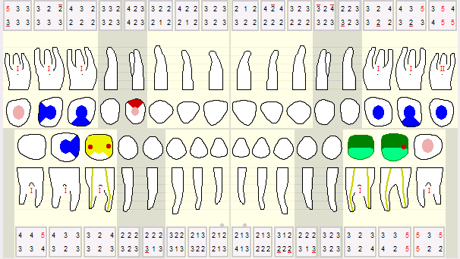
Assessment - Basic

Slide 18
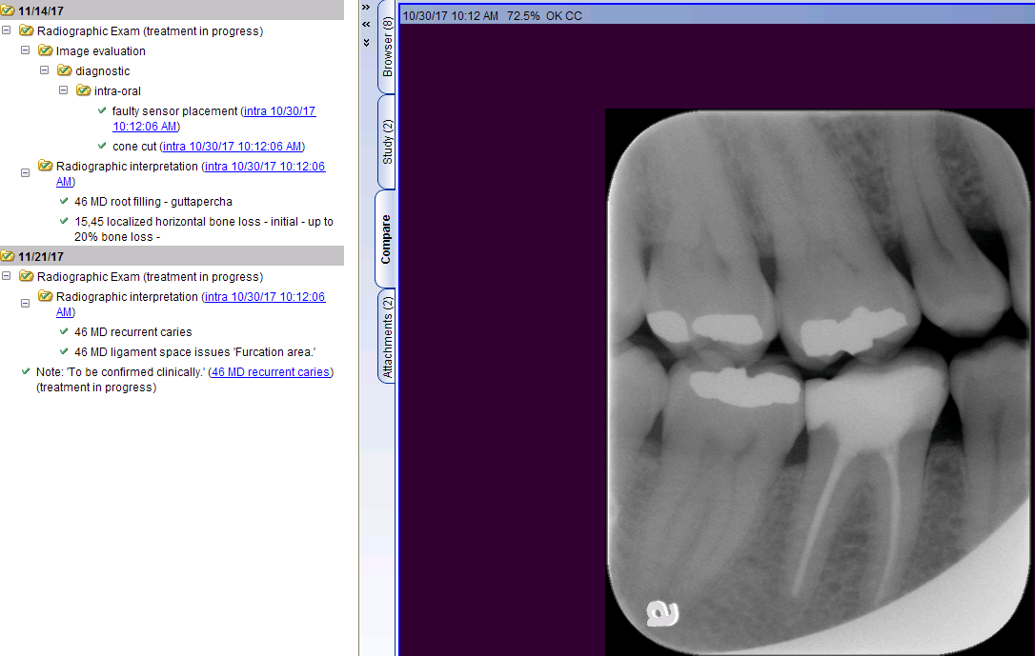
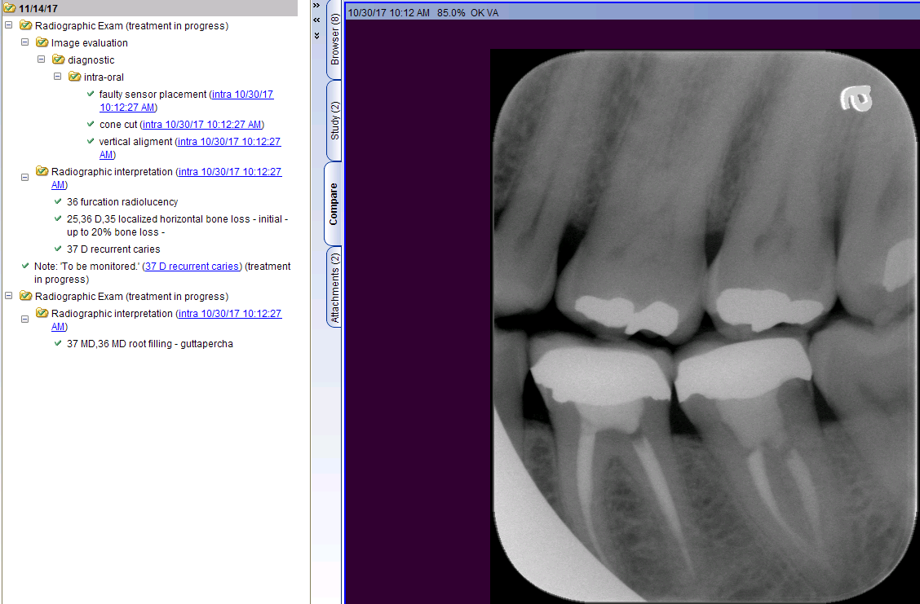
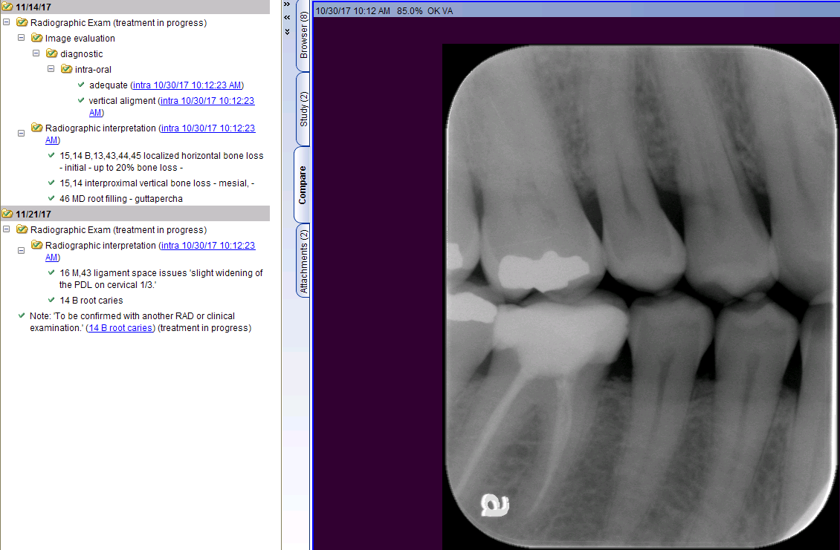
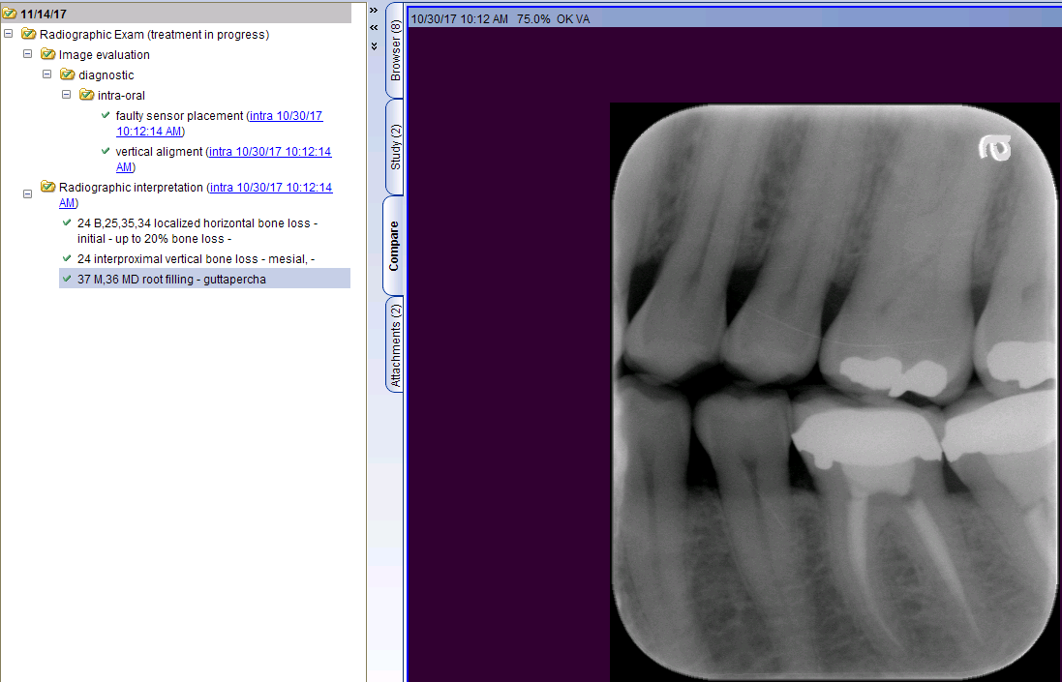
Assessment - Radiographic

Slide 19
Assessment - Radiographic

Slide 20
Assessment - Radiographic

Slide 21
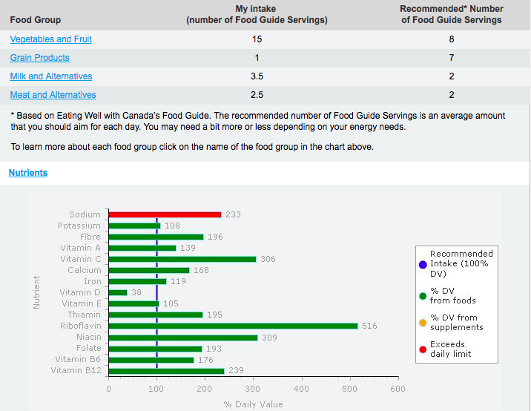
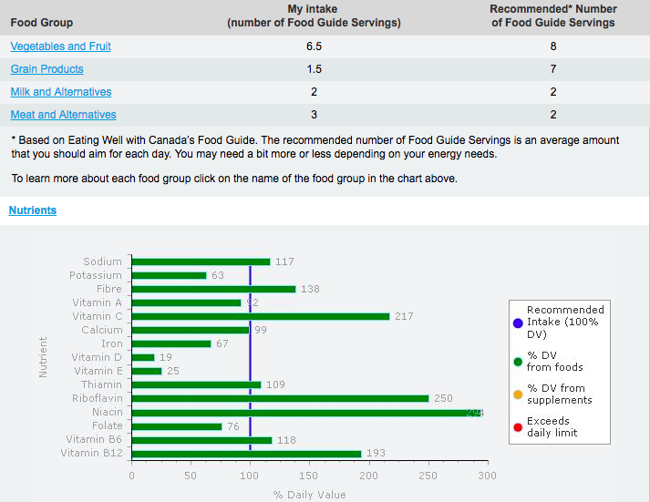
Assessment - Dietary

Slide 22
THE CASE OF MS. KG
Diabetes
  General Characteristics
  A1C Levels
  Oral Considerations
Client Case
  Assessment
  Diagnosis
  Planning
  Implementation
  Evaluation
Conclusion
References
DIABETES & A1C LEVELS

Slide 23
Diagnosis
“New client, female, 60, volunteers, is aware of dental conditions, no ins. Lives alone. Last dental visit: 2012. HH: type II diabetes, high BP/cholesterol and mental health issues (all stable). Current PSC: electric tb 2x/day fluoride tp (name questionable), waxed floss 1x/day, antibacterial life brand mouthwash no fluoride 1x/day. Deposits: gen slight plaque supra g & loc slight calc sub g molars. Caries: high due to presence of incipient caries, PI: 66%. AAP: gen plaque induced gingivitis w/ loc chronic perio on 18, 27, 28, 37, 38, 48. Prognosis: gen fair (pd, infrequent dental visits, incipient caries, furcations). Possible referral to DMD upon interpretation of RADs.”

Slide 24
Diagnosis
“New client, female, 60, volunteers, is aware of dental conditions, no ins. Lives alone. Last dental visit: 2012. HH: type II diabetes, high BP/cholesterol and mental health issues (all stable). Current PSC: electric tb 2x/day fluoride tp (name questionable), waxed floss 1x/day, antibacterial life brand mouthwash no fluoride 1x/day. Deposits: gen slight plaque supra g & loc slight calc sub g molars. Caries: high due to presence of incipient caries, PI: 66%. AAP: gen plaque induced gingivitis w/ loc chronic perio on 18, 27, 28, 37, 38, 48. Prognosis: gen fair (pd, infrequent dental visits, incipient caries, furcations). Possible referral to DMD upon interpretation of RADs.”
AAP: gen plaque induced diabetes mellitus- associated gingivitis w/ loc chronic perio on 18, 27, 28, 37, 38, 48.
Armitage, 1999

Slide 25
THE CASE OF MS. KG
Diabetes
  General Characteristics
  A1C Levels
  Oral Considerations
Client Case
  Assessment
  Diagnosis
  Planning
  Implementation
  Evaluation
Conclusion
References
DIABETES & A1C LEVELS

Slide 26
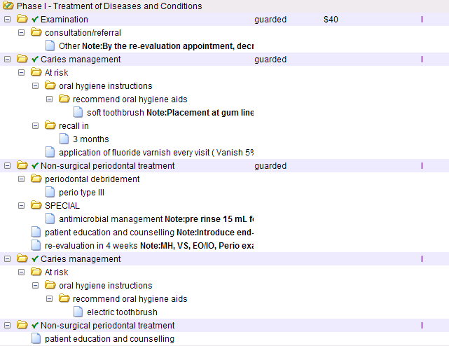
Planning

Slide 27
THE CASE OF MS. KG
Diabetes
  General Characteristics
  A1C Levels
  Current Research
Client Case
  Assessment
  Diagnosis
  Planning
  Implementation
  Evaluation
Conclusion
References
DIABETES & A1C LEVELS

Slide 28
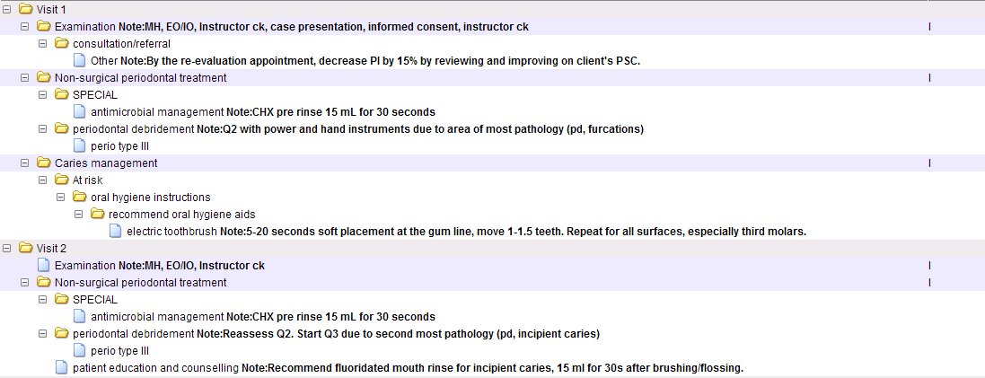
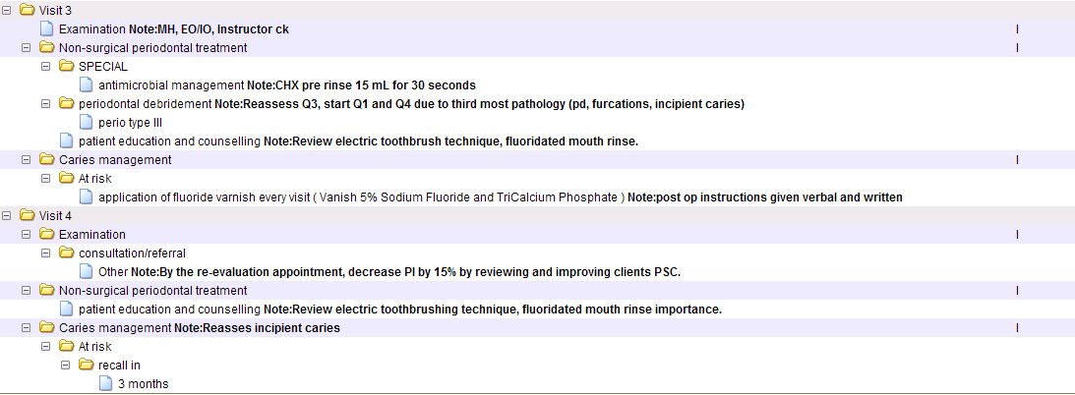
Implementation

Slide 29
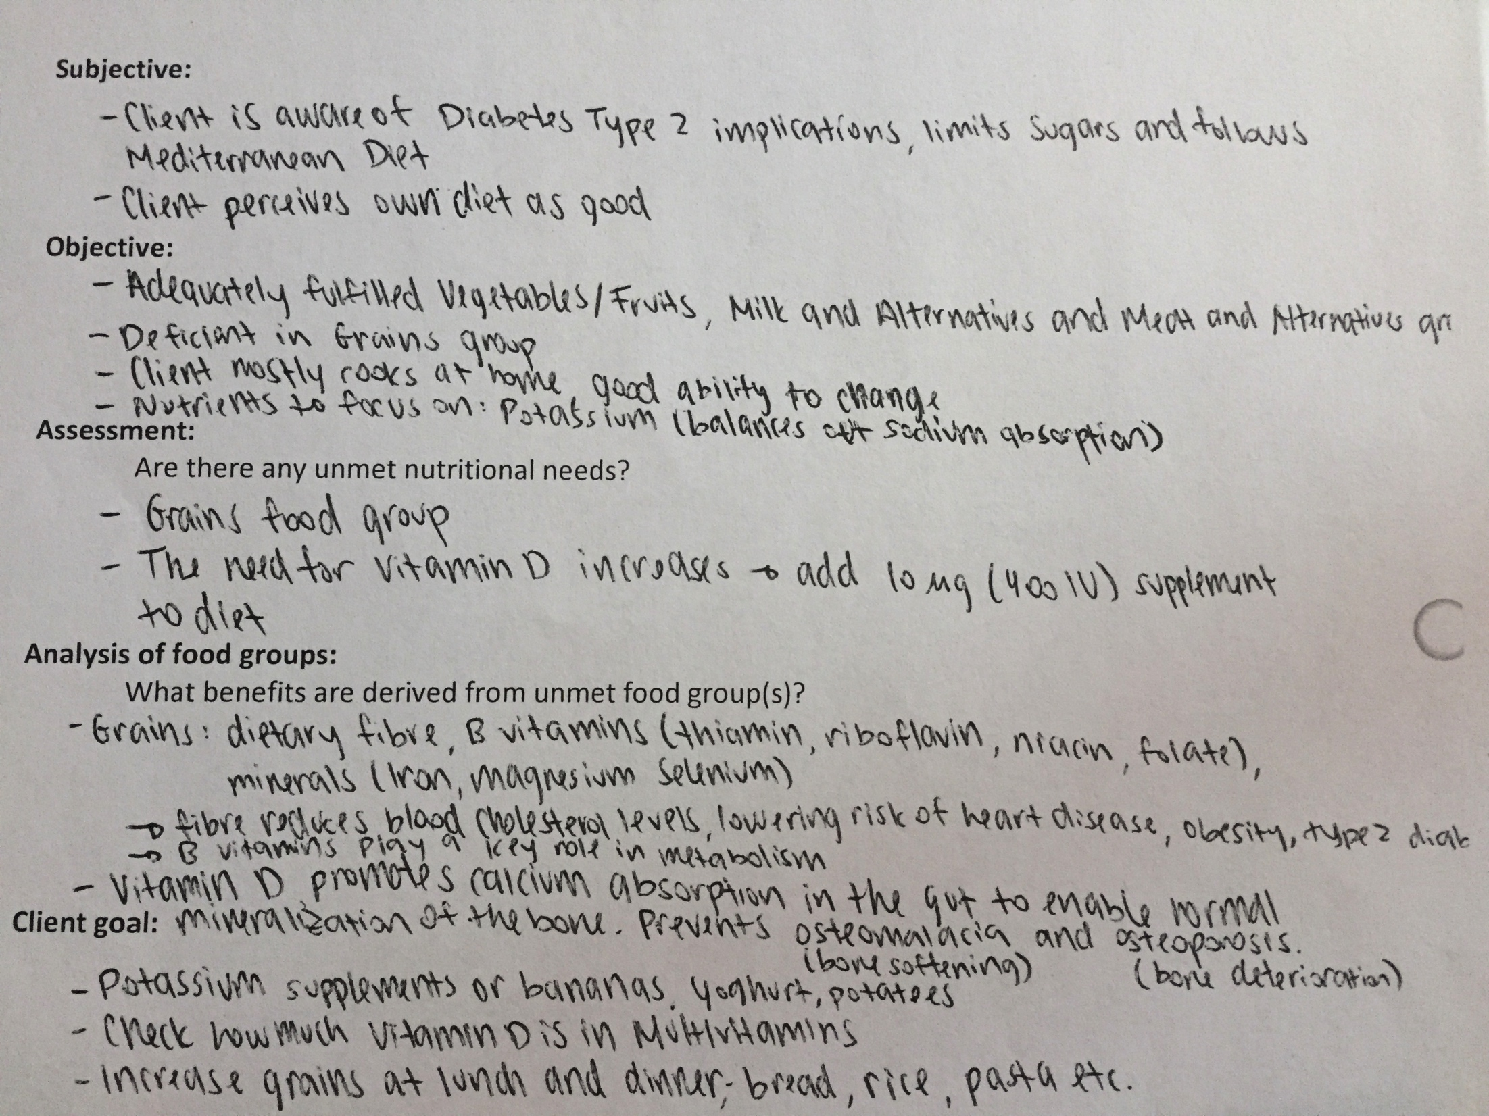
Implementation

Slide 30
THE CASE OF MS. KG
Diabetes
  General Characteristics
  A1c Levels
  Oral Considerations
Client Case
  Assessment
  Diagnosis
  Planning
  Implementation
  Evaluation
Conclusion
References
DIABETES & A1C LEVELS

Slide 31
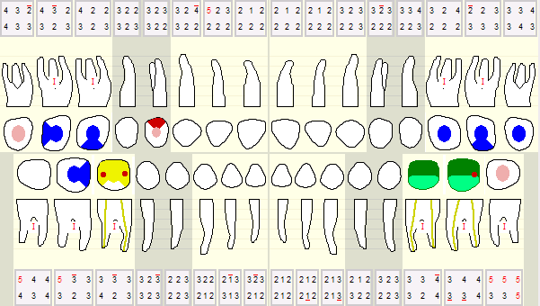
Evaluation

Slide 32
Evaluation

Slide 33
Evaluation
S: Treatment was good, thorough. Cleaned my teeth really well. Client felt that the cavitron pressure was a bit high, could be decreased next time. Overall, was very good. It was helpful to be taught about the fluoride, as the client thought that that was for teenagers. For the electric tb, client still tends to move her arm but tries to stay conscious and not move.
O: EO: WNL. IO: bilateral linea alba, slight coating on tongue. Trauma on left buccal tissue due to bruxism. Follow up on left buccal tissue- WNL. CCCT: C: gen red-pink, C: margins: gen rolled, papilla gen fills embrasure space, C: firm and resilient on the mand, spongy on the max, 12 and 13 papilla is bulbous. T: stippling present. PD: 5 mm at 12 (pseudo-pocket bulbous papilla), 38, 47, 48.
A: Gen improving. Gen reduction in perio pockets 1-2 mm. Prognosis is fair due to minimal attachment loss, class I furcations. Client is now rinsing with fluoridated mouthrinse and being mindful of not manually moving the electric tb, as this can further her abfraction. Dietary assessment completed, client is in action phase of TTM, will increase grain products and potassium intake. Client presents with gen plaque induced gingivitis w/loc chronic perio on 12 (suspected pseudo-pocket), 38, 47, 48. Incipiencies presented on 14, 18, 38.
P: RC 4 months. DMD check 14B next appt. Goal: 15% PI reduction to be assessed.
Notes:
Referral for 14, 37, 46.

Slide 34
THE CASE OF MS. KG
Diabetes
  General Characteristics
  A1C Levels
  Oral Considerations
Client Case
  Assessment
  Diagnosis
  Planning
  Implementation
  Evaluation
Conclusion
References
DIABETES & A1C LEVELS

Slide 35
Conclusion
Diabetes Mellitus is a group of metabolic diseases characterized by insulin insufficiency
  FPG levels are the primary diagnostic criterion
  A1C levels to be measured periodically to assess the disease status
    Describes the amount of formed HbA_{1C} in blood
    4-6% is normal, diabetes mellitus @ 7%
Client Ms. KG’s condition is stable due to consistent use of medications
  PSC Education: soft placement of tb at gumline
  Goal: PI reduction 15% (66% → 51%)
  Dietary: increase potassium and grain intake.

Slide 36
THE CASE OF MS. KG
Diabetes
  General Characteristics
  A1C Levels
  Oral Considerations
Client Case
  Assessment
  Diagnosis
  Planning
  Implementation
  Evaluation
Conclusion
References
DIABETES & A1C LEVELS

Slide 37
References
Little JW, Miller CS, Rhodus NL. Diabetes Mellitus. In: Little JW, Falace, editors. Little and Falace’s dental management of the medically compromised patient. St. Louis, Missouri: Elsevier; 2018.(14) p.230-54.
American Diabetes Association: Standards of care — Diabetes Care 34(suppl1): S11-S61, 2011.
World Health Organization. Executive summary: standards of medical care in diabetes —2010: current criteria for the diagnosis of diabetes, World Health Organization. Diabetes Care 33:S4S10, 2010.
American Diabetes Association: Diagnosis and classification of diabetes mellitus, Diabetes Care 34(suppl1): S62-69, 2011.
Rhodus NL, Vibeto BM, and Hamamoto DT: Glycemic control in patients with diabetes mellitus upon admission to a dental clinic: considerations for dental management. Quintessence Int 2005; 36: pp. 474-482.
Armitage G. Development of a Classification System for Periodontal Diseases and Conditions. Annals of Periodontology. 1999;4(1):1-6.

